Slide 1

Good Use of Data
Dr. James Goddin, Granta Design

Slide 2
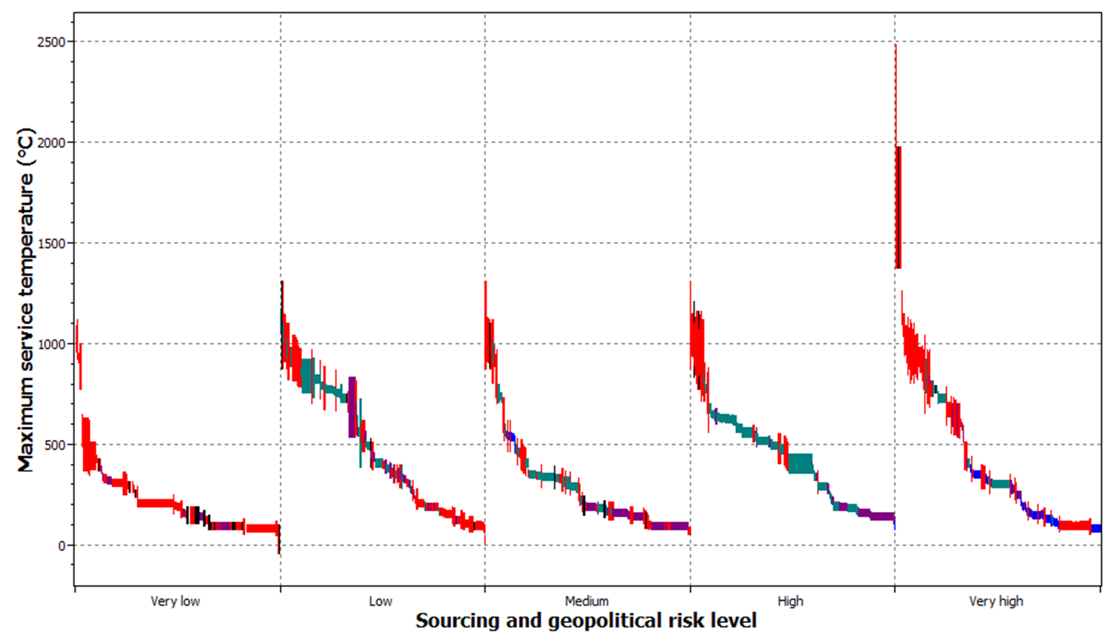
Material Properties vs. Risk
Notes:
This is a relatively simple example of what is possible by combining material property data with critical materials data in Granta CES.
The X-axis highlights the highest sourcing and geopolitical risk level of elements contained in the ~2000 alloys contained in the MaterialUniverse database.
The Y-axis highlights the maximum service temperature of the alloy.
From this it is apparent that, for an operating environment above 1400 degrees, all of the available materials in this dataset will contain at least one element at very high risk of disruption due to geopolitical instability in the producing countries.
What this graph does not account for is the quantity of the element contained in the composition.

Slide 3
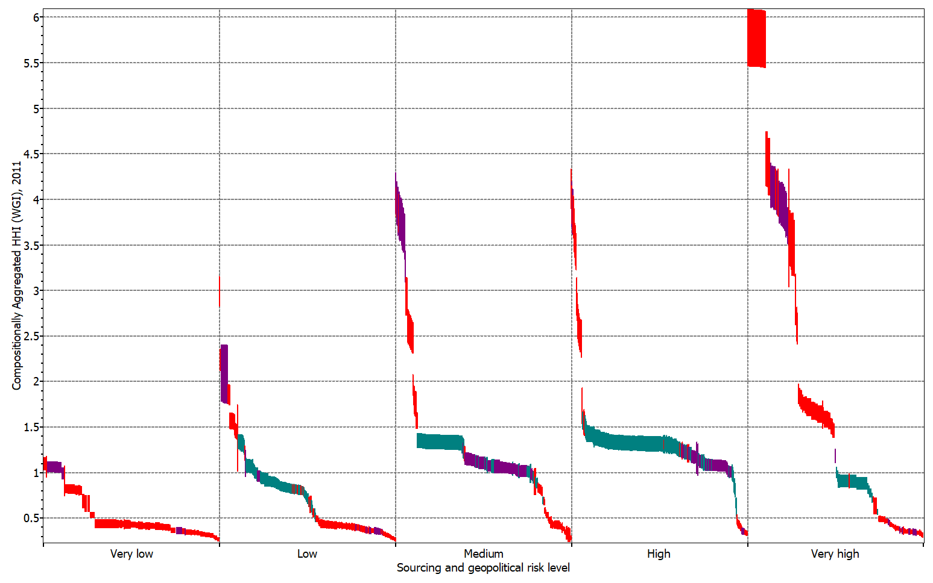
Trace Element vs. Major Alloying Component
Notes:
The X-axis in this plot is the same as in the previous slide.
The Y-axis is however the same metric of sourcing and geopolitical risk but calculated for the overall composition of the alloy, taking every element into account according to the relative proportion in the alloy and accounting for the sourcing and geopolitical risk of each element according to production concentration and geopolitical risk according to the World Bank Governance index.
The red records in the top right of the plot are the 100% pure rare earth elements, The purple are light alloys and the Green are various grades of steel.
What this plot highlights is that various alloys the difference in mindset when approaching specialist application vs. bulk applications – If we only need a few kilograms of an element to serve our business needs we might not care if that element has a very high risk as we could stockpile enough. If on the other hand we’re using hundreds of thousands of tonnes of the material (e.g. steel in construction) we might care about alloys that contain a higher proportion of lower risk elements.

Slide 4
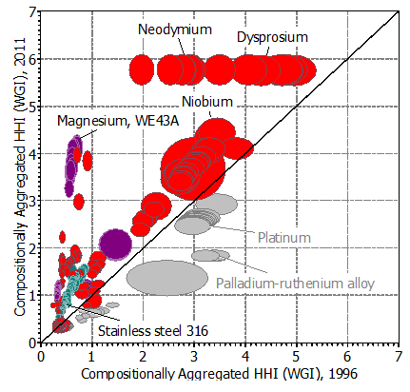
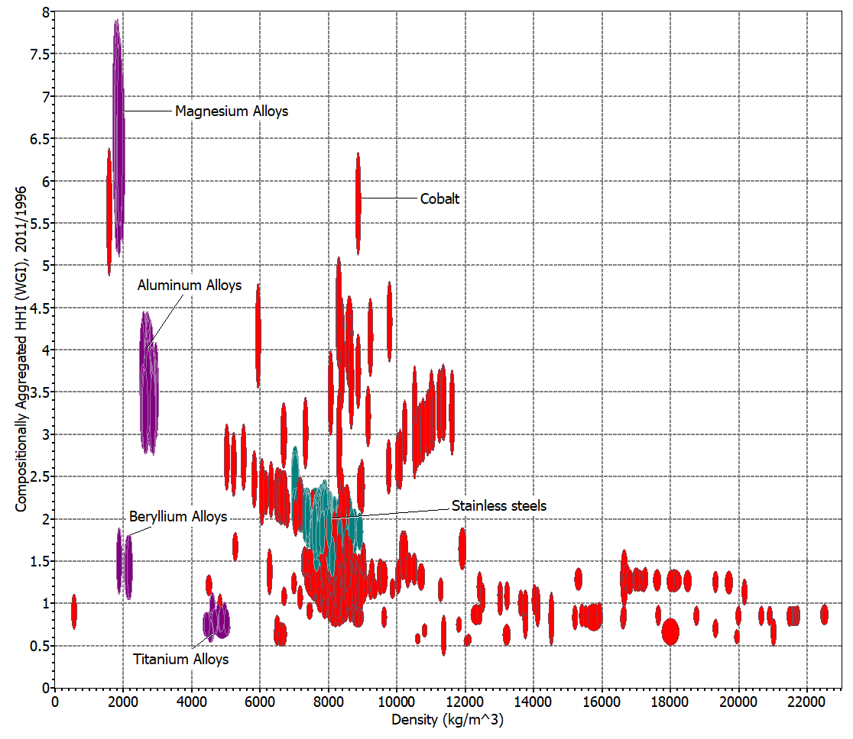
Increasing or decreasing risk?
Notes:
Considering the compositionally aggregated risks from the previous slide.
The plot on the left looks at the risk for the material evaluated in 1996 vs the same risk evaluated in 2011 (15 years)
Any material above the diagonal line has increased in risk over this period (the further from the line, the greater the increase in risk), materials below have decreased in risk. In both cases we’re looking at sourcing and geopolitical risk for the whole composition.
It is perhaps surprising to know that most of the metals we use have increased in risk, with the exception of the platinum groups alloys.
Looking at the increase in risk over this period against Density, the plot on the right serves to highlight that many of the light alloys have been impacted during this 15 year period. Magnesium and Aluminium alloys have all increased in risk, primarily due to an increase in supply of the base elements (Mg and Al) from China during this period. What might this increase mean for applications that need light alloys (automotive and aerospace)?

Slide 5
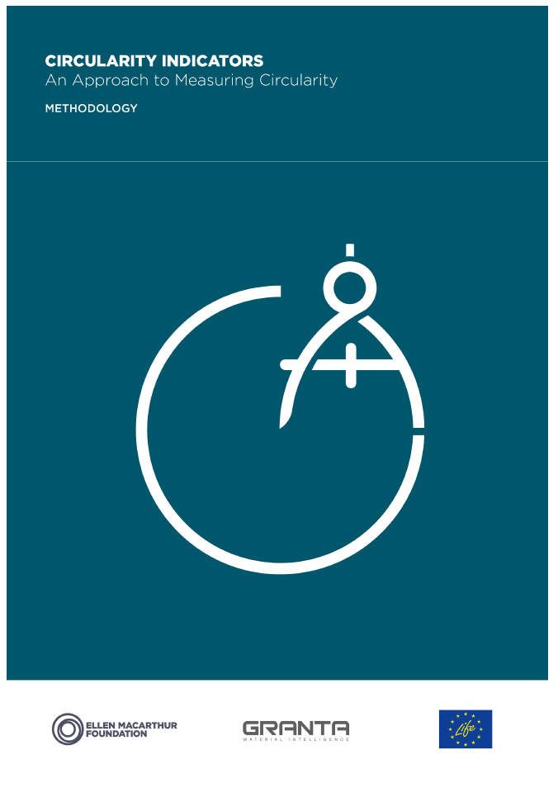
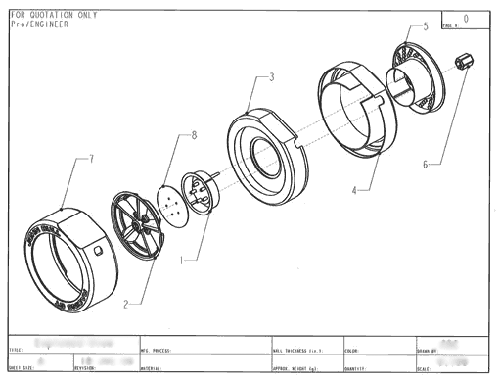


How do we know how circular products are?
Design of new products
Internal reporting
Procurement
https://www.ellenmacarthurfoundation.org/programmes/insight/circularity-indicators
Notes:
Materials data can also help us to understand how to design products for the circular economy.
Granta Design developed a metric for quantifying material/product circularity with the Ellen MacArthur Foundation in 2013-2015, and this has been updated in 2019.
The methodology is available freely online.

Slide 6
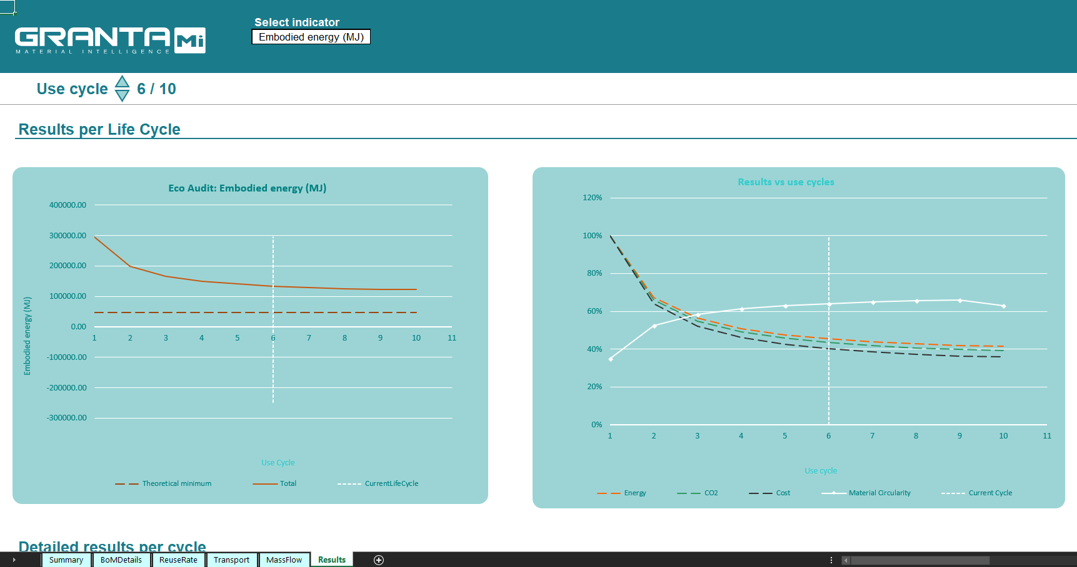
Multiple Life Cycle Analysis
Notes:
The plot on this page highlights the need to consider impacts across multiple lifecycles when dealing with circular economy products.
Quite often the benefits of using more durable materials don’t accrue until the second or third cycle of the product, something that the boundary conditions of a linear LCA might not pick up, to understand the benefits we have to expand our system boundaries to cover the multiple lifecycles of the product.

Slide 7
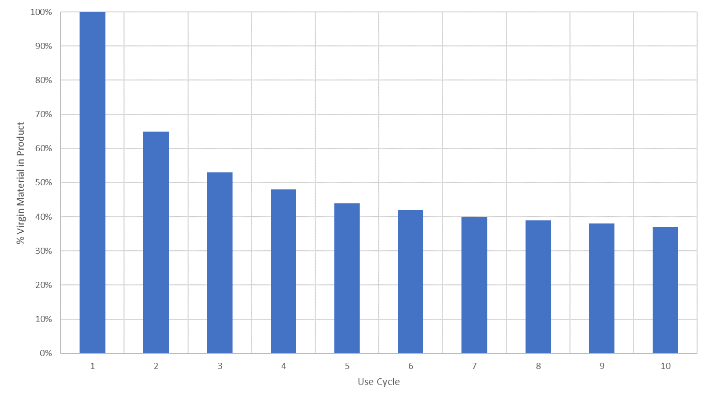
Reduced exposure to price volatility
For a 300k vehicle fleet ~ ±$15m (past 5 years)
In some models reliance on virgin materials reduced by 84% - a $2.5Bn saving?
But: heavily dependent upon new recovery technology.
Notes:
Applying the circular economy to Critical Materials.
This plot indicates the decrease in virgin material requirements for electric vehicle batteries for a 300,000 vehicle fleet.
The model in this case highlighted of course a larger reduction in materials required as reuse and recycling were increased.
Interestingly it also highlighted a reduction linked to the frequency of removing lower capacity cells from used vehicles, with a more frequent intervention rate being preferable.
The model also served to highlight the potentially significant reduction in company exposure to price volatility in virgin material markets through the circular economy approach that might warrant investment is recovery technologies.

Slide 8
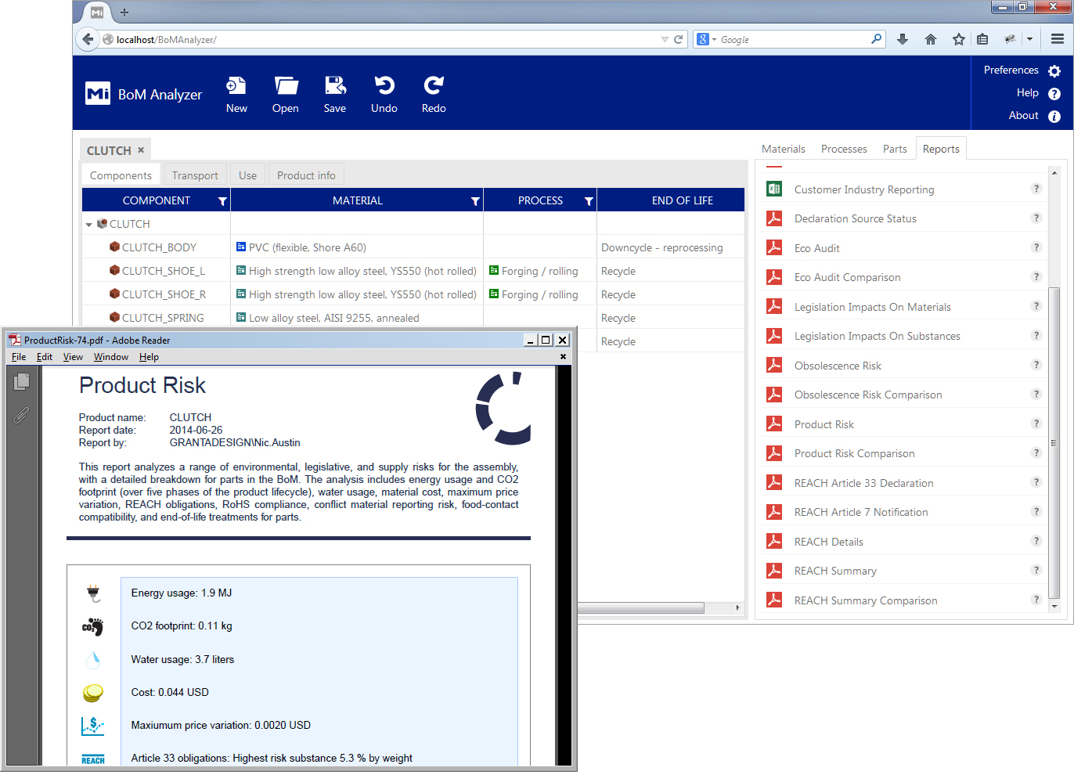
Product Level Reporting
This is one of the hands on tools tomorrow.
None of this is possible without robust materials data.
The value of robust materials data is much more than this though.
Notes:
The same toolset Granta used in this analysis also allows us to assess other types of risk, particularly regulatory risks associated with substances that are being banned by REACH for example.
Again this analysis depends upon a robust approach to the data needed, in this case the links between materials, substances they contain, specifications, and regulations.
As this is a constantly evolving risk, it also requires regular updated to keep pace with new legislations and lists, and the ability to re-run assessments against these new lists to identify any changes that would require attention.

Slide 9




Why materials information matters
Growth
Profit
Risk
Understand materials behavior to increase product lifetime
Reduce environmental impact, gain market share
Minimize
regulatory risk due to restricted substances
Lightweight
with composites
for competitive
advantage
Innovate with additive manufacturing
Specify the
right materials
for global
manufacturing
locations
Make it
at lower cost by substituting materials
Ensure
ROI from
simulation, with
the right input
data
Reduce materials-related warranty issues or recalls
Avoid risks
to human
health
Notes:
This slide highlights some of the many aspects of materials development, selection, product design and compliance that are directly dependent upon robust materials information.

Slide 10

“Summing it all up, per annum, we’re looking at savings of about $10m across three sites…”
Notes:
And this is why leading advanced engineering organisations are investing in materials information management technologies.

Slide 11

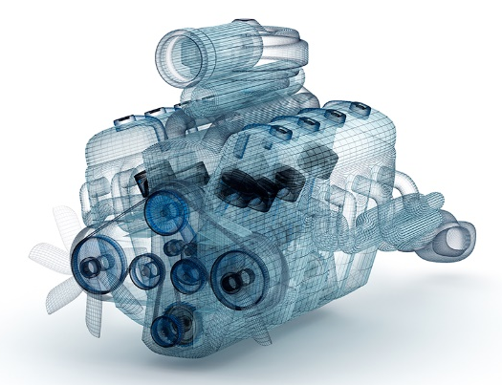
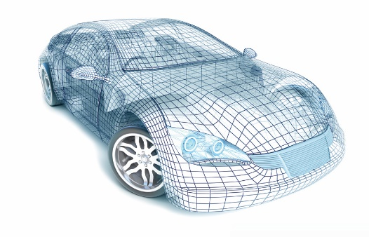
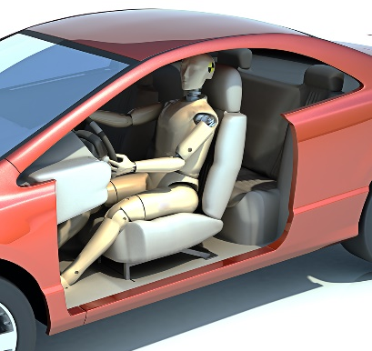

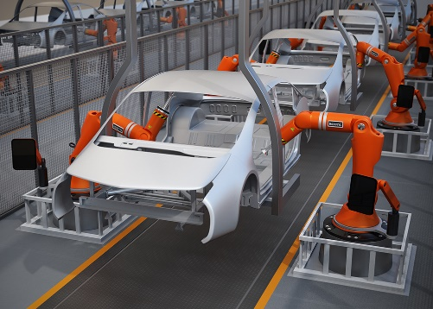
Materials information throughout product engineering
Concept
Engineering Design
CAE models
Simulation
Basic material properties
Detailed engineering properties
Aesthetic / Rendering
Testing and analysis
Compliance data
In-service data
Supplier specs
Prototyping
Customer
Manufacture
Simulation image: Shutterstock
Other images: Adobe Stock Photography
Notes:
This slide serves to highlight that it’s not just materials scientists that care about materials information, the same materials data is used through product development and capturing and centralising this knowledge has some very significant benefits. E.g. avoiding expensive duplication, design changes and supporting qualification and certification, as well as simply the time spent by engineers looking for data (which all adds up).

Slide 12






















How is this valuable asset managed today?
Concept
Engineering Design
CAE models
Simulation
Basic material properties
Detailed engineering properties
Aesthetic / Rendering
Testing and analysis
Compliance data
In-service data
Supplier specs
Prototyping
Customer
Manufacture
Simulation image: Shutterstock
Other images: Adobe Stock Photography
Notes:
This slide represents the materials data landscape in many companies today – it’s no wonder there is often lost data, data that only gets used once or which can no longer be understood…

Slide 13








The big picture: ‘Digitalization’ of business processes
Finance
Human Resources
Why?
Product Design
Materials
Notes:
Other forms of digitalisation are of course further ahead, materials is a complex and varied domain however and is still catching up.

Slide 14
Why has materials information lagged behind?
Materials information
Complex
Diverse: requires flexibility
Needs specialist tools / data structures
Has its own lifecycle
Varies through the product lifecycle
Requires focus and effort
E.g., Multi-dimensional functional data
(how properties vary with conditions)
Metals, plastics, composites, additive manufacturing, coatings…
Complicated
inter-relationships, units, unique data types…
Solutions come through hard-won implementation experience
Generic data in conceptual design → grade-specific in manufacturing
Constantly updated with new tests,
in-service data…
Notes:
So why, exactly, has materials information lagged behind other areas in its digitalization.
Essentially, because it is something of a niche area, and some of the data is highly specialised and technical. This slide breaks that down a little more – these are all reasons why organizations have “got by” with how things work today.
But this lag is becoming increasingly unsustainable, as the gap between materials and some other areas of the business becomes obvious and as some of the strategic problems relating to materials come to the fore.

Slide 15




Consequences
Images: licensed from Adobe Stock Photography
Risk and error
Inaccurate weight roll-ups
Wrong simulation results
Product failures…
Weeks of wasted time
Finding / verifying data
Re-mapping BoMs
Repeating tests & analysis…
Broken processes
Can’t check compliance
CAD and CAE inconsistent
Inadequate revision control…
Barriers to innovation
Complex change processes
Experience is not shared
Outdated materials lists…
Notes:
Some of the consequences of not managing materials information robustly.

Slide 16
The cost of lagging behind
50% of this
expensively-acquired
data was
USED ONCE
and NEVER
RE-USED.
The average engineer spent
1 HOUR PER WEEK
just looking for
materials data.
Typically,
20%
of materials tests
DUPLICATE
existing work.
Granta Design 2016 survey
300+ respondents
Notes:
Before we address how to meet the challenge of digitalizing materials, let’s do a little more to understand why the effort will be worthwhile.
Here are some statistics from a recent Granta survey of our contacts in major engineering enterprises.
Something as simple as unnecessary time spent looking for data can correspond to $100,000s of dollars across all of the engineers in an organization
Imagine if you could reduce testing costs by 20% simply by not repeating tests – how many $thousands or $millions?
And what a wasted wealth of information there is, simply because data captured for one purpose is not re-used – could we get to market faster, or get breakthrough insights if we mined that resource?

Slide 17
An example productivity business case
Key assumptions (based on a medium-sized aerospace company with revenues of $2bn)
# of materials experts | 5 | # of design engineers | 100
# design iterations failed p.a. due to materials data issues | 20 | Typical cost of a design iteration | $40,000
% materials engineer time on tests that are unused or duplicated | 20% | Materials and equipment costs associated with unnecessary tests | $20,000
% time materials engineers spend rolling up & analyzing data | 20% | Annual cost of an engineer/scientist | $120,000
Business case
(1) Cut time materials engineers spend rolling up & analyzing data by 50% |  |  | $60,000
(2) Eliminate lost and duplicated tests |  |  | $140,000
(3) Reduce average weekly time searching for data from 1 hour to 15 mins per engineer |  |  | ~$240,000
(4) Reduce design iteration failures by 50% |  |  | $400,000
Value of increased capacity available due to efficiency gains |  |  | ~$840,000
The Business Case for Materials Information Management, Granta Design, 2012 (page 6)
http://www.grantadesign.com/papers/whitepaper.htm
Notes:
This is a slightly more detailed work-up of the business case for enterprise materials information management systems.

Slide 18
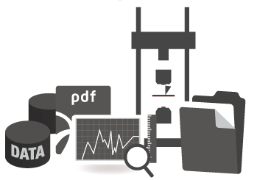


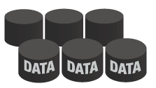
Introducing GRANTA MI
Aesthetic / Rendering
In-service data
Features include:
Specialist materials data structures
Tools to manage the materials data lifecycle
Full traceability
Access and change control, workflow
Proprietary
materials
information
Basic material properties
Compliance data
CORPORATE
MATERIALS
INFORMATION
+
Testing and analysis
Supplier specs
GRANTA MI
A comprehensive library of material reference information:
Metals, plastics, composites…
Detailed engineering properties
CAE models
Notes:
A core concept is the combination of in-house or proprietary materials data (from testing and analysis) with robust and well trusted commercial materials datasets to fill gaps in that knowledge and to broaden the scope of data available immediately.

Slide 19









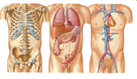

Our materials information library
Unique, comprehensive, linked
Key
Generic data
Design data
Prospector ®
Plastics
Powder
Metallurgy
Supplier data
MaterialUniverse™
MMPDS
Steelspec
Composites
QED
Standards, specs
Test data
Specialist
Restricted
substances
CAMPUS ®
Plastics
NIMS Creep
& Fatigue
ESDU
StahlDat SX
CMH-17
ecoInvent
materials
CAMPUS®
& M-Base
ASME
BPVC
Firehole
Composites
MI-21
Sheet Steels
Human
Biological
Materials
Critical
Materials
Senvol
Database™
JAHM Curve
Data
ASM Medical
Materials
Colors
Notes:
From the Granta perspective this is an example of some of the specialist data sets we have linked to our more general MaterialUniverse data module – the one we used for the plots at the start of this presentation.

Slide 20









Introducing GRANTA MI
Images: licensed from Shutterstock
PRODUCT DESIGN & DEVELOPMENT
SIMULATION
MANUFACTURING
Inform decisions
Ensure accuracy
Standardize
MATERIALS
EXPERTS
CORPORATE
MATERIALS
INFORMATION
ENVIRONMENTAL & REGULATORY
Optimize selection
Minimize risk
Gain productivity
Rationalize
INTEGRATION
Maximize returns
Collaborate
MATERIALS
ENGINEERING
PROCUREMENT
CORPORATE SYSTEMS
TESTING / QA
PLM, CAD, CAE, ERP
SUPPLIERS
Notes:
These are some examples of the typical users of a commercial materials information management system and what they need the materials knowledge for.

Slide 21
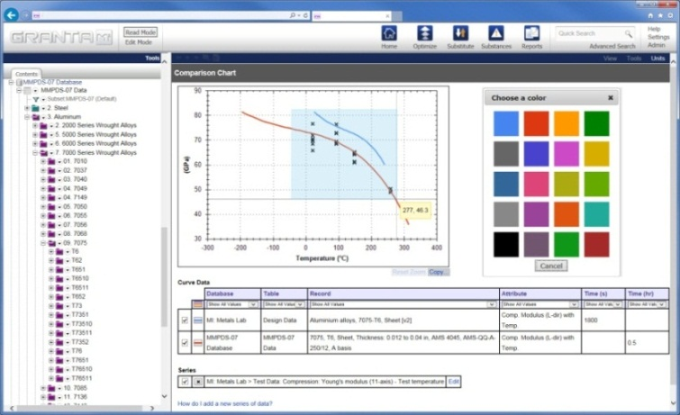
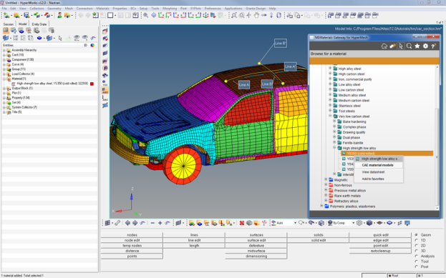

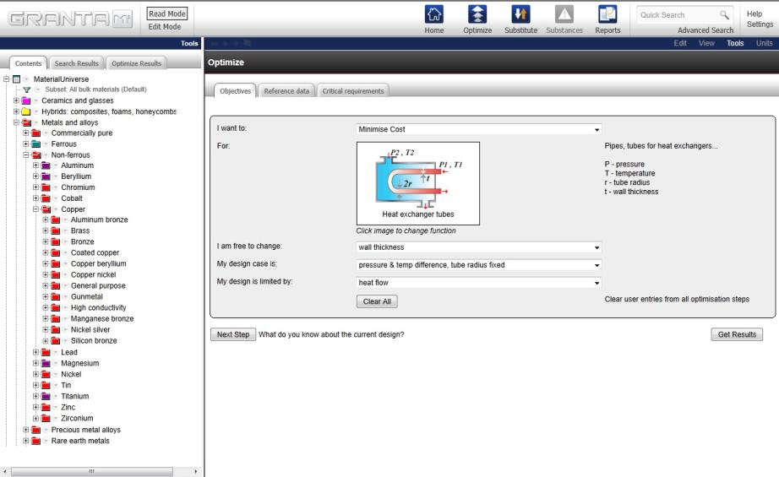
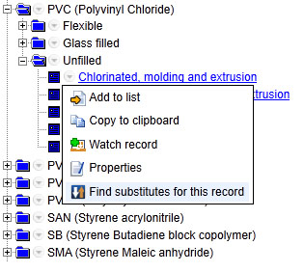
Targeted apps where they are needed
Based on a ‘single view of the truth’ for materials
CORPORATE
MATERIALS
INFORMATION
MATERIALS
ENGINEERING
Analyze property data
SIMULATION
Materials data for CAE
PRODUCT
DESIGN
ENVIRONMENTAL
& REGULATORY
Select materials guided by ‘business rules’
Analyze product risk
Notes:
Different users can access GRANTA MI via apps that are appropriate to their role and that fit within their workflow – web apps, from within a web browser, or even from within a 3rd party tool like CAD or CAE.
The slide shows some examples.
They key point is that all of these users are accessing, quickly and efficiently, a “single view of the materials truth” for their company.
No inconsistencies, no inaccuracies – and the full history of the company’s materials activities is captured for re-use and traceable.

Slide 22
Regulatory
Compliance
Early-stage risk assessment
Manage risk for materials portfolio
Support design for compliance
Assess / report product compliance
Concept
Design
Requirement
definition
Conceptual design
R&D
Capability / technology acquisition
Materials Authority
Determine gaps in material data
Plan test program
Generate Design data
Investigate failures / substitution
Materials
Testing / QA
Characterize materials
Material batch testing
Analyze samples / testing
Design
Definition
Detailed Design
Design Refinement
Simulation
Concept-stage simulation
Develop material cards
Design support / analysis
Design analysis / validation
Investigate failures
Manufacturing
Engineering
Design support (DfM)
Manufacture prototypes
Manufacture final product
Procurement
Source raw materials & parts
Order raw materials & supplied parts
Support
Customer support / Maintenance
Requirement Definition
Conceptual Design
Capability Acquisition
Detailed Design
Validate / Develop
Production
In-Service Support
Notes:
This diagram illustrates what we mean by that idea of “building your company’s material intelligence”.
Down the left hand side are most of the key functions or teams you might find in an engineering enterprise.
Across the bottom is a representation of the product lifecycle.
The boxes show many of the processes where materials information is relevant.
Our aim is to provide this information at all of these points, in a consistent, single system…

Slide 23
Regulatory
Compliance
Early-stage risk assessment
Manage risk for materials portfolio
Support design for compliance
Assess / report product compliance
Concept
Design
  We need to assess regulatory risk for our materials
  We need to avoid restricted substances when designing
  We need to assess regulatory risk for our products
Requirement
definition
Conceptual design
  We want to make reliable, consistent materials choices
R&D
Capability / technology acquisition
Materials Authority
  We want to feed back our lessons learned into the design process
Investigate failures / substitution
Determine gaps in material data
Plan test program
Generate Design data
  We lose materials data and duplicate tests
Materials
Testing / QA
Characterize materials
  We need a reliable way to get data into our CAD/PLM tools
Material batch testing
Analyze samples / testing
  We need to incorporate eco considerations in design
Design
Definition
  We need to generate design/simulation data and make sure its consistent and traceable
Detailed Design
Design Refinement
Simulation
Concept-stage simulation
Develop material cards
Design support / analysis
Design analysis / validation
Investigate failures
  We get problems because we use incorrect, inconsistent, or obsolete data
Manufacturing
Engineering
  We waste a lot of time finding and processing materials data
Design support (DfM)
Manufacture prototypes
Manufacture final product
Procurement
Source raw materials & parts
Order raw materials & supplied parts
  We want to limit proliferation of materials choices
  We often need to find a cheaper material / process to do the job
Support
Customer support / Maintenance
Requirement Definition
Conceptual Design
Capability Acquisition
Detailed Design
Validate / Develop
Production
In-Service Support
Notes:
This diagram illustrates what we mean by that idea of “building your company’s material intelligence”.
Down the left hand side are most of the key functions or teams you might find in an engineering enterprise.
Across the bottom is a representation of the product lifecycle.
The boxes show many of the processes where materials information is relevant.
Our aim is to provide this information at all of these points, in a consistent, single system…

Slide 24




Examples (www.grantadesign.com/casestudies/)
General Motors: delivering the right data to design
  “Less rework, better products, no recalls, fewer warranty issues”
Tecumseh: materials selection
  “Graphical selection methods helped save €2 million.”
Honeywell: test data management
  “Cutting about 80% of the time… to generate a new model”
Boeing: restricted substance risk assessment
  “We enable better answers in much less time”
Rolls-Royce: enterprise-wide benefits
  “We’re looking at about £6.9M of savings”
Notes:
The good news is that we’re making great progress.
Here are some practical examples.

Slide 25







Advantages from strengthening materials intelligence
Material
Intelligence for your company
Better, faster,
safer products
More ROI from testing and qualification
Smart materials choices
Empower product engineering (CAD / PLM)
Ensure the right simulation results
Gain a competitive edge in composites
Enable innovation in Additive Manufacturing
Meet the restricted substances challenge

Slide 26
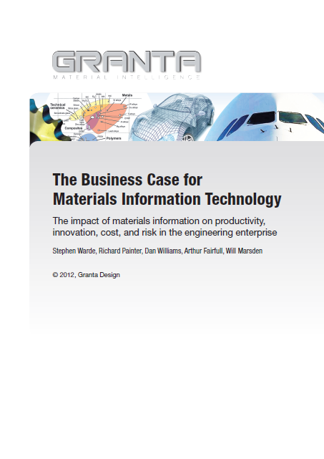
More information
Watch the video
“What is the value of materials data management?”
www.youtube.com/user/GrantaDesign
Read the White Paper
www.grantadesign.com/download/
pdf/whitepaper.pdf

Slide 27
How we support our customers
Software
Professional Services
Network
Information
Develop and apply material intelligence.
A single ‘gold source’ for your corporate materials information.
Targeted apps, when and where they are needed.
An unrivalled catalog of materials property data and related information.
Licensed from leading providers or researched and maintained by our expert team.
Project Managers and Materials Consultants work closely with you to establish which services you need and to project-manage and deliver those services quickly, efficiently, and effectively.
Our consortia bring together leading engineering enterprises to share knowledge and drive materials information technology.
Granta is actively engaged in a wide range of industry collaborative projects.

Slide 28
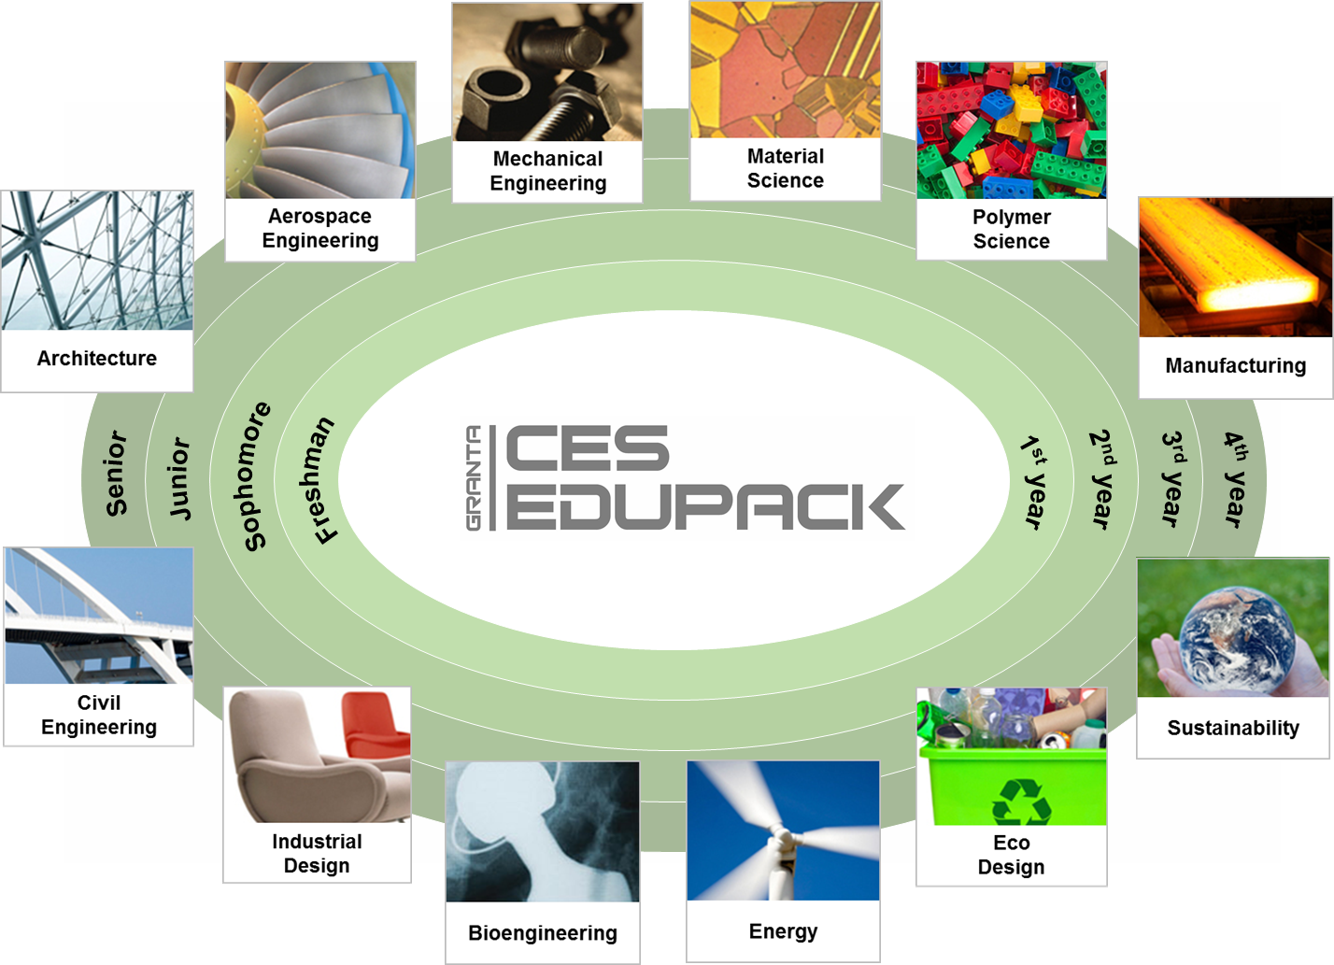
Granta for education
Notes:
We also collaborate extensively with the academic community, on the development of tools and education resources.

Slide 29
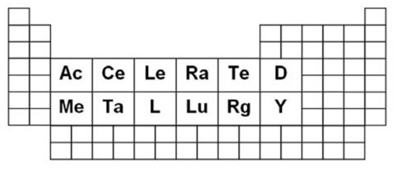
Example Project – Accelerated Metallurgy
28 partner EU project
Project nearing completion
Combines:
Large scale computational exploration of new alloys (25,000+)
High throughput synthesis of new alloys – 1 every 20-30 seconds.
High throughput and distributed testing and characterisation
All data in a shared Granta MI database, a ‘Virtual Alloy Library’
  Strong standardisation
  All data linked appropriately and automatically
  All data accessible by all partners
  All compositions screened for risk as part of R&D

Slide 30
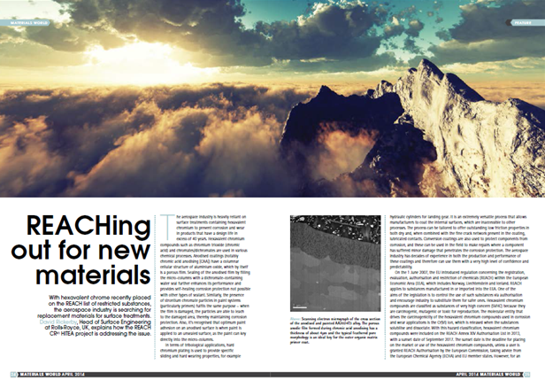
Example Project - HITEA
Consortium of leading UK aerospace partners
  Identification of substitutes to Hexavalent Chromium (REACh)
Distributed test programme
  Shared burden, shared benefit
  Strong standardisation activity
  Significant high value data
All data collated and shared in Granta MI
  All coating systems screened against emerging legislation
  Identifies candidate solutions known to be subject to risk

Slide 31
Questions / Discussion
Thank you for your attention

Slide 32


















www.suscritmat.eu
Sustainable Management of Critical Raw Materials

