Slide 1

CRM and Sustainable Development:
Critical Raw Materials in the global context of the need
for resource efficiency and the Sustainable Development Goals (SDGs)
Guido Sonnemann
Full Professor, University of Bordeaux
guido.sonnemann@u-bordeaux.fr
© Guido Sonnemann, 2018

Slide 2
- Outline -
Problem-setting
Global consumption patterns
Problem-setting
Global consumption patters
Interrelation of consumption and production: The need for resource efficiency
Sustainable Development Goals
Role of critical raw materials
Interrelation of consumption and production
Sustainable Development Goals
Role of critical raw materials
Acknowledgement: Parts of the course material was developed at UNEP DTIE

Slide 3
What is the problem?
Problem-setting
Global consumption patterns
“The major cause of the continued deterioration of the global environment is the unsustainable patterns of consumption and production, particularly in industrialized countries, which is a matter of grave concern, aggravating poverty and imbalances.”
Agenda 21 (Chap. 4.3), Earth Summit, Rio 1992
Interrelation of consumption and production
Sustainable Development Goals
Role of critical raw materials
Notes:
For more information https://sustainabledevelopment.un.org/outcomedocuments/agenda21

Slide 4
What is the Magnitude?
Problem-setting
Global consumption patterns
“It is simply impossible for the world as a whole to sustain a Western level of consumption for all. In fact, if 7 billion people were to consume as much energy and resources as we do in the West today we will need more than one planet to satisfy all our needs.”
Gro Harlem Brundtland, 1994
Interrelation of consumption and production
Activities at the international level
Role of critical raw materials
Notes:
For more information https://www.britannica.com/topic/Brundtland-Report

Slide 5


Sustainable Development: a long-term issue
Problem-setting
Global consumption patterns
If we go on with current production and consumption patterns,
Two planets are needed by 2050
Interrelation of consumption and production
Sustainable Development Goals
Role of critical raw materials
Source: Footprint Network
1900
2002
2050
2100
According to Ecological Footprint approach
Notes:
The Ecological Footprint measures the demand by humans on and the supply of nature.
On the demand side, the Ecological Footprint measures the ecological assets that a given population requires to produce the natural resources it consumes (including plant-based food and fiber products, livestock and fish products, timber and other forest products, space for urban infrastructure) and to absorb its waste, especially carbon emissions. The Ecological Footprint tracks the use of six categories of productive surface areas: cropland, grazing land, fishing grounds, built-up land, forest area, and carbon demand on land.
On the supply side, a city, state or nation’s biocapacity represents the productivity of its ecological assets (including cropland, grazing land, forest land, fishing grounds, and built-up land). These areas, especially if left unharvested, can also absorb much of the waste we generate, especially our carbon emissions.
Both the Ecological Footprint and biocapacity are expressed in global hectares—globally comparable, standardized hectares with world average productivity. Each city, state or nation’s Ecological Footprint can be compared to its biocapacity.
If a population’s Ecological Footprint exceeds the region’s biocapacity, that region runs an ecological deficit. Its demand for the goods and services that its land and seas can provide—fruits and vegetables, meat, fish, wood, cotton for clothing, and carbon dioxide absorption—exceeds what the region’s ecosystems can renew. A region in ecological deficit meets demand by importing, liquidating its own ecological assets (such as overfishing), and/or emitting carbon dioxide into the atmosphere. If a region’s biocapacity exceeds its Ecological Footprint, it has an ecological reserve.
Conceived in 1990 by Mathis Wackernagel and William Rees at the University of British Columbia, the Ecological Footprint launched the broader Footprint movement.
For more information: https://www.footprintnetwork.org/our-work/ecological-footprint/

Slide 6
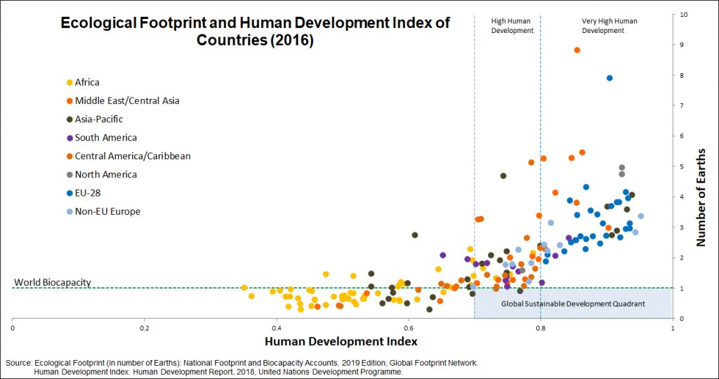
Problem setting - Twin Challenge for Sustainable Development
Problem-setting
Global consumption patterns
Interrelation of consumption and production
Sustainable Development Goals
Role of critical raw materials
Notes:
“Development” is shorthand for committing to well-being for all. “Sustainable” implies that such development must come at no cost to future generations. In other words, development is required to occur within what the planet’s ecosystems are able to replenish season after season, year after year. It needs to operate within the planetary boundaries.
One simple way to assess sustainable development is by using the Ecological Footprint and the Human Development Index (HDI). An Ecological Footprint less than 1.6 global hectares per person makes those resource demands globally replicable (in 2019). The United Nations considers an HDI over 0.8 to be “very high human development.”
CRM are needed in most countries to achieve a factor X improvement in resource-efficiency in order to strive for sustainable development, i.e. moving to the “magic square”-
For more information https://www.footprintnetwork.org/our-work/sustainable-development/

Slide 7
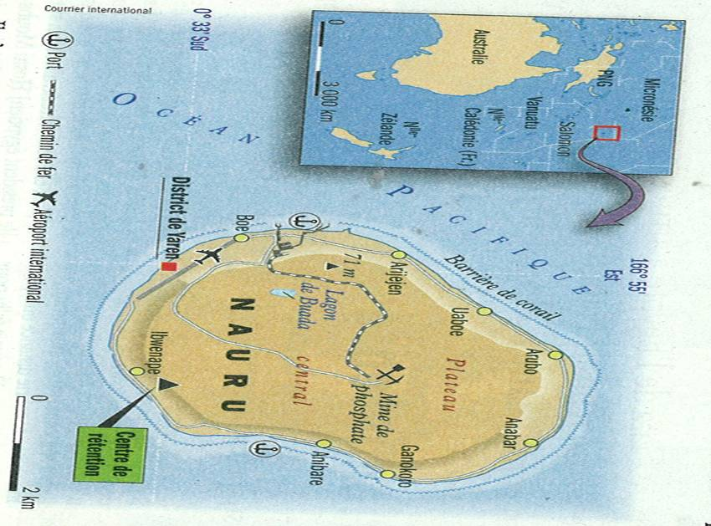
It was politically correct… but has proven unsustainable
Problem-setting
The Case of Phosphate Mining in Nauru
Global consumption patterns
Interrelation of consumption and production
Phosphate mining begins in 1840’s
Brings important influx of wealth and opportunity, but tailings gray coral reefs
Today, no phosphate remains and few additional resources left to exploit
Result: 9,000 people in poverty, struggling to restart their economy
Sustainable Development Goals
Role of critical raw materials
Source: “Nauru: L’ineluctable faillite d’un micro-Etat,”
Courrier International, No 900, 2008.
Notes:
Part of the CRM 2017 list of the EC is Phosphorus and Phosphate that is the past has been extracted unattainably in Nauru.
Over a century of phosphate mining has rendered most of the island of Nauru uninhabitable. Extensive mining, in particular after independence, has resulted in a huge loss of traditional culture and the country becoming reliant on foreign aid.
Nauru is the smallest country in the world, with an area of 21 km2 and population of roughly 13,000. Located in Micronesia, this small island state is heavily dependent on international aid due to its excessive mining of phosphate. “The government estimates that the secondary phosphate deposits have a remaining life of about 30 years” (BBC 2017). The phosphate mining carried out partly by Nauru, but mostly by Australian and British companies, had rendered most of the island both uninhabitable and infertile (about 80% of the surface of the island) by the 1960s, leaving everything but the coastal strip uninhabitable (Klein 2014). With a rise in sea levels due to global temperature rise, Nauru’s entire population is highly vulnerable, as there is nowhere to relocate to.
Environmental Impacts: Air pollution, Biodiversity loss (wildlife, agro-diversity), Food insecurity (crop damage), Loss of landscape/aesthetic degradation, Soil erosion, Deforestation and loss of vegetation cover, Groundwater pollution or depletion
Health Impacts: Malnutrition, Health problems related to alcoholism and prostitution
Socio-economical Impacts: Displacement, Loss of livelihood, Loss of traditional knowledge/practices/cultures, Social problems (alcoholism, prostitution, etc..), Violations of human rights, Land dispossession, Loss of landscape/sense of place

Slide 8


The Case of Mining Critical Metals in the Congo Basin
Problem-setting
Coltan, an ore that contains tantalum and niobium used for electronics and car manufacture, is resourced from one of the most conflict-ridden countries in the world.
Global consumption patterns
Interrelation of consumption and production
Sustainable Development Goals
Role of critical raw materials
Source of photos: Pinterest
Notes:
Columbite-tantalite — coltan for short — is a dull metallic ore found in major quantities in the eastern areas of Congo. When refined, coltan becomes metallic tantalum, a heat-resistant powder that can hold a high electrical charge. These properties make it a vital element in creating capacitors, the electronic elements that control current flow inside miniature circuit boards. Tantalum capacitors are used in almost all cell phones, laptops, pagers and many other electronics
How Is Coltan Mined?
Coltan is mined through a fairly primitive process similar to how gold was mined in California during the 1800s. Dozens of men work together digging large craters in streambeds, scraping away dirt from the surface in order to get to the coltan underground. The workers then slosh water and mud around in large washtubs, allowing the coltan to settle to the bottom due to its heavy weight. A good worker can produce one kilogram of coltan a day. Coltan mining is very well paid in Congo terms.
Financing the Conflict
A highly controversial U.N. Security Council report outlined the alleged exploitation of natural resources, including coltan, from Congo by other countries involved in the current war. There are reports that forces from neighboring Rwanda, Uganda and Burundi are involved in smuggling coltan from Congo, using the revenues generated from the high price of coltan to sustain their efforts in the war. All countries involved in the war deny exploiting Congo's natural resources. The path that coltan takes to get from Central Africa to the world market is a highly convoluted one, with legitimate mining operations often being confused with illegal rebel operations, and vice versa, making it difficult to trace the origin. To be safe and in line with the Dodd-Frank act many electronics companies have publicly rejected the use of coltan from anywhere in Congo, instead relying on their main suppliers in Australia. But it may be a case of too late. Much of the coltan illegally stolen from Congo is already in laptops, cell phones and electronics all over the world.

Slide 9
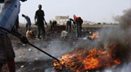
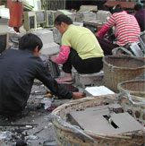
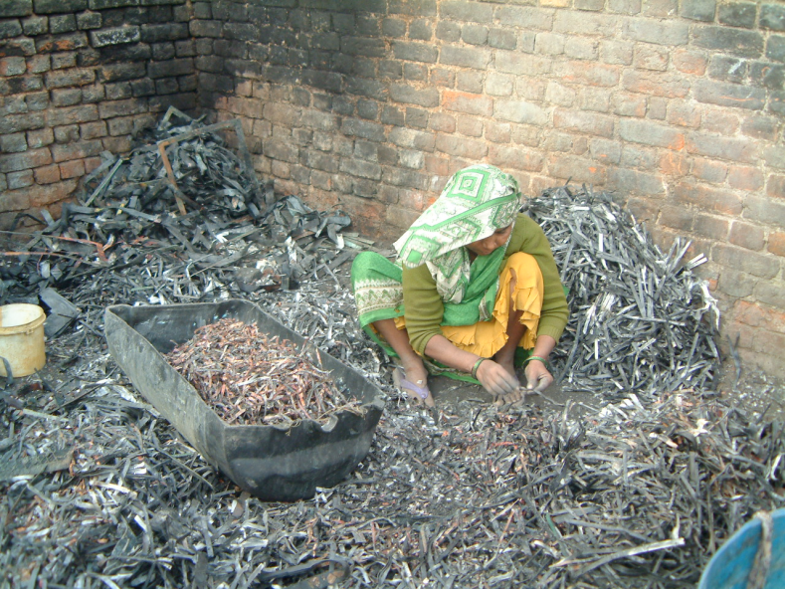
Problem-setting
The Case of WEEE Recycling
by the Informal Sector in Ghana and India
Global consumption patterns
Interrelation of consumption and production
Sustainable Development Goals
Role of critical raw materials
Source of photos: EMPA and WRF
Notes:
Backyard recycling of e-waste by burring and leaching to get mainly gold back has negative impacts on workers' health and the environment.

Slide 10

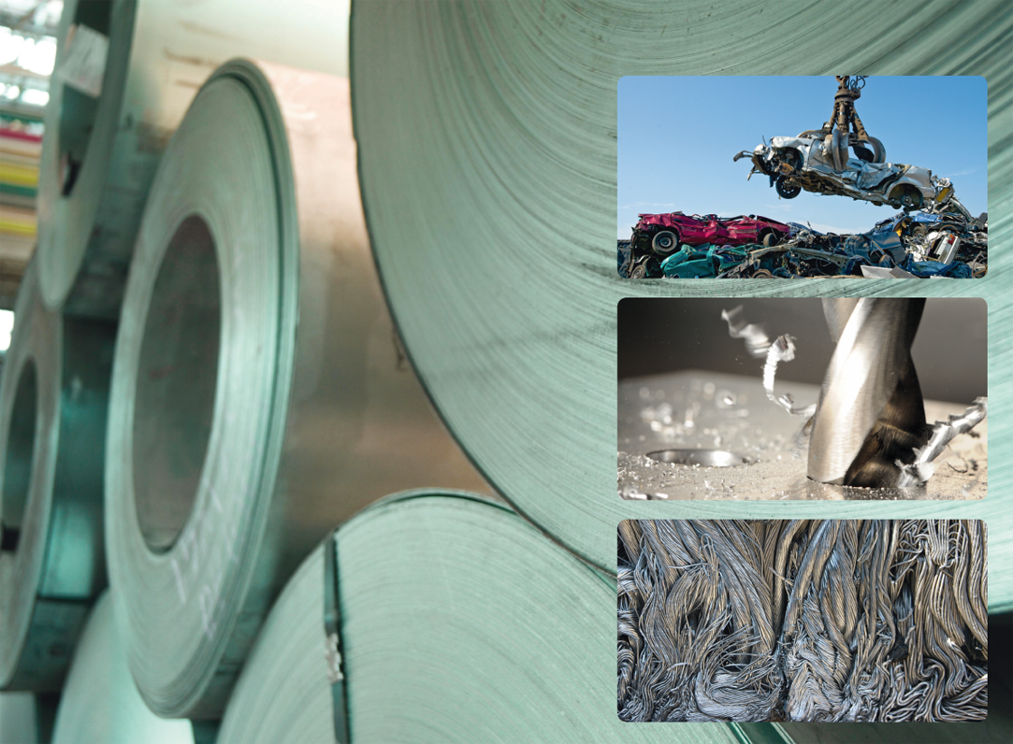
Problem-setting
Critical Metals for Clean Technologies
- Examples -
Global consumption patterns
Tellurium, selenium for high efficiency solar cells
Neodymium and dysprosium for wind turbine magnets
Lanthanum and cobalt for hybrid vehicle batteries
Terbium and indium for advanced metal imaging
Platinum for automotive catalysts and fuel cells
→ These and other critical metals might become unavailable for
use in modern technology without enhanced end-of-life recycling rates.
Interrelation of consumption and production
Sustainable Development Goals
Role of critical raw materials
Source: International Resource Panel

Slide 11



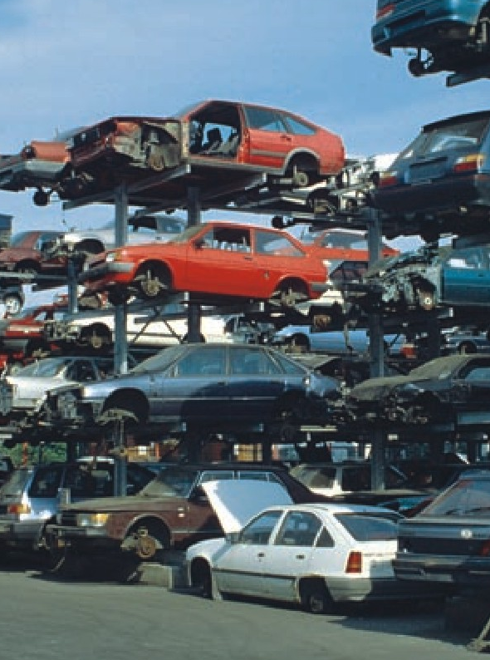

Problem-setting
Precious Metals:
Palladium example
Global consumption patterns
Interrelation of consumption and production
Sustainable Development Goals
Role of critical raw materials
Source: International Resource Panel
www.unep.fr/scp/rpanel
Notes:
Main applications of palladium are automotive catalysts (> 60%) and electronics (> 16%); further applications are industrial catalysts, dental, jewelry.

Slide 12
Problem-setting
The case of Palladium: Challenges for recycling
Current global mine production about 220 tons/year; high regional concentration
Main applications are automotive catalysts (> 60%) and electronics (> 16%); further applications industrial catalysts, dental, jewelry
Current end-of-life recycling rate 60-70% (global average)
  Excellent rates for industrial applications: 80-90%
  Moderate rates for automotive applications: 50-55%
  Poor rates for electronic applications: 5-10%
Lack of recycling infrastructure for consumer goods
Limited amount of cell phones are recycled in an appropriate way
The main problems are insufficient collection and pre-treatment schemes in the most countries of the world
Global consumption patterns
Interrelation of consumption and production
Sustainable Development Goals
Role of critical raw materials
Source: International Resource Panel
Notes:
Challenges of recycling for Palladium
Current end-of-life recycling rate 60-70% (global average)
Excellent rates for industrial applications: 80-90%
Moderate rates for automotive applications: 50-55%
Poor rates for electronic applications: 5-10%
Lack of recycling infrastructure for consumer goods

Slide 13


Problem-setting
Specialty Metals:
Indium example
Global consumption patterns
Interrelation of consumption and production
Sustainable Development Goals
indium
Role of critical raw materials
tellurium
Courtesy of Umicore Precious Metals Refining
www.unep.fr/scp/rpanel
Notes:
Indium has become an important metal since it is used for LCD glass, lead-free solders, semiconductors/LED and also photovoltaic etc. although it is just a by-product.

Slide 14
Problem-setting
The case of Indium: Just a by-product
Strategic metal used for LCD glass, lead-free solders, semiconductors/LED and also photovoltaic etc.
Strong growth in gross demand is predicted for indium: from ca. 1,200 tons (2010) to ca. 2,600 tons (2020)
Specialty metals like indium are crucial for future sustainable technologies like PV, battery technologies, catalysts, efficient lighting systems etc. but used also in huge amount in gadgets like LCD screens for games
The supply of indium from natural resources is crucial: so-called minor metal, which occurs just as a by-product (mainly zinc ores) in low concentrations
The current end-of -life recycling rate of indium is below 1% like for the most other specialty metals: urgent progress is necessary to enhance their recycling
Global consumption patterns
Interrelation of consumption and production
Sustainable Development Goals
Role of critical raw materials
Source: International Resource Panel
Notes:
Specialty metals like indium are crucial for future sustainable technologies like PV, battery technologies, catalysts, efficient lighting systems etc. but used also in huge amount in gadgets like LCD screens for games
The supply of indium from natural resources is crucial: so-called minor metal, which occurs just as a by-product (mainly zinc ores) in low concentrations
The current end-of -life recycling rate of indium is below 1% like for the most other specialty metals: urgent progress is necessary to enhance their recycling

Slide 15
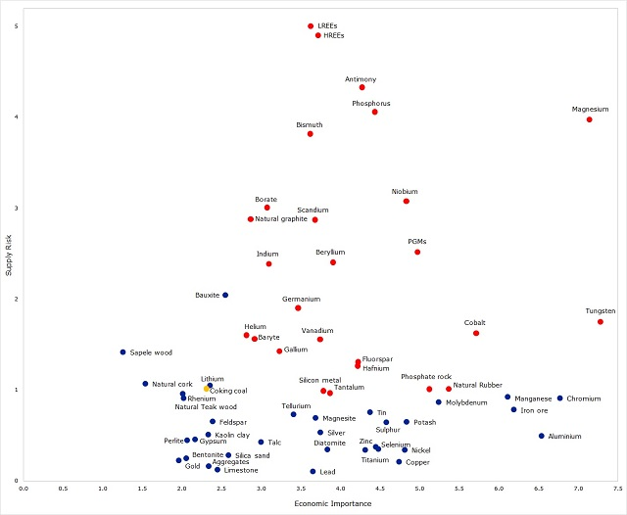
27 Critical Raw Materials CRM
(of 61 candidate materials, incl. 3 material groups)
Problem-setting
Global consumption patterns
Interrelation of consumption and production
Sustainable Development Goals
Source: EC 2017
Role of critical raw materials
www.unep.fr/scp/rpanel
Notes:
According to the 2017 list of CRM of the European Commission, light and Heavy Rare Earths Elements (HREEs and LREEs) have the highest supply risk. Platinum Group Metals (PGMs), including six metals such as Palladium (Pd) have a higher economic importance. Indium has less supply risk and less economic importance but is part of the CRM list. Finally, Phosphoruns and Phoshate rock are also both included in this CRM list.

Slide 16
Implementation Gap since 2002
Problem-setting
Global consumption patterns
Fundamental changes in the way societies produce and consume are indispensable for achieving global sustainable development. All countries should promote sustainable consumption and production patterns…. Governments, relevant international organizations, the private sector and all major groups should play an active role in changing unsustainable consumption and production patterns.
WSSD Johannesburg Plan of Implementation, Sept. 2002
Interrelation of consumption and production
Sustainable Development Goals
Role of critical raw materials
Notes:
For more information https://www.sustainabledevelopment2015.org/AdvocacyToolkit/index.php/earth-summit-history/historical-documents/94-jpoi

Slide 17
Global Consumption Patterns
Problem-setting
Gross Domestic Product
Global consumption patterns
China,
Interrelation of consumption and production
Sustainable Development Goals
Role of critical raw materials
Notes:
Environmental effects of economic activities are ultimately driven by the global consumption patterns, via impacts of the production, use, and waste management phases of products and services ultimately consumed. Thus we need insight into the final consumption expenditures and related products that have the greatest life-cycle environmental impacts. The figure shows the gross domestic product of the countries in the world at the beginning of the century. The Northern countries dominate: North America, Western Europe and China, Japan and South Korea.
For more information: https://www.resourcepanel.org/reports/assessing-environmental-impacts-consumption-and-production

Slide 18
Examples of inequalities in Consumption
Problem-setting
Global consumption patterns
1.3 billion people live on less than 1 US dollar a day.
The overall consumption of the richest fifth of the world’s population is 16 times that of the poorest fifth.
Nearly 160 million children are malnourished.
More than 880 million people lack access to health services.
1.5 billion lack access to sanitation and clean water.
Interrelation of consumption and production
Sustainable Development Goals
Role of critical raw materials
Notes:
1.3 billion people live on less than 1 US dollar a day and close to 1 billion cannot meet their basic consumption requirements.
The overall consumption of the richest fifth of the world’s population is 16 times that of the poorest fifth;
Nearly 160 million children are mmalnourished.
More than 880 million people lack access to health services ·
1.5 billion lack access to sanitation and clean water, 1 billion do not have adequate housing.

Slide 19
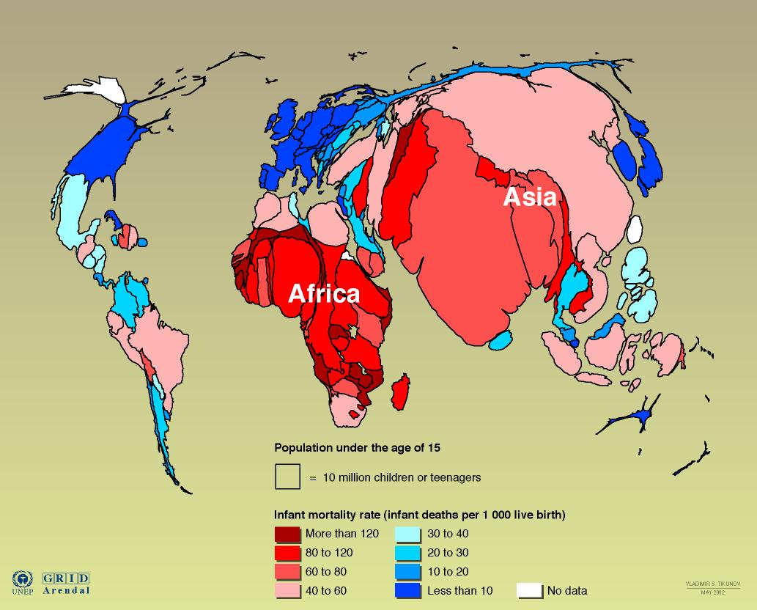
Problem-setting
Population under the age of 15
Global consumption patterns
Interrelation of consumption and production
Sustainable Development Goals
Role of critical raw materials
Notes:
Poverty and environmental degradation are closely interrelated. While poverty results in certain kinds of environmental stress, the major cause of the continued deterioration of the global environment is the unsustainable pattern of consumption and production, particularly in industrialized countries, which is a matter of grave concern, aggravating poverty and imbalances. And the cause is not the number of population of a country, although a high number of population can lead to a high consumption level as we are currently experiencing in China and India. Actually, the number of population gives an indication of the potential future consumption level of a country since most human strive for a Western style of life with a high consumption level.
For more information: https://sustainabledevelopment.un.org/content/dsd/agenda21/res_agenda21_04.shtml

Slide 20
Population, Consumption & Environment
Problem-setting
Global consumption patterns
Population is not the main problem of environmental degradation, but rather the consumption and production patterns.
Need for inter- and intra-generation equity.
Need to meet the basic needs of the whole population (food, shelter, health, education, clothing).
Interrelation of consumption and production
Sustainable Development Goals
Role of critical raw materials

Slide 21
Interrelation of Cleaner Production and Sustainable Consumption
Problem-setting
Global consumption patterns
Over the last decade, we have seen significant improvements in Cleaner Production (pollution prevention, waste minimization mainly at the production level).
However, changes in consumption patterns have offset the environmental gains achieved through Cleaner Production.
Interrelation of consumption and production
Sustainable Development Goals
Role of critical raw materials

Slide 22
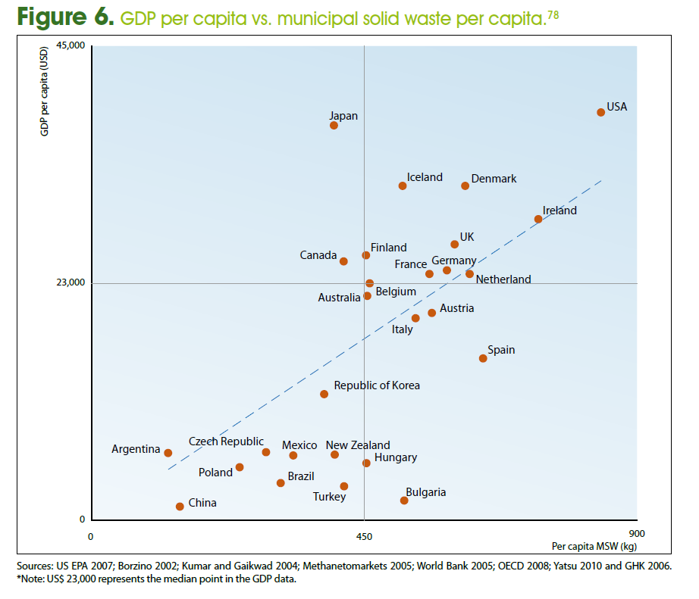
Problem-setting
Global consumption patterns
Interrelation of consumption and production
Sustainable Development Goals
Role of critical raw materials
Notes:
The amount of municipal solid waste (MSW)per capita is half in Japan than US although both have a similar level of GDP. That means the Japanese economy is more resource-efficient with regard to MSW. Some European countries on the one or the other side of the curve but less extreme.

Slide 23
Problem-setting
Global consumption patterns
Interrelation of consumption and production
Sustainable Development Goals
Role of critical raw materials
Source: OECD
Notes:
The resource and material intensity is improving, while the absolute resource use is still increasing. The situation is much better for water than for MSW.

Slide 24
Problem-setting
Global consumption patterns
Interrelation of consumption and production
Sustainable Development Goals
Role of critical raw materials
Source: UNEP DTIE
Notes:
A distinction can be made between ‘relative’ and ‘absolute’ decoupling. Relative decoupling of resources or impacts means that the growth rate of the environmentally relevant parameter (resources used or some measure of environmental impact) is lower than the growth rate of a relevant economic indicator (for example GDP). The association is still positive, but the elasticity of this relation is below 1 (Mudgal et al., 2010). Such relative decoupling seems to be fairly common. With absolute decoupling, in contrast, resource use declines, irrespective of the growth rate of the economic driver. This latter relation is shown by the Environmental Kuznets Curve that claims that if prosperity rises beyond a certain point, the environmental impact of production and consumption decreases. Absolute reductions in resource use are rare (De Bruyn, 2002; Steger and Bleischwitz, 2009); they can occur only when the growth rate of resource productivity exceeds the growth rate of the economy.
For more information: https://www.resourcepanel.org/file/400/download?token=E0TEjf3z

Slide 25
Decoupling Equation
Problem-setting
Global consumption patterns
I = P * A * T
Total environmental impact = Population * per capita Affluence * Technology
Interrelation of consumption and production
Sustainable Development Goals
Role of critical raw materials
Source: Holdren and Ehrlich (1974)
Role of critical raw materials
Notes:
I = PAT is the mathematical notation of a formula put forward to describe the impact of human activity on the environment.
I = P × A × T
The expression equates human impact on the environment (I) to the product of three factors: population (P), affluence (A) and technology (T).
Critical raw materials play an important role in technological development that contribute to transmaterialisation (energy efficiency), dematerialisation (high tech), and structural changes (technology development).
The variable "I" in the "I=PAT" equation represents environmental impact. The environment may be viewed as a self-regenerating system that can endure a certain level of impact. The maximum endurable impact is called the carrying capacity. As long as "I" is less than the carrying capacity the associated population, affluence, and technology that make up "I" can be perpetually endured. If "I" exceeds the carrying capacity, then the system is said to be in overshoot, which may only be a temporary state. Overshoot may degrade the ability of the environment to endure impact, therefore reducing the carrying capacity.
In the I=PAT equation, the variable P represents the population of an area, such as the world. Since the rise of industrial societies, human population has been increasing exponentially. The United Nations project that world population will increase from 7.7 billion today (2019) to 9.8 billion in 2050 and about 11.2 billion in 2100.
The variable A in the I=PAT equation stands for affluence. It represents the average consumption of each person in the population. As the consumption of each person increases, the total environmental impact increases as well. A common proxy for measuring consumption is through GDP per capita. While GDP per capita measures production, it is often assumed that consumption increases when production increases. GDP per capita has been rising steadily over the last few centuries and is driving up human impact in the I=PAT equation.
The T variable in the I=PAT equation represents how resource intensive the production of affluence is; how much environmental impact is involved in creating, transporting and disposing of the goods, services and amenities used. Improvements in efficiency can reduce resource intensiveness, reducing the T multiplier. Since technology can affect environmental impact in many different ways, the unit for T is often tailored for the situation to which I=PAT is being applied. For example, for a situation where the human impact on climate change is being measured, an appropriate unit for T might be greenhouse gas emissions per unit of GDP.

Slide 26
Two aspects of decoupling
Problem-setting
Global consumption patterns
Interrelation of consumption and production
Activities at the international level
Role of critical raw materials
Source: International Resource Panel
Notes:
Here decoupling means using less resources per unit of economic output and reducing the environmental impact of any resources that are used or economic activities that are undertaken. The Figure captures the essence of the two key aspects of decoupling as applied to sustainable development, namely resource decoupling and impact decoupling.
For more information: https://www.resourcepanel.org/reports/decoupling-natural-resource-use-and-environmental-impacts-economic-growth

Slide 27
The need for resource efficiency
Problem-setting
Global consumption patterns
Promoting sustainable consumption and production patterns
New product-oriented strategies (life cycle perspective, design and manufacture)
Understanding consumption
Integrated approach of sustainable consumption and production.
➔De-linking resource use and environmental impacts from economic growth
➔And striving towards resource-efficiency
Interrelation of consumption and production
Sustainable Development Goals
Role of critical raw materials

Slide 28
Resource Efficiency
Problem-setting
Global consumption patterns
Efficiency at economic level
+
Environmental dimension
+
Resource efficiency
(raw materials, including CRM , energy, water, biomass, land & waste)
→ By producing more wellbeing with less material consumption, RE enhances the means to meet human needs while respecting the ecological carrying capacity of the Earth.
Interrelation of consumption and production
Reducing the environmental impact
of consumption and production
of goods and services over their full life cycles
Sustainable Development Goals
Role of critical raw materials
Notes:
Resource efficiency means a win-win situation at the economic level by cost savings and at the same time environmental benefits. This is because raw materials have to be purchased and all emission and waste flows mean losses. Moreover, these losses need to be treated (for instance air filter and wastewater treatment) which has a cost, similar to taxes such as for landfill or carbon emissions.

Slide 29

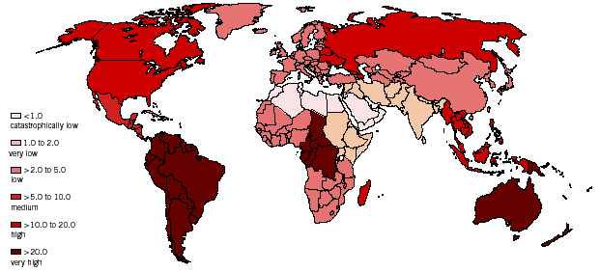
Spotlight on global systems of production and consumption
Problem-setting
Global consumption patterns
Global system of production and consumption
Interrelation of consumption and production
Resource
Extraction
Producers
Retailers
Consumers
End-of-life
managers
Sustainable Development Goals
Role of critical raw materials
Including CRM
Source: CSCP
Notes:
The economy of the world is global. Markets, and the industries that supply them, operate in a global environment. Transport, information and communication infrastructures have enabled this. Production and consumption chains are spread across the globe requiring ever more complex logistics systems to supply, produce and distribute products. Elements of the production and consumption chains move globally, driven by the cost and availability of skilled labour, the availability of materials and resources, the state of infrastructure, and the needs of the consumers.
One example of such a global system is the production and consumption of computer. CRM might come from Africa and China, the production is done in China or elsewhere in Asia, the retailing is done through the USA, the product is used by the consumer in Europe and the end-of-life might be a recycling by the informal sector in India, in which case the CRM are not recovered.

Slide 30
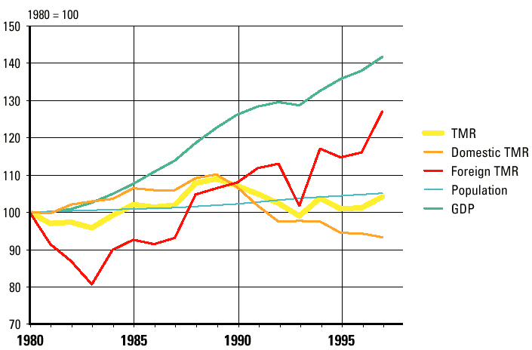
Increasing evidence for burden shifting
Problem-setting
Global consumption patterns
Global systems of production and consumption lead to rising resource extraction in developing countries....
Interrelation of consumption and production
Activities at the international level
Role of critical raw materials
Data from Wuppertal Institute for European situation of E-15
Notes:
The Total Material Requirement (TMR) measures total primary material requirements of production and consumption. It comprises the domestic and foreign share and the used and unused extraction of resources. In so far the TMR includes the „ecological rucksacks“. These consist on the one hand of unused domestic extraction like overburden from coal mining, excavated soil for construction or soil erosion in agriculture. On the other hand, TMR includes all foreign liye-cycle wide required primary materials, used and unused, which are necessary to provide an imported good (indirect material flows). Thus the TMR constitutes the most comprehensive quantitative Input-indicator (aggregating quantities of all primary material flows besides water and air) for the magnitude of potential environmental pressure through the extraction and use of natural resources.
Concering EU-15 there is clear empirical evidence of burden shifting from growing resource extraction to the outside world, especially to developing countries. Though the domestic TMR between 1980 and 1997 in EU-15 absolutely decoupled from GDP-growth, the foreign TMR raised in parallel (Bringezu et al. 2005).

Slide 31
Understanding supply chain and use-phase issues
Problem-setting
Global consumption patterns
high
Resource use
Consumption and EoL
Policy, performance and reputation opportunities
Interrelation of consumption and production
Environmental Impact
Management effort
80% of overall efforts focus on 20% of the total risk
Sustainable Development Goals
low
Natural Resources
Manufacturing sites
Product distribution
Transportation
Consumers
Based on a source of CSCP
Role of critical raw materials
Life Cycle
Design for a Circular Economy
of CRM containing products
Recycling of CRM
Mining of CRM
Substitution of CRM
Notes:
80% of overall effort to reduce environmental impact have focused in the past on 20% of the total risk.
The hotspot of the environmental impacts of a product is not always in the manufacturing stage, where most efforts are traditionally positioned, but it can be the mining for instance. The environmental impact of mining CRM can reduced by recycling.
And CRM can help to reduce the environmental in the use phase of cars for example.

Slide 32
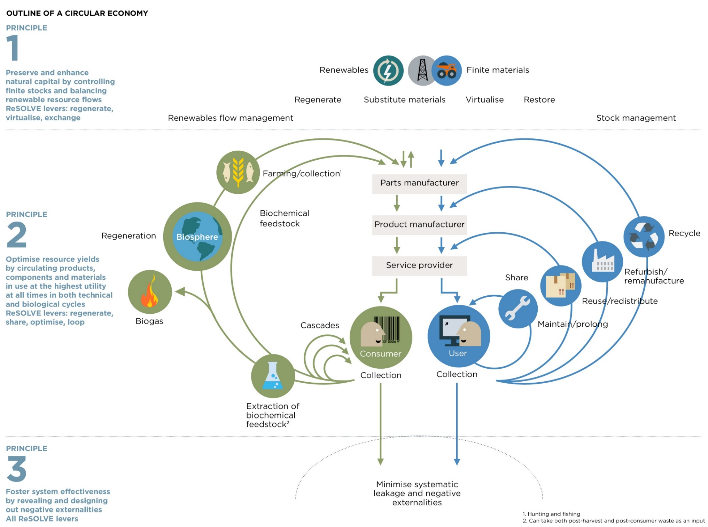

Moving towards a Circular Economy (CE)
Problem-setting
Global consumption patterns
Interrelation of consumption and production
Activities at the international level
Role of critical raw materials
Aim: Circular CRM
Notes:
Moving towards a more circular economy is a logical proposition. Use less natural resources, reduce pollution, tackle climate change, enhance consumer satisfaction, while also improving the bottom line. The rational path, however, is not always the path of least resistance.
The circular economy aims to eradicate waste—not just from manufacturing processes, as lean management aspires to do, but systematically, throughout the life cycles and uses of products and their components. Indeed, tight component and product cycles of use and reuse, aided by product design, help define the concept of a circular economy and distinguish it from the linear take–make­–dispose economy, which wastes large amounts of embedded materials, energy, and labour. In a circular economy, the goal for durable components, such as metals and most plastics, is to reuse or upgrade them for other productive applications through as many cycles as possible. This approach contrasts sharply with the linear mind-set embedded in most of today’s industrial operations. Even their terminology—value chain, supply chain, end user—expresses a linear take–make–dispose view.
A circular economy seeks to rebuild capital, whether this is financial, manufactured, human, social or natural. This ensures enhanced flows of goods and services. The system diagram illustrates the continuous flow of technical and biological materials through the ‘value circle’. The model distinguishes between technical and biological cycles. Consumption happens only in biological cycles, where food and biologically-based materials (such as cotton or wood) are designed to feed back into the system through processes like composting and anaerobic digestion. These cycles regenerate living systems, such as soil, which provide renewable resources for the economy. Technical cycles recover and restore products, components, and materials through strategies like reuse, repair, remanufacture or (in the last resort) recycling.
For more information: https://www.mckinsey.com/business-functions/sustainability/our-insights/moving-toward-a-circular-economy
and https://www.ellenmacarthurfoundation.org/circular-economy/concept/

Slide 33
Problem-setting
Achievements in 2015 (1):
Paris agreement aims to strengthen:
Global consumption patterns
The global response to the threat of climate change by keeping a global temperature rise this century well below 2 degrees Celsius above pre-industrial levels and to pursue efforts to limit the temperature increase even further to 1.5 degrees Celsius.
The ability of countries to deal with the impacts of climate change.
Interrelation of consumption and production
Sustainable Development Goals
Role of critical raw materials

Slide 34
Achievements in 2015 (2):
The 2030 agenda
Problem-setting
Global consumption patterns
Interrelation of consumption and production
Sustainable Development Goals
Role of critical raw materials
Notes:
For more information: https://sustainabledevelopment.un.org/?menu=1300

Slide 35
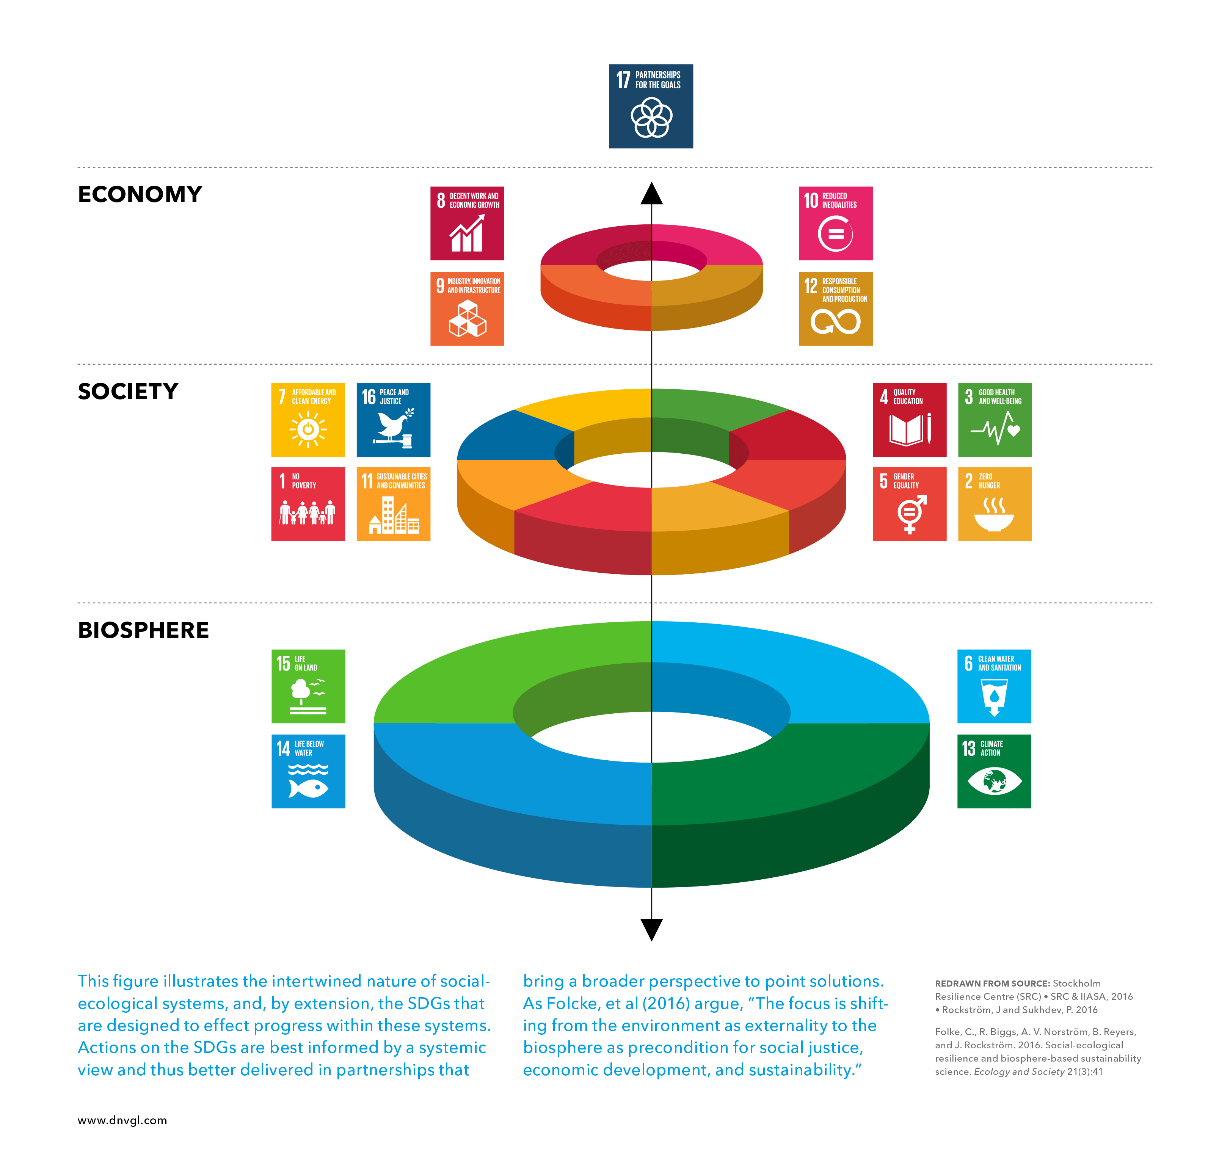
Clustering of SDGs
Problem-setting
2nd IRTC Round Table, Oct 9, 2018, Tokyo
Global consumption patterns
Interrelation of consumption and production
Sustainable Development Goals
Role of critical raw materials
Notes:
The Clustering of the Sustainable Development Goals (SDGs) implies that economies and societies are seen as embedded parts of the biosphere.
This model changes our paradigm for development, moving away from the current sectorial approach where social, economic, and ecological development are seen as separate parts. Now, we must transition toward a world logic where the economy serves society so that it evolves within the safe operating space of the planet.
For more information: https://www.stockholmresilience.org/research/research-news/2016-06-14-how-food-connects-all-the-sdgs.html

Slide 36
The role of the Circular Economy (CE)
Problem-setting
2nd IRTC Round Table, Oct 9, 2018, Tokyo
Global consumption patterns
Interrelation of consumption and production
Sustainable Development Goals
Role of critical raw materials
Notes:
The circular economy holds particular promise for achieving multiple SDGs, including in particular SDG 12 on sustainable consumption and production but also SDGs 6 on energy, 8 on economic growth, 11 on sustainable cities, 13 on climate change, 14 on oceans, and 15 on life on land.

Slide 37
The key role of Goal 12 in the SDGs
Problem-setting
Global consumption patterns
Interrelation of consumption and production
Sustainable Development Goals
Role of critical raw materials
Notes:
SDG 12 on sustainable consumption and production has a key role to play as we can see if we move to the targets defined for this goal.

Slide 38
Problem-setting
Goal 12 targets (1):
Ensure sustainable consumption and production patterns
Global consumption patterns
Implement the 10-year framework of programmes on sustainable consumption and production, all countries taking action, with developed countries taking the lead, taking into account the development and capabilities of developing countries
By 2030, achieve the sustainable management and efficient use of natural resources
Interrelation of consumption and production
Sustainable Development Goals
Role of critical raw materials

Slide 39
Problem-setting
Goal 12 targets (2):
Ensure sustainable consumption and production patterns
Global consumption patterns
By 2030, substantially reduce waste generation through prevention, reduction, recycling and reuse
By 2030, halve per capita global food waste at the retail and consumer levels
Promote public procurement practices that are sustainable, in accordance with national policies and priorities
Interrelation of consumption and production
Sustainable Development Goals
Role of critical raw materials

Slide 40
Problem-setting
Goal 12 targets (3):
Ensure sustainable consumption and production patterns
Global consumption patterns
By 2020, achieve the environmentally sound management of chemicals and all wastes throughout their life cycle, in accordance with agreed international frameworks, and significantly reduce their release to air, water and soil in order to minimize their adverse impacts on human health and the environment
Interrelation of consumption and production
Sustainable Development Goals
Role of critical raw materials

Slide 41
DPSIR framework for key indicator areas for environmental sustainability assessment
Problem-setting
2nd IRTC Round Table, Oct 9, 2018, Tokyo
Global consumption patterns
Interrelation of consumption and production
Focus of CRM
Sustainable Development Goals
Role of critical raw materials
Notes:
For more information on the DPSIR framework https://www.eea.europa.eu/publications/TEC25
In this figure CRM are positioned in the indicator framework of DPSIR /Drivers, Pressures, State, Impacts, Responses). Pressures on the environment come from resource use (materials, including CRM, land, water and energy). These pressures are changing the status of various safeguard subjects: Climate, biodiversity, health and supply security, particular relevant for CRM and not an environmental parameter. The use of CRMs is often done with the aim to mitigate climate change.

Slide 42
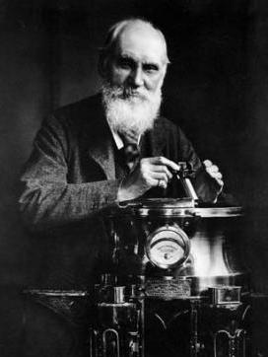
Supporting role of input-output based industrial ecology assessment tools
Problem-setting
2nd IRTC Round Table, Oct 9, 2018, Tokyo
Global consumption patterns
« If you cannot measure it, you cannot improve it »
(Lord Kelvin)
Interrelation of consumption and production
1824 - 1907
Life cycle Assessment
Material Flow Analysis
Environmentally Extended Input Output Analysis
Sustainable Development Goals
Role of critical raw materials
Need to include CRM in the assessment tools
Notes:
In order to measure the contribution of CRMs to sustainable development they need to be included in the most relevant input-output based industrial ecology assessment tools that are Life cycle Assessment, Material Flow Analysis and Environmentally Extended Input Output Analysis.

Slide 43
UNE Life Cycle Initiative’s recommendations on impact indicators for abiotic resources
Problem-setting
Global consumption patterns
Interrelation of consumption and production
Sustainable Development Goals
Way how CRM are part of the life cycle impact assessment
Role of critical raw materials
Source: UNE (2019)
Notes:
The integration of criticality assessment, herein termed “product-level supply risk assessment” is seen as a complement to environmental life cycle assessment. Two methods explicitly developed for this purpose—Geopolitical Supply Risk (GeoPolRisk) and the Integrated Method to Assess Resource Efficiency (ESSENZ) were suggested and interim recommended for use as life cycle impact assessment indicator by the UNE hosted Life Cycle Initiative, based on a set of criteria including considerations of data sources, uncertainties, and other contentious methodological aspects. They can be useful for preliminary assessments of the potential impacts of raw material supply risks on a product system (i.e., “outside-in” impacts) alongside the impacts of a product system on the environment (i.e., “inside-out” impacts). Care is needed to not overlook critical raw materials used in small amounts but nonetheless important to product functionality.
For more information UNE (2019) Global Guidance on Environmental Impact Assessment indicators – Volume 2

Slide 44
Which Raw Materials are critical in line with the SDGs and what is the link to CE?
Problem-setting
2nd IRTC Round Table, Oct 9, 2018, Tokyo
Global consumption patterns
Economic
growth
Raw Materials
for
Interrelation of consumption and production
Low carbon and RE technologies
with
Supply Risk
Sustainable Development Goals
Role of critical raw materials
Notes:
The Supply Risk of CRM includes the risk of conflict (i.e. conflict metals) in relation to the social SDG 16 Peace.
CRM are needed for the economic SDGs 8, 9 and 12, that is economic growth, industry & innovation and responsible consumption & production.
The latter is the one that focuses and resource efficiency and hence is the link to the circular economy.
Evidently, CRMs most “noble” role is the support in mitigation technologies for climate change (SDG 13 – Climate Action).
The open question is whether this clean tech role is the most strategic use or rather the general contribution to economic growth or security needs.

Slide 45
Conclusions
Sustainable development is from a resource efficiency point of view about double-decoupling resource use and environmental impacts from economic growth and human well-being.
CRMs have a key role to play in order to allow for resource efficient technologies and decoupling.
The circular economy is a mitigation strategy for CRMs.
SDGs can be classified in economic, social and environmental cluster. The open question is whether CRMs are mostly contributing to economic growth or through its use in cleantech to climate action.
Identifying which materials are critical for achieving social SGDs (e.g. access to clean energy and housing), the creation of jobs and infrastructure in developing countries is an area that needs further consideration.

Slide 46
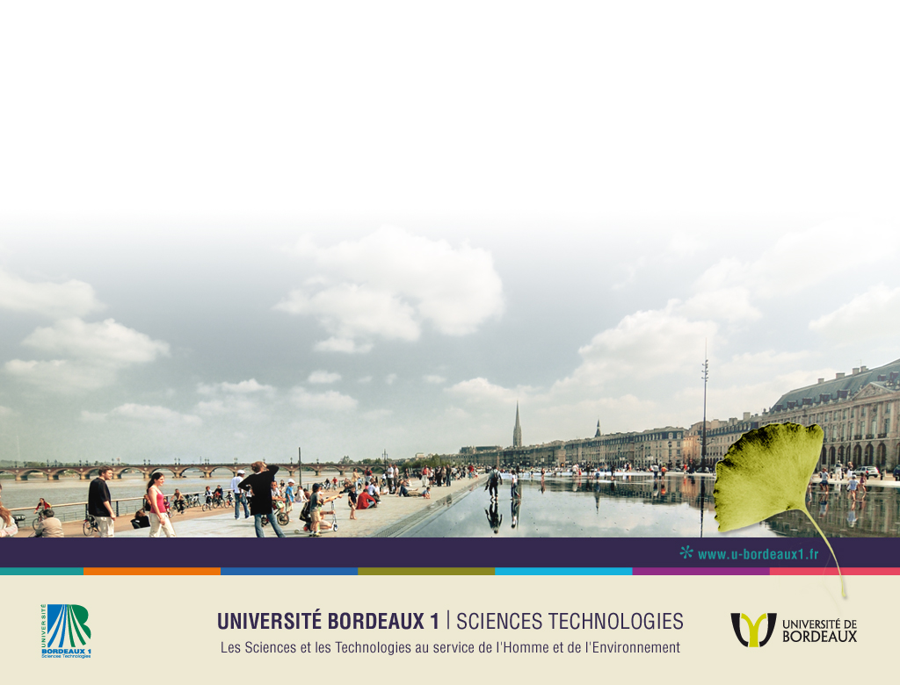



Thank you for your attention!
Prof. Dr. Guido Sonnemann
guido.sonnemann@u-bordeaux.fr
CyVi
Groupe de recherche sur l’Analyse du Cycle de Vie et Chimie Durable
Institut des Sciences Moléculaires - ISM
Université de Bordeaux – UMR 5255 CNRS
351 Cours de la libération – Bât A12
33 405 TALENCE cedex – France
Tél : 05 40 00 31 83
Web : http://www.ism.u-bordeaux1.fr

Slide 47


















www.suscritmat.eu
Sustainable Management of Critical Raw Materials

