Slide 1

Life Cycle Assessment - Practicum
Stefano Cucurachi, Leiden University, CML
©Leiden University, 2018

Slide 2

Electricity from fuel oil
Notes:
Remember the simple example we considered in the lecture?

Slide 3


Electricity from fuel oil
Global warming
Acidification
Notes:
We calculated for this system the impacts on global warming and acidification.

Slide 4
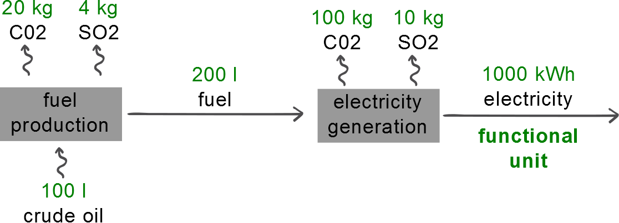
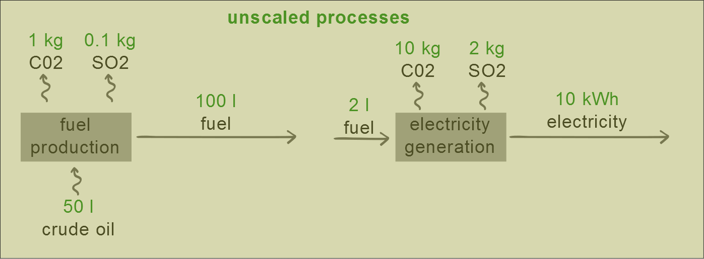
Processes scaled
Scaling factor: 2
Scaling factor: 100
Notes:
Here you see our scaled processes.

Slide 5
Life cycle inventory (the flows to and from the environment
Amount | Unit | Substance
100 | l | crude oil
120 | kg | CO2
14 | kg | SO2
Notes:
Our inventory (LCI) results

Slide 6
Life cycle inventory (the flows to and from the environment
Amount | Unit | Substance | Characteriz-ation factor | Unit | GW
100 | l | crude oil | - | kg-CO2-eq. | -
120 | kg | CO2 | 1 | kg-CO2-eq. | 120
14 | kg | SO2 | 0.1 | kg-CO2-eq. | 1.4
 |  |  |  | Total | 121.4
Global warming
Amount | Unit | Substance | Characteriz-ation factor | Unit | Acidification
100 | l | crude oil | - | kg-SO2-eq. | -
120 | kg | CO2 | - | kg-SO2-eq. | -
14 | kg | SO2 | 1 | kg-SO2-eq. | 14
 |  |  |  | Total | 14
Acidification
Notes:
And our impact scores (LCIA) results.

Slide 7
Process tree/flow diagram: NdFeB magnets
Notes:
What if we wanted to take into account a more realistic case study? Please take a look at the document provided in the word format. We want to conduct using excelm so no specific LCA software for now, the environmental impacts associated with producing NdFeB magnets.

Slide 8
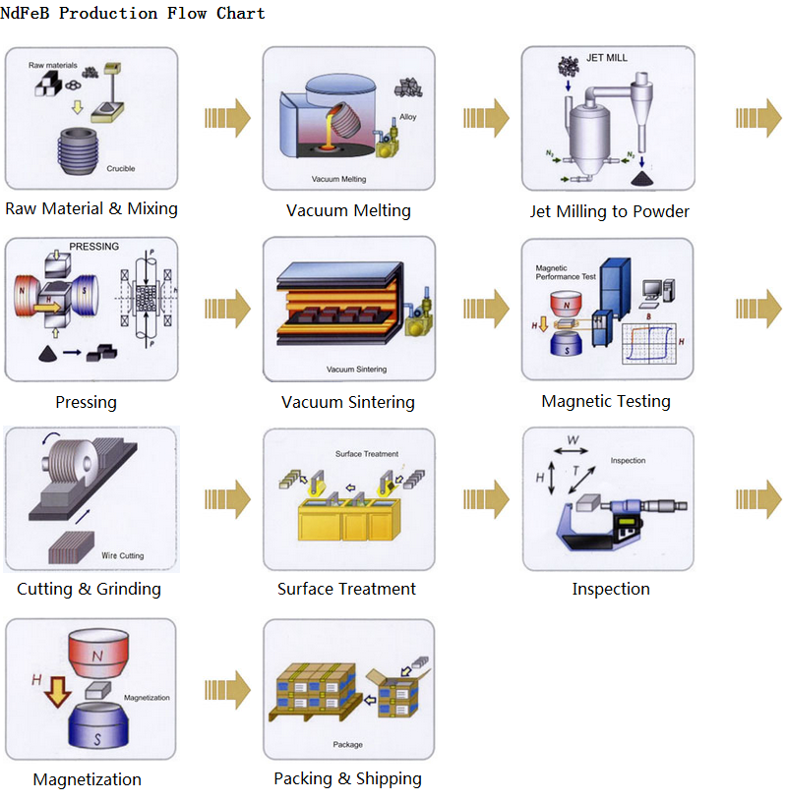
Process tree/flow diagram: NdFeB magnets
ndfebmagnet.net
Notes:
I grabbed this from the web. What we see here is a schematic representation of the processes involved in producing neodymium magnets, from extraction of raw materials, to the manufacturing phases.

Slide 9
Process tree/flow diagram: system boundaries and cut-off
Energy B
Raw material E
Ancillary material A
Raw material D
Ancillary material F
Compon-ent A
Raw material C
Compon-ent
B
Water
Assembly
Energy A
Use
Suh, 2009
Disposal
Notes:
9
9
Keep in mind that we want to keep this system manageable.

Slide 10
Capital
Capital
Capital
Cut-off
Capital
Capital
Energy B
Raw material E
Ancillary material A
Raw material D
Capital
Cut-off
Ancillary material F
Compon-ent A
Raw material C
Compon-ent
B
Capital
Capital
Water
Assembly
Energy A
Capital
Capital
Capital
Use
Disposal
Capital
Suh, 2009
Notes:
10
10
If we keep on adding inputs and outputs, the system will expand.

Slide 11
Suh, 2009
Notes:
11
11
And quite fast…

Slide 12
Suh, 2009
Notes:
12
12
BOOM! Get out of control!

Slide 13
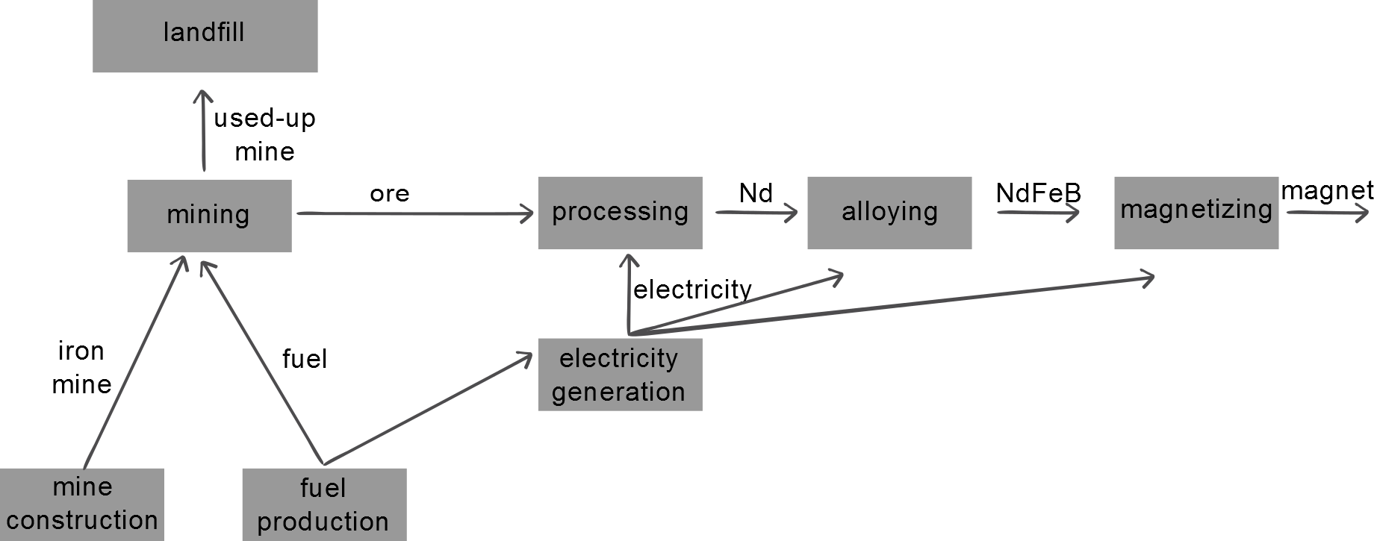
Process tree/flow diagram: NdFeB magnets
Notes:
13
13
To avoid that, for this example, we made some modelling choices and simplified the system. All the data that is relevant for this system is available in the excel sheet that comes with the exercise.

Slide 14
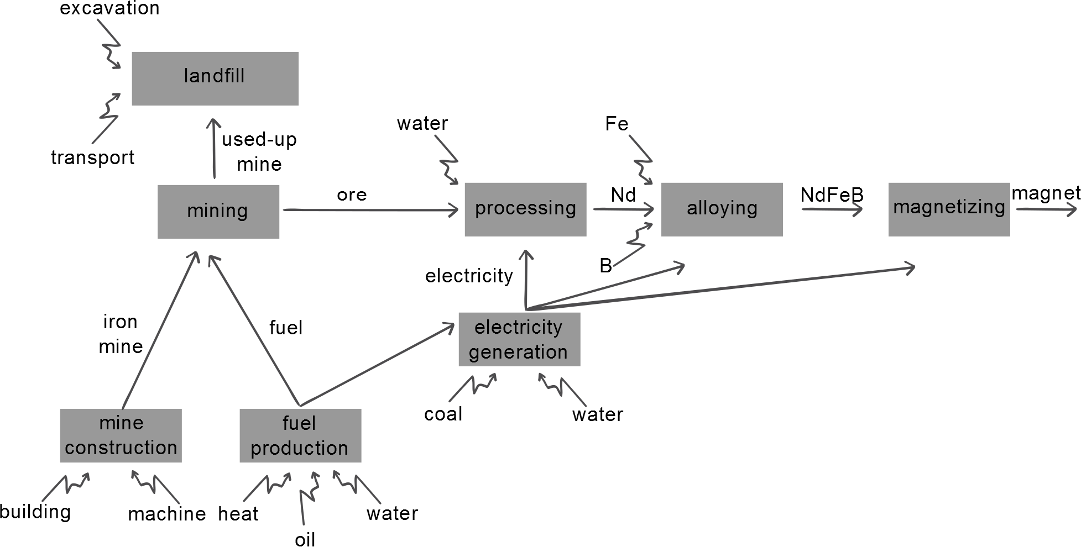
Process tree/flow diagram: NdFeB magnets
Notes:
14
14
This are the inputs and outputs of the system. Take a look at the description of the exercise and try and solve the system. Good luck.

Slide 15
Scaled processes
Notes:
15
15

Slide 16
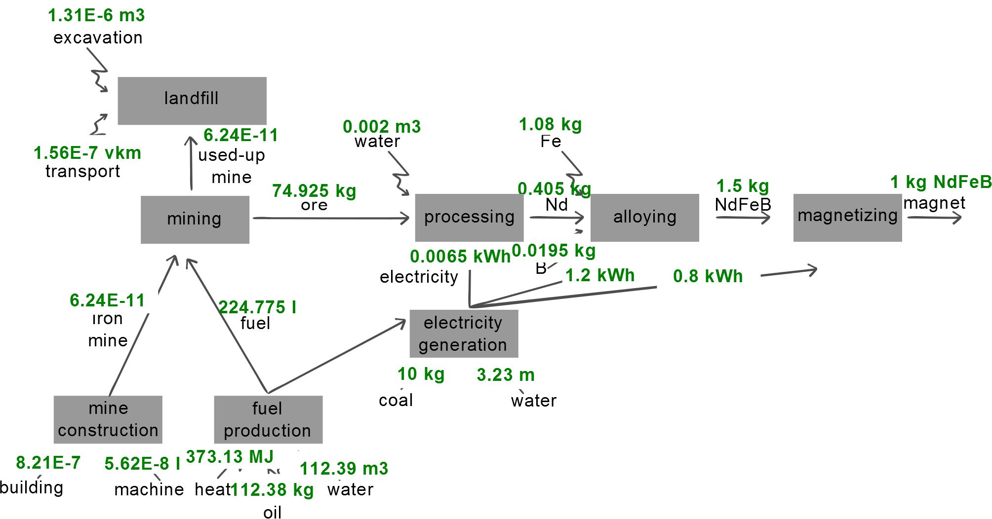
Scaled processes
Notes:
16
16
To be shown after the exercise for students to compare their results.

Slide 17
Impact Assessment

Slide 18
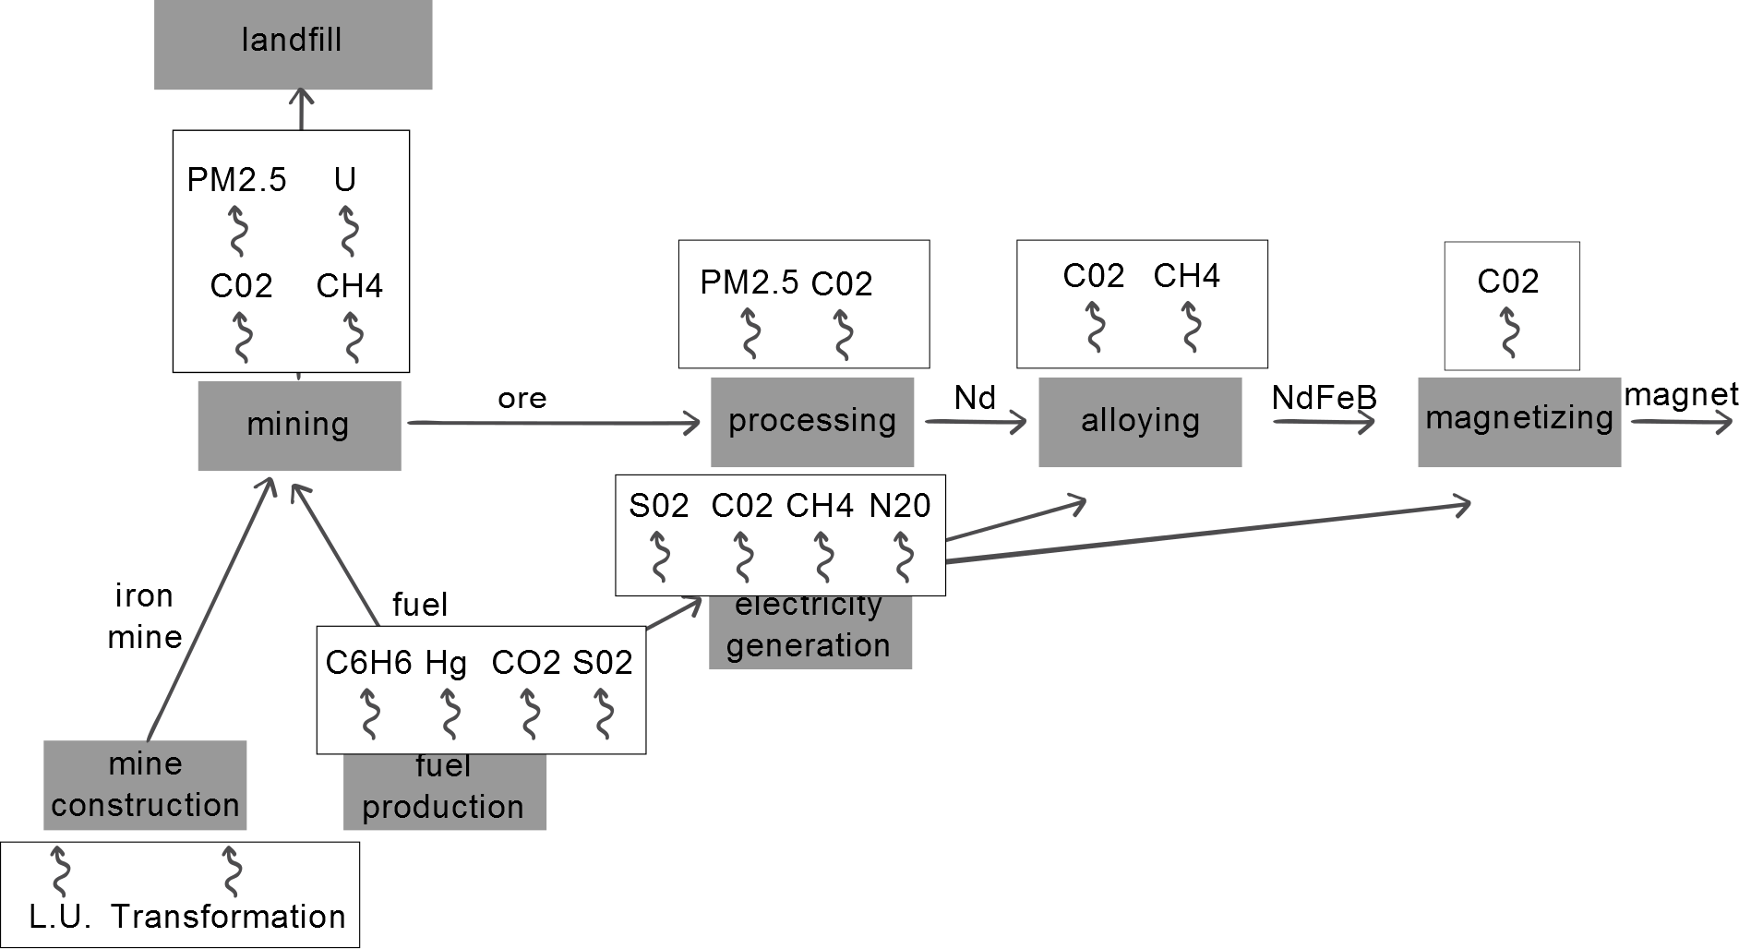
Process tree/flow diagram: NdFeB magnets
Notes:
18
18
To be shown after the exercise for students to compare their results.

Slide 19
Discussion of results
What did we find?
Interpretation?
Demonstration in software
Notes:
Reflection points in class.

Slide 20
Life Cycle Assessment - Practicum
Stefano Cucurachi, Leiden University, CML
©Leiden University, 2018

Slide 21



















www.suscritmat.eu
Sustainable Management of Critical Raw Materials

