Slide 1

Materials Selection & Eco Design
Materials For Tablet Devices
Tatiana Vakhitova, Claes Fredriksson, Luca Petruccelli
Ansys Granta
© Fredriksson, Petruccelli 2018

Slide 2
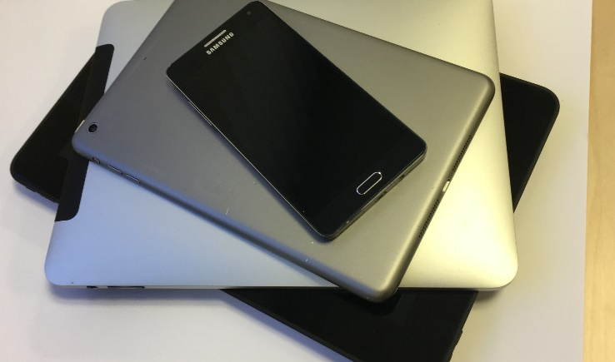
Consumer electronics: Tablet devices
https://www.statista.com/statistics/272595/global-shipments-forecast-for-tablets-laptops-and-desktop-pcs/
© Fredriksson, Petruccelli 2018
Notes:
Around 2 billion mobile phones are sold yearly and devices such as laptops or tablets sell several hundred million units each per year so the impact of existing and future products of this kind is enormous.
There are important questions as to the sustainability of materials used in these electronic devices, such as recyclability, energy use, hazardous, restricted or critical status and resource issues.
Also, as the screens have become larger, the mechanical properties of the casing and the display glass have increased in importance

Slide 3

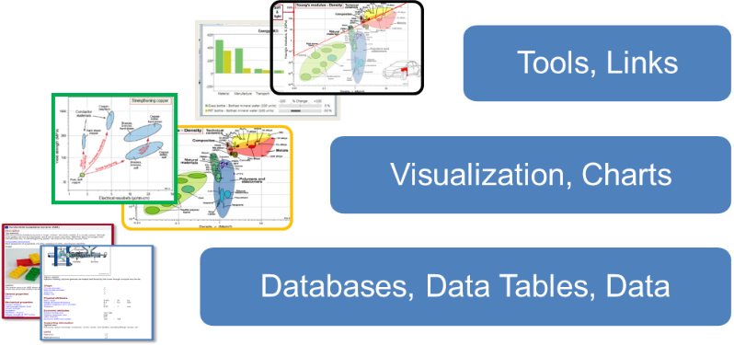
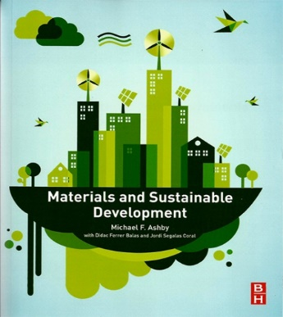
Software capabilities and reference textbooks
Environment
CES EduPack provides an excellent platform for
teaching/learning and making materials decisions:
Eco Design and Sustainable Development textbooks
Sustainability
© Fredriksson, Petruccelli 2018
Notes:
3
This Case Study will be using the concepts developed by Prof Mike Ashby and co-workers here in Cambridge
CES EduPack provides an excellent platform for teaching and discussing materials decisions
We will show a range of features that you can use in your teaching with CES EduPack.
There will be discussions of data on mechanical properties, criticality and eco properties
We will benchmark material options visually using charts of their performance and assess them using the extended Eco Audit tool
The methodologies are described in greater detail in the books of Mike Ashby, particularly the ones that you can see to the right

Slide 4

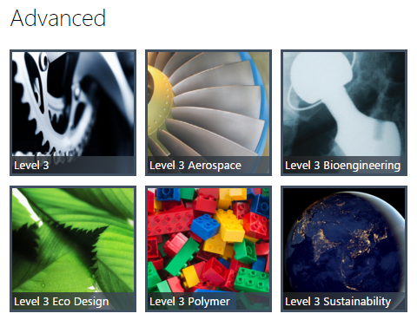
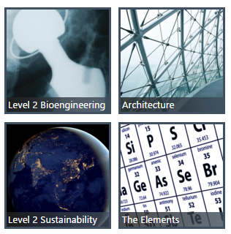
The Sustainability database
Databases
© Fredriksson, Petruccelli 2018
Notes:
We will be using the Sustainability database at Level 3 for this Case, which contains all the 4000 standard engineering materials of the MaterialUniverse
This has the Enhanced Eco Audit (for life-cycle cost estimation) and data on Legislation and regulations as well as energy storage, which we will use today
It also has convenient direct links to the Elements data-table, where you find further data on resources and criticality of the constituents

Slide 5
Workflow
Overview of backpanel casing material properties
- Polycarbonate, PC (Unfilled, low viscosity, molding and extrusion, flame retarded)
- Aluminum, (Al 6061 T4, wrought alloy)
2. Benchmarking of panels and glass performance
- Bending strength and stiffness
- PC, Al
3. Restricted substances and Critical materials
- US, EU, RoHS, SIN
4. Eco Audit assessment of substitution
- PC vs Virgin, Typical%, 100% recycled, Reused Al 6061
5. Reality Check
© Fredriksson, Petruccelli 2018
Notes:
We will now use EduPack to make an overview plot of current backpanel casing materials and show exactly how this is done
I will benchmark the polycarbonate and the aluminium backpanels with other materials .
When we return, Luca will discuss Restricted substances and Critical materials
We will also compare alternatives from a life-cycle perspective using Eco Audit

Slide 6
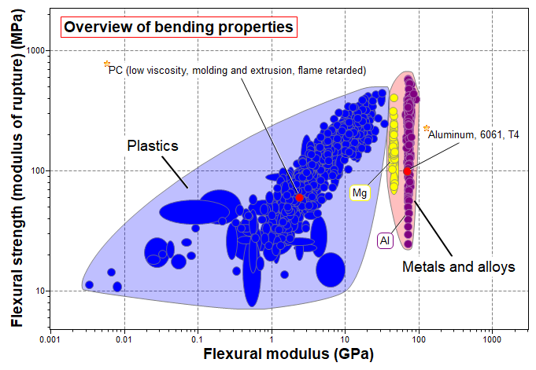
Tablet back panel casing overview
© Fredriksson, Petruccelli 2018
Notes:
An overview plot, including the 2 main material candidates, is shown in the chart above.
Flexural stiffness is important in order to protect the LCD and circuit board inside the tablet, and flexural strength is needed to prevent plastic deformation.
In the chart, thermoplastics and the light metal alloys Al and Mg are included for comparison using the custom subset feature.
By right-clicking on the material names, the candidates can be labelled, made into favorites, their bubbles brought to front and their color can be changed to red for greater visibility.
The chart shows that these candidates represent intermediate strength and stiffness. The Al appear stronger and stiffer than the polycarbonate. However, this is not a just way to compare materials for a lightweight tablet backplate.
The candidates have different densities and would have different thicknesses in this application.

Slide 7
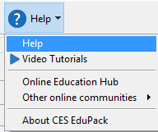
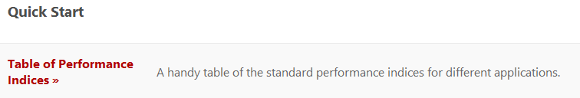

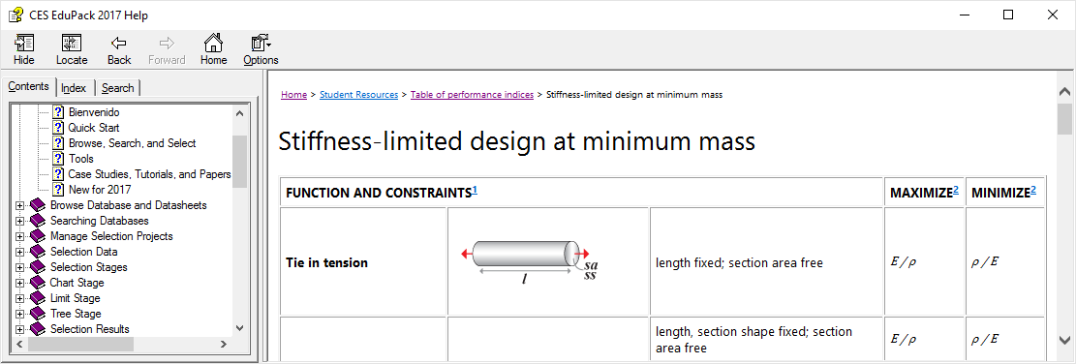
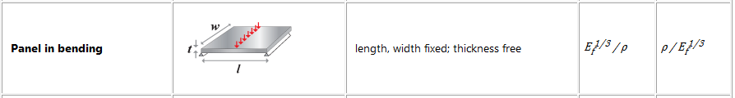
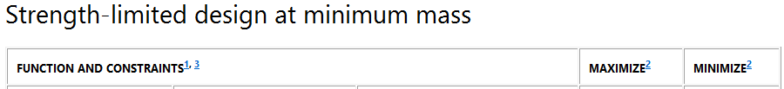

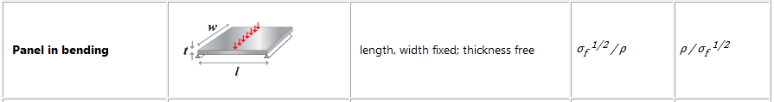
Benchmarking panel and glass
Basic Selection information
Function: Panel in bending, t free
Constraints: Existing materials
Objective: Minimize mass
Elementary
Advanced
ρ / E_{f} ^ (1/3) (flexural modulus) ρ / σ_{f} ^ (1/2) (flexural strength)
© Fredriksson, Petruccelli 2018
Notes:
Although a simple chart plotting flexural strength on one axis and flexural modulus on the other will give you an overview of material properties, benchmarking needs to be done in relation to the relevant performance index of the specific application.
For a panel in bending, with the objective to minimize mass, the indices will be combinations of properties, limited by strength and stiffness, respectively.
The performance indices for both strength-limited design and stiffness-limited design of a panel in bending are shown in the next slide.

Slide 8
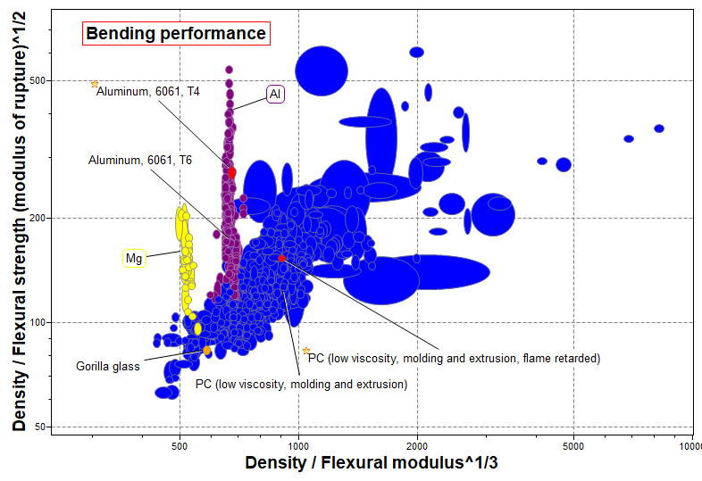
Making a relevant comparison
© Fredriksson, Petruccelli 2018
Notes:
The best way to make a fair comparison between materials is to use Performance indices
Let’s investigate mechanical performance: Flexural stiffness and Flexural strength
This plot is at Sustainability Level 3, All bulk materials (background), Limit stage with Composition overview: Hardwoods, Composite woods (green), Then highlight plywood as a reference material
Plywood compares relatively well with other woods and other materials

Slide 9
Workflow
Overview of backpanel casing material properties
- Polycarbonate, PC (Unfilled, low viscosity, molding and extrusion, flame retarded)
- Aluminum, (Al 6061, wrought alloy)
2. Benchmarking of panels and glass performance
- Bending strength and stiffness
- PC, Al
3. Critical materials and restricted substances
- US, EU, RoHS, SIN
4. Eco Audit assessment of substitution
- PC vs Virgin, Typical%, 100% recycled, Reused Al 6061
5. Reality Check
© Fredriksson, Petruccelli 2018
Notes:
Now, we have seen how EduPack is used to benchmark mechanical properties and performance

Slide 10
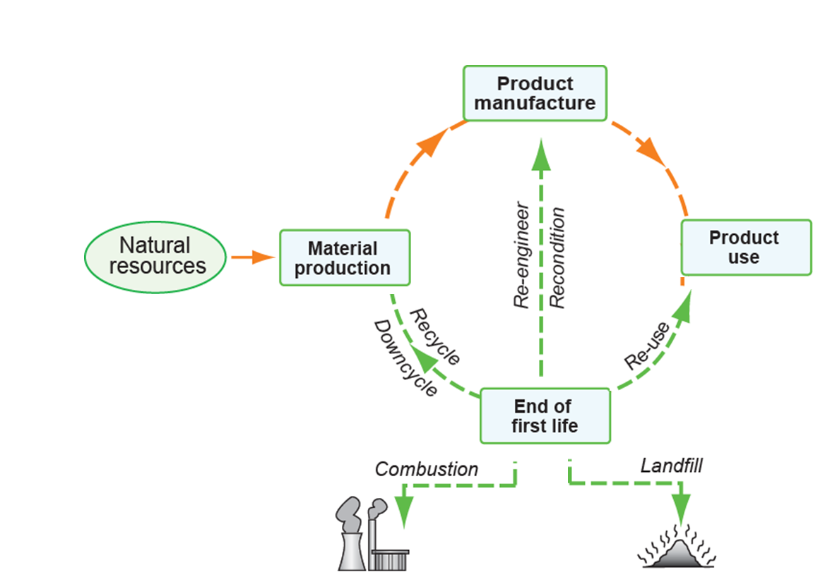
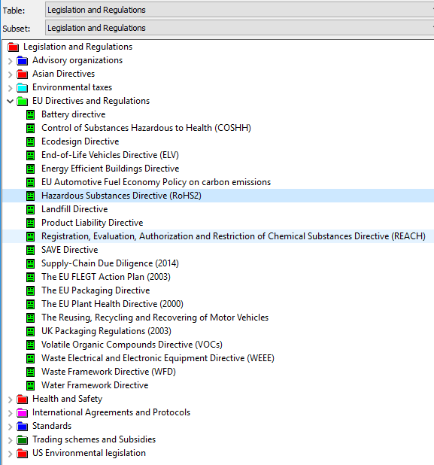
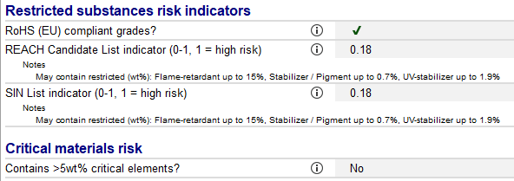
Restricted substances: Polycarbonate
Toxic and hazardous substances
“Restricted” substances: those that risk damage to human health or to the bio-sphere
© Fredriksson, Petruccelli 2018
Notes:
Let’s have a look at the risks related to the life cycle of a product such as a tablet device. Here, we will focus on potential restricted substances related to the polycarbonate.
Restricted substances are linked to several phases of the life cycle of the product;
The compliance of the materials depends on the specific substances used in the materials. For example, a flame retarded polymer could contain Brominated flame-retardants, which are restricted.
In the sustainability database, there is a data-table on Legislation and Regulations that provides a summary of the most important materials-related legal requirements, such as the latest RoHS2 directive and REACH legislation.
In this example, Restricted substances indicators show that our polycarbonate polymer could contain a variety of restricted additives.
The significant risk value of 0.18 shows that it will be important to select a specific grade of this polymer, that is intended for electronic devices to be sold globally

Slide 11
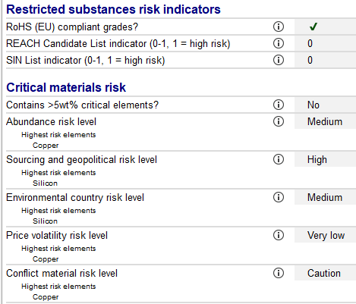
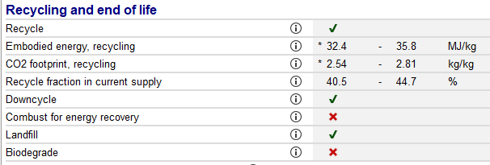
Restricted substances: Aluminum
(excerpt from Polycarbonate)
(excerpt from Al 6061)
RoSH2 compliant grades are below listed weight %:
0.1% Lead
0.1% Mercury
0.01% Cadmium
0.1% Hexavalent chromium (VI or Cr6+)
0.1% Polybrominated biphenyls (PBB)
0.1% Polybrominated diphenyl ether (PBDE)
(excerpt from Al 6061)
© Fredriksson, Petruccelli 2018
Notes:
Let’s now compare with the selected grade of aluminium,
The Al 6061 option, shown to the right, appears better from a restricted materials perspective.
Metals and alloys that always contain restricted metals as part of their composition are not compliant, while those that may contain these metals as impurities (i.e., not always present) are assumed to have compliant grades available. Al 6061 passes this test; risk=0
Flame retardants are also problematic for recycling. Although flame retarded unfilled PC can theoretically be recycled, it would require a closed materials loop, since its properties are different from other grades of PC due to the additive.

Slide 12

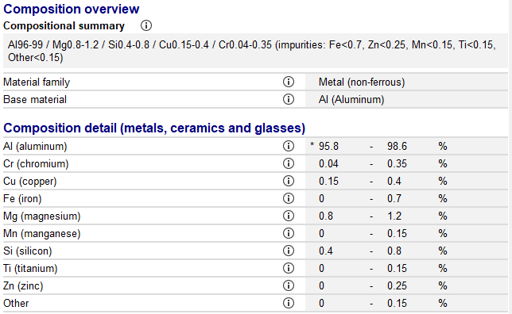
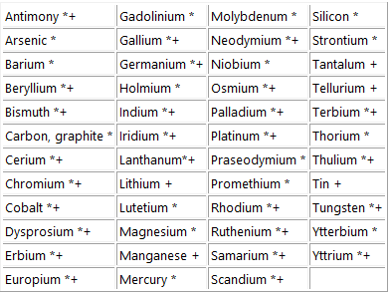
Critical materials and Elements: Al 6061
“Critical” Elements: essential for economic or security reasons, for which supply is uncertain
Supply chain constraints
(excerpt from Al 6061)
© Fredriksson, Petruccelli 2018
Notes:
Critical materials aspects are linked to the first phase of a product’s life-cycle
Critical elements are not universally defined, but the concept represents an assessment of the current and future supply risk of an element and the difficulty of substituting the function they are providing;
In CES EduPack, there is a compositional summary and composition detail for all materials at Level 3
The EU and US have both published lists of critical elements which are included in CES EduPack. The 2017 lists is shown here (updated for 2018).
Al 6061 does not contain significant amounts of any critical element (Cr, Si, Mn and Mg are critical, though)

Slide 13
Workflow
Overview of backpanel casing material properties
- Polycarbonate, PC (Unfilled, low viscosity, molding and extrusion, flame retarded)
- Aluminum, (Al 6061, wrought alloy)
2. Benchmarking of panels and glass performance
- Bending strength and stiffness
- PC, Al, Gorilla glass
3. Critical materials and restricted substances
- US, EU, RoHS, SIN
4. Eco Audit assessment of substitution
- PC vs Virgin, Typical%, 100% recycled, Reused Al 6061
5. Reality Check
© Fredriksson, Petruccelli 2018
Notes:
We will now use EduPack to assess the effects of a possible substitution

Slide 14

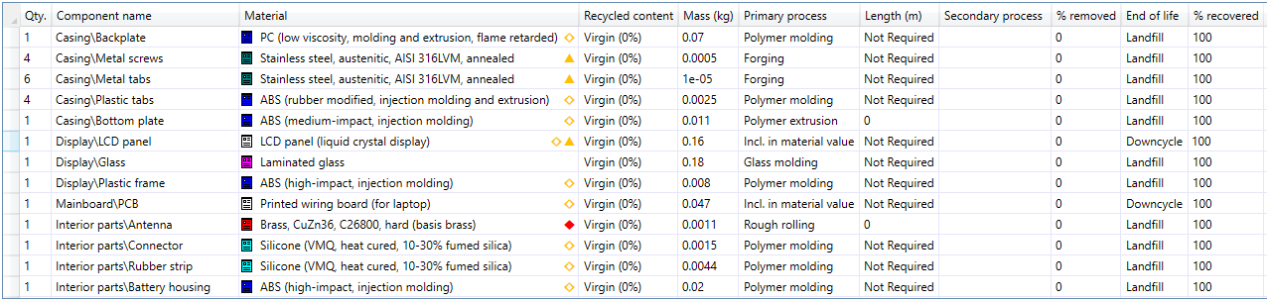
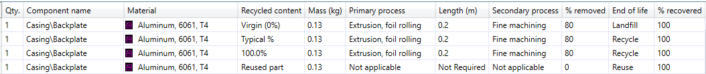
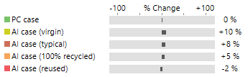
Eco Audit of changes, substituting PC by Al
Manufacture: China, Country of use: Europe, Life: 2 year,
Transport, Sea: 22000 km, Usage: 10 W, 250 days/yr, 1 h,
Bill of Materials (adapted from: Tehan & Kandlikar, Environ. Sci. Technol. 2013, 47, 3997−4003)
Polycarbonate (flame-retarded):
Al 6061 replacing PC above:
© Fredriksson, Petruccelli 2018
Notes:
Substituting flame-retarded PC with Al 6061 in the backplate of the casing, we remove the risk of restricted substances in the material by design and improve the recyclability.
A simplified generic BOM for a tablet with PC casing is given below. Secondary processes and material removal are neglected here.
We have assumed Transport to be 22 000 km of sea freight (Shanghai to Rotterdam) for use (charging) in Europe, 10 W, 1 h, 250 days/year.
We compare with 4 different scenarios of Al: (i) Virgin material; (ii) Typical reused fraction; (iii) 100% recycled; and (iv) reused.
The color coding for the diagram is shown at the bottom

Slide 15
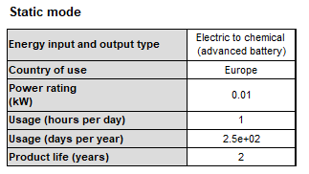
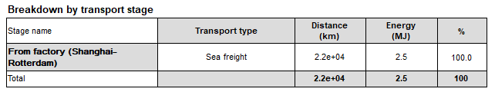
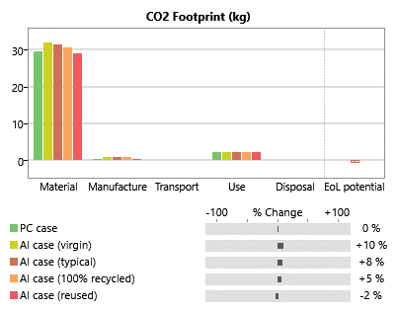
Summary Chart
© Fredriksson, Petruccelli 2018
Notes:
The Eco Audit Summary give an overview of which life phase has the largest contribution (Material)
We have worked with a static use phase, charging batteries 1 h every day, 250 days/year
The aluminium substitution represents a 10% increase in both energy use and CO₂ footprint, due to higher mass of the component and the machining process needed to manufacture it. Nonetheless, the higher impact of the Al casing solution can be offset by the use of recycled materials and recycling at the End of life.
In total, closed loop aluminium reuse results in slightly less (2%) energy use and CO₂ footprint than PC

Slide 16
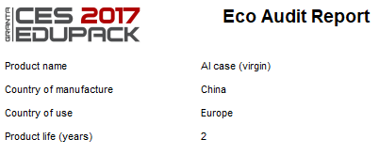
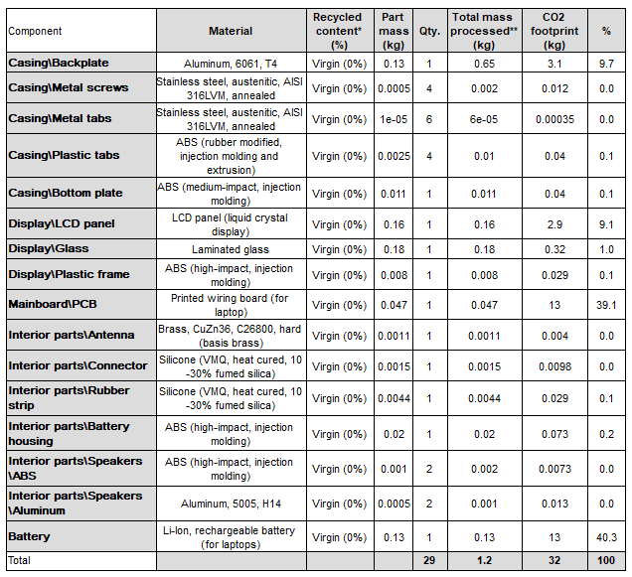
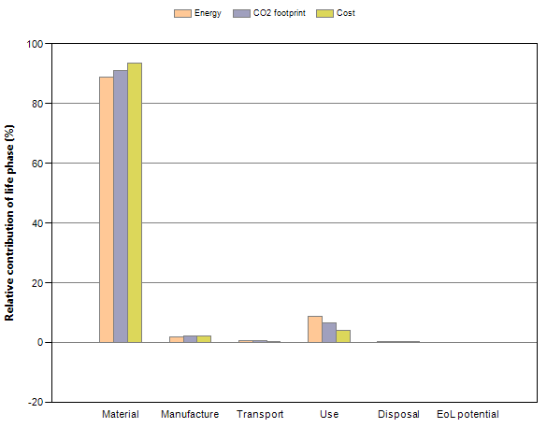
Detailed report
Detailed breakdown of individual life phases, Material (CO₂):
Summary:
© Fredriksson, Petruccelli 2018
Notes:
The Eco Audits also give numerical values and additional information to work with
We know that material is the most CO2 emitting phase of the life-cycle, so how to improve?
The detailed Eco Audit report gives the necessary numerical data. Here the mainboard PCB and battery are both ~40%

Slide 17
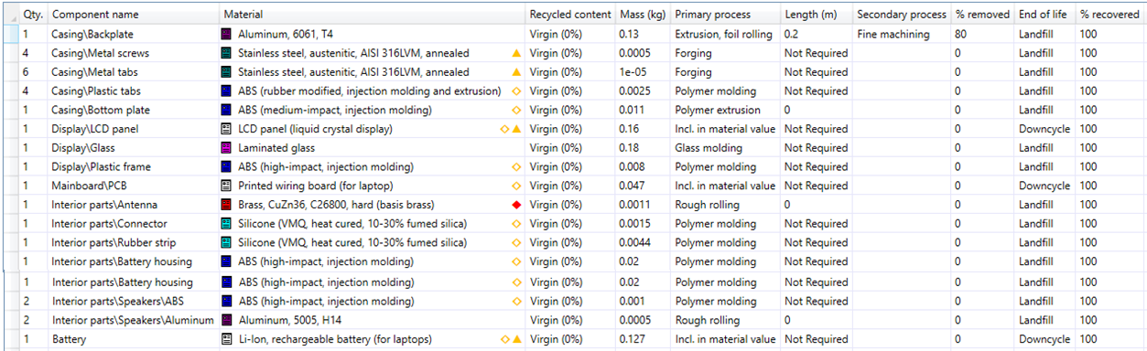
Reality check iPad2
Restricted and hazardous materials eliminated
Beryllium,
Mercury
Lead,
Arsenic,
PVC,
Phtalates,
Brominated flame retardants
Recovered 2016 from iPhone 6:
1 metric ton of gold ($40 million)
1360 tonnes of copper
2040 tonnes of aluminum
© Fredriksson, Petruccelli 2018
Notes:
The Eco Audits are based on a Bill of materials for Kindles and iPad2 from the reference given before and in the Case study paper

Slide 18
Questions
Contact details:
Tatiana Vakhitova @ ansys.com
Claes Fredriksson @ ansys.com
Education & Collaborative Projects Teams @ ANSYS Granta
http://www.grantadesign.com/education/
http://www.grantadesign.com/company/collaborations/
© Fredriksson, Petruccelli 2018

Slide 19


















www.suscritmat.eu
Sustainable Management of Critical Raw Materials

