Slide 1

Sustainability Assessment
Dr Tatiana Vakhitova (presenter) and Prof Mike Ashby
ANSYS Granta at ANSYS Inc. / University of Cambridge
© Vakhitova, Ashby, 2020
Notes:
[slide 1]
Hello all, I am Tatiana Vakhitova. I work for ANSYS Granta Academic Relations team. I have a PhD from Engineering Department at the University of Cambridge and work on development of sustainability teaching resources with Prof Mike Ashby. I will tell you about our approach to sustainability assessment also described in Mike’s book Materials and Sustainable Development.

Slide 2
5-step Methodology: Mission
  Mission
  Provide framework and toolkit for critical, independent discussion
  of a proposed Sustainable Development proposal
© Vakhitova, Ashby, 2020
Notes:
[slide 2]
What is the Mission with 5-step method for sustainability assessment –
To Provide framework and toolkit for critical, independent discussion of a proposed Sustainable Development proposal

Slide 3

The three essential Capitals
Natural
capital
Manufactured
capital
Human and Social capital
© Vakhitova, Ashby, 2020
Notes:
[slide 3]
You all know about 3 pillars of sustainability – planter profit people. We like to think of those key components in terms of capitals, like here – natural, manufactured and human/social and their interaction. Capital is an asset, which you can conserve, build up, draw down, use to convert to other services and goods – each of these is a capital in its own sense - they all have associated accumulated value. Natural capital derives from resources of the world (earth crusts and oceans); manufactured – is our built environment, infrastructure of all sorts; human & social represents level of education, culture and other intangible values of people. How our developments and in this case proposals of sustainable technologies, like e-cars, affect those?

Slide 4


What are we trying to achieve?
What is a “Sustainable” Development?
One that provides needed products or services in ways that minimize the drain on resources, is legal, economically viable and acceptable to all stakeholders.
“Half of all new cars must be electric by 2030
to meet EU emission targets”
– The Times, 26 November (2015)
Articulation icon
© Vakhitova, Ashby, 2020
Notes:
[slide 4]
What is a “Sustainable” Development?
One that provides needed products or services in ways that minimize the drain on resources, is legal, economically viable and acceptable to all stakeholders.
Let us look at a statement from 2015: “Half of all new cars must be electric by 2030 to meet EU emission targets”
The year does not play a huge role, as the target for e-cars only increases.
This statement is our articulation, the icon is on the right.

Slide 5
Defining Articulation
Objective
Size scale
Time scale
Any articulation has an
“Meet EU emission targets” = Objective
“Half of all new cars” = Size scale
(40 m/year globally, 7 m/year Europe)
“By 2030” = Time scale (11 years)
© Vakhitova, Ashby, 2020
Notes:
[Slide 5]
Any articulation has Objective, Size and Timescale
In a case of e-cars: “Meet EU emission targets” = Objective
“Half of all new cars” = Size scale (40 m/year globally, 7 m/year Europe)
“By 2030” = Time scale (11 years)

Slide 6




5-step Methodology
1. What’s the proposal? How big? How soon?
2. Who will be affected? What are their concerns?
3. FACTS about the Articulation & Stakeholder concerns?
4. What impact on the 3 Capitals?
5. Reflection: consider alternatives.
© Vakhitova, Ashby, 2020
Notes:
[Slide 5]
In 5-step Methodology, after we have defined the Objective, we will need to Identify Stakeholders and their concerns.
Stakeholder is Anyone profiting from or affected by the proposal. In case of e-cars these include Among others:
Government;
The public
Local communities
Owners
Manufacturers
Lobbyists
Investors
The third step is Fact finding: here we look at the implications for resource-related and human-related factors, such as Materials Energy Environment Legislation Economic Society
Forth step - Form a judgement about an impact on 3 capitals and Fifth – Reflection.
Let’s look at the 3 remaining steps in the case of e-cars in more details.

Slide 7




Which facts?
?
?
?
© Vakhitova, Ashby, 2020
Notes:
[slide 7]
3d step – fact finding
We need to research FACTS About the articulation & stakeholder concerns:
What resource demands? What environmental impacts? What social implications?….
In case of e-cars:
What is the carbon footprint of grid electricity?
What materials? How much lithium, cobalt?
What about supply chain?
Consumers acceptance of higher price, limited range?
We will use Tools & Data in Granta’s EduPack:
Eco Audit with Costing function;
Social Impact Audit Tool;
Social, Economic and Legal Data from Nations of the World;
Database on Materials and Processes with eco data and information on criticality and restricted substances

Slide 8
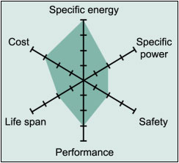
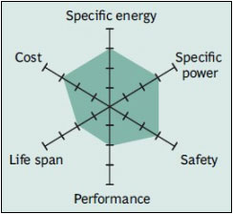
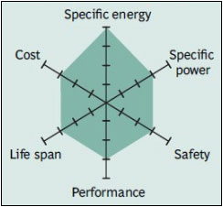
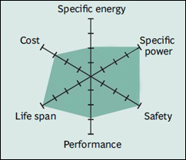
Li-ion types of batteries
Lithium Cobalt Oxide (LCO)
Lithium Manganese Oxide (LMO)
Lithium Nickel Manganese Cobalt Oxide (LiNiMnCoO₂ or NMC)
Lithium Ferrite Phosphate (LFP)
Source: http://batteryuniversity.com/learn/article/types_of_lithium_ion
© Vakhitova, Ashby, 2020
Notes:
[slide 8]
Batteries for modern electric cars (and many electronic devices) are based on Li-ion technology.
Here are some of the most common ones. Here we can see why this type of battery is so popular.
It has very good overall performance, in particular specific energy; Specific energy = stored energy per mass, promotes range
The most important one is probably the LiNiMvCoO2. This has just a bit over 1 weight% Lithium and 8-9 weight% Cobalt.
This may not seem much, but it translates to around half of all industrial use of both these metals for batteries, globally.

Slide 9
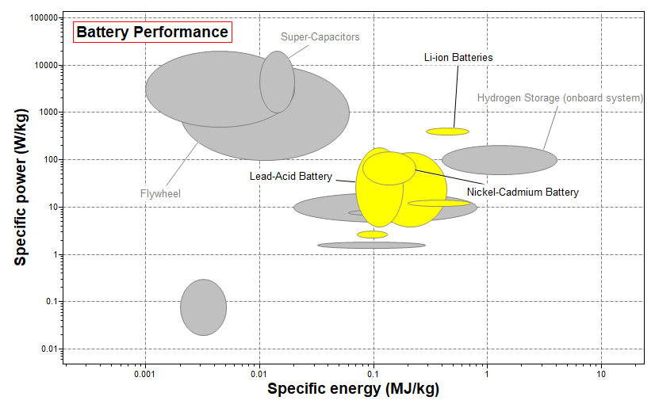
Battery performance
Specific power = power per mass, promotes acceleration
Specific energy = stored energy per mass, promotes range
© Vakhitova, Ashby, 2020
Notes:
[slide 9]
Li-ion batteries perform better than others, without lead or cadmium
Here you can see a chart, made with Granta’s EduPack, which shows how different batteries are performing in relation to specific power and specific energy.
Where: Specific power = power per mass, promotes acceleration and Specific energy = stored energy per mass, promotes range

Slide 10
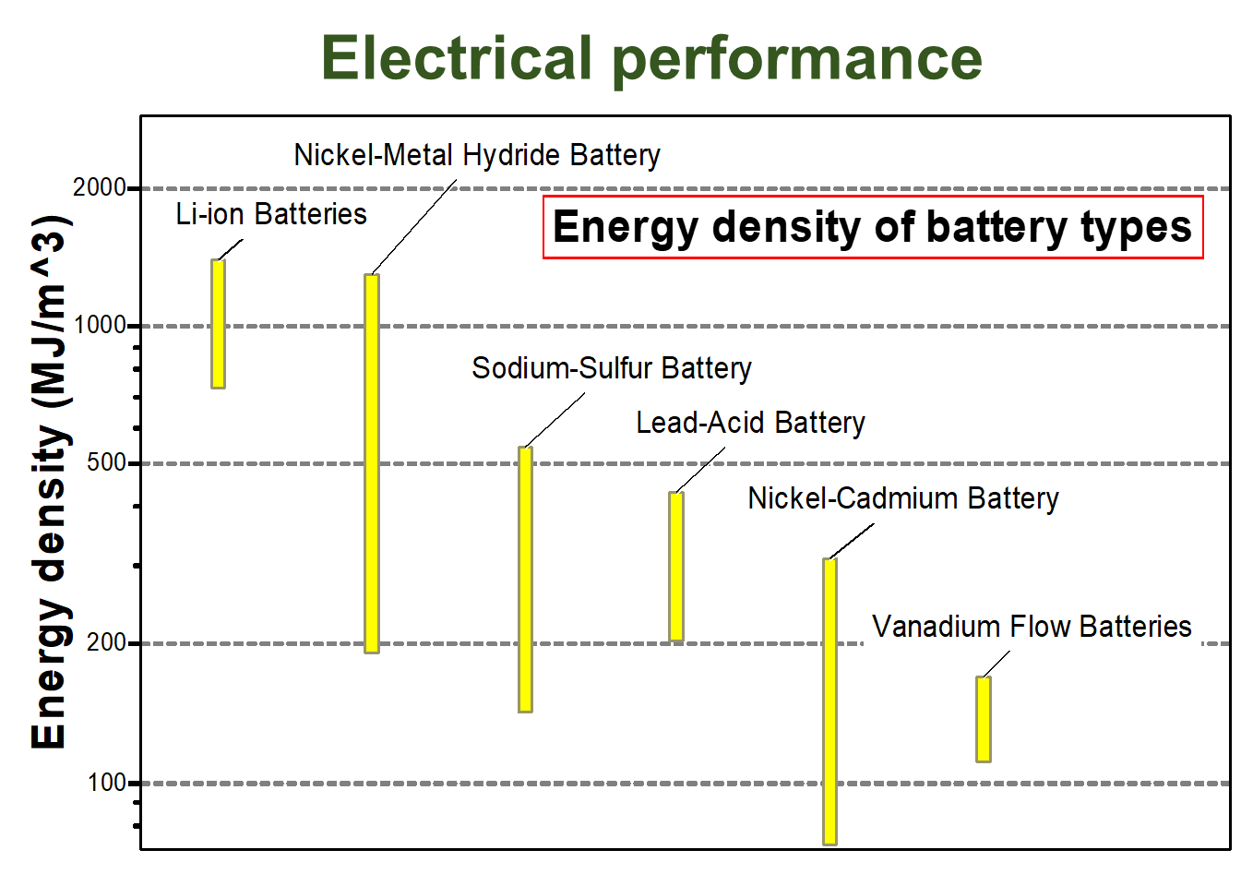
Battery performance
Another important consideration is battery space:
Energy density = stored energy per volume, aids design and comfort
Lithium is the best but, it’s on the US list of critical elements and Lithium
batteries usually contain Cobalt, which is a conflict mineral (critical EU & US)
© Vakhitova, Ashby, 2020
Notes:
[slide 10]
Another important consideration is battery space: here a chart, showing different types of batteries in terms of heir Energy Density = stored energy per volume, aids design and comfort
Lithium is the best, BUT it’s on the US list of critical elements and Lithium batteries usually contain Cobalt, which is a conflict mineral and also a critical material on EU & US lists.

Slide 11
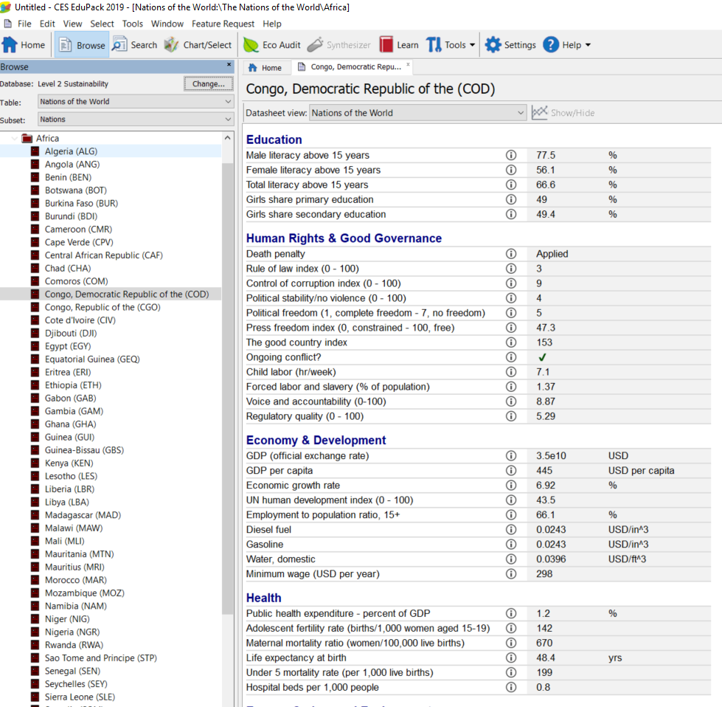
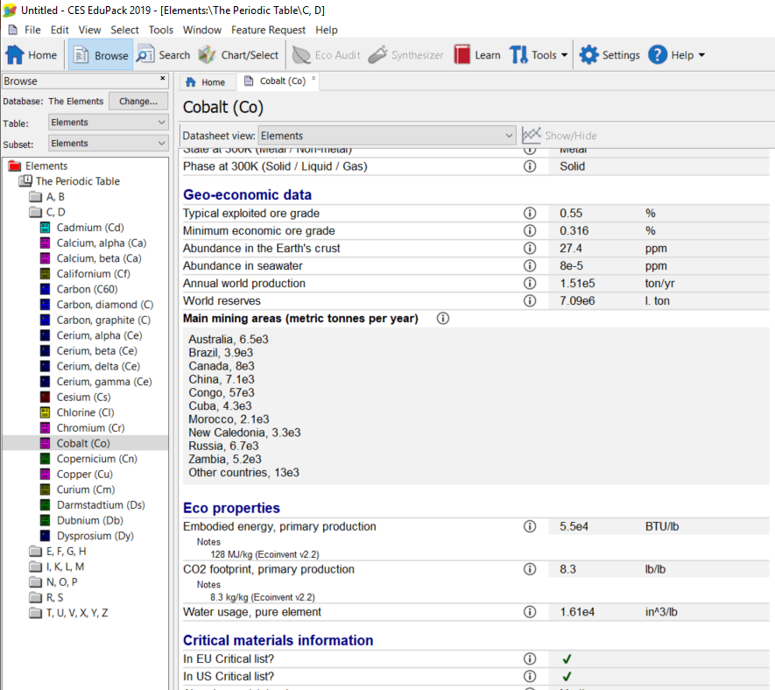
ZOOMing in on Cobalt …
© Vakhitova, Ashby, 2020
Notes:
[slide 11]
if we look at Granta’s EduPack and its Elements Database in Sustainable Development Edition, we can browse for Cobalt record.
The extract of this record provides useful information on main mining areas and criticality status of the element among other data.
Predominantly its production is happening in the Democratic republic of Congo a country with many social hotspots, with ongoing conflict.
The Nations of the World database provides detailed socio-economic data.

Slide 12
Forming a Judgement
?
?
?
?
© Vakhitova, Ashby, 2020
Notes:
[slide 12]
Getting back to our 5-step method: we now need CRITERIA to assess the implications of the facts. Here again our framework of 3 capitals will help us.

Slide 13
Impact on the Three Capitals
Natural capital
× Objective not achieved
✓ Possible if grid decarbonized
Human and Social capital
× Range anxiety not met
Battery development
Manufactured capital
× Supply chain for Li & Co in doubt
Expanded production
Social investments opportunities
© Vakhitova, Ashby, 2020
Notes:
[Slide 14]
A very short possible assessment:
Natural capital
× Objective not achieved
✓ Possible if grid decarbonized
Manufactured capital
× Supply chain for Li & Co in doubt
Expanded production
Social investments opportunities
Human and Social Capital
× Range anxiety not met
Battery development

Slide 14
Reflection: the bigger picture
?
?
?
What lay behind the proposal?
What are its strengths and weaknesses?
Long-term vs. short-term gain?
Could the objective be achieved in other ways?
© Vakhitova, Ashby, 2020
Notes:
[slide 14]
Finally – reflection: with all the facts at our disposal, here we have outlined only a few, we can now think about:
What lay behind the proposal?
What are its strengths and weaknesses?
Long-term vs. short-term gain?
Could the objective be achieved in other ways?
In the Short-term:
Objective can not be achieved
Infrastructure (material supply, battery recycling) doubtful
In the Medium-term:
Decarbonize the national grid
Create recycling infrastructure
In the Long-term:
Re-think (re-define?) car use

Slide 15
Sustainability Assessment
Dr Tatiana Vakhitova
Contact Details: Tatiana.vakhitova@ansys.com
ANSYS Granta at ANSYS Inc.
© Vakhitova, Ashby, 2020
Notes:
[Slide 15]
Thank you!

Slide 16


















www.suscritmat.eu
Sustainable Management of Critical Raw Materials

