Slide 1

Circular Product Design
Ruud Balkenende
TU Delft
© Ruud Balkenende, 2019

Slide 2
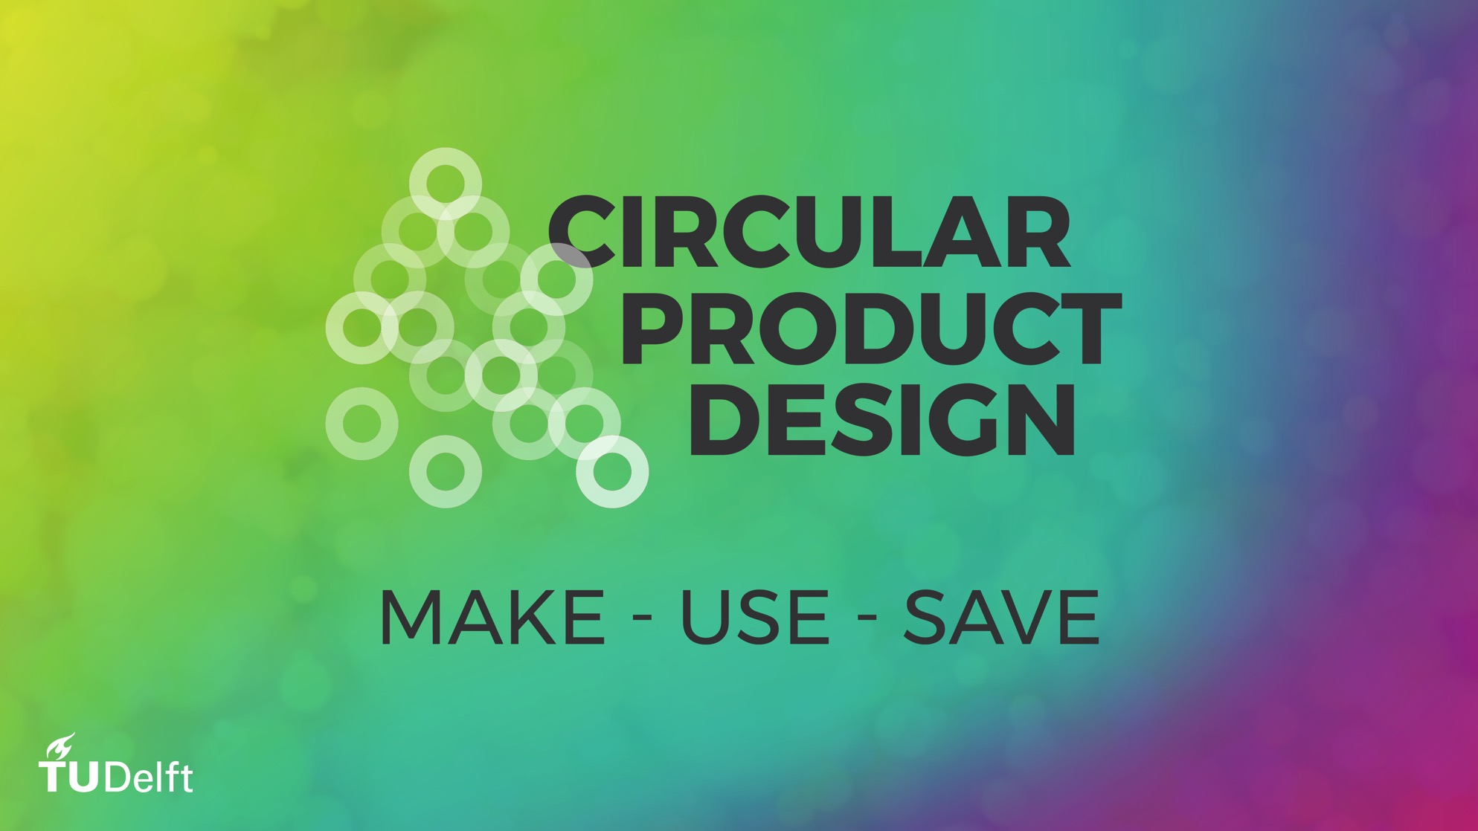
© Ruud Balkenende, 2019

Slide 3
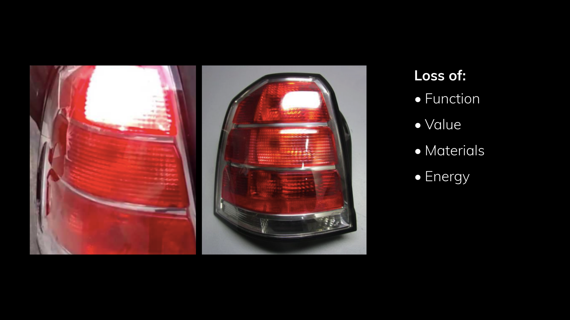
© Ruud Balkenende, 2019
Notes:
Transparent cover of rear light is damaged,
But an entirely new module is needed
→ Avoidable loss of value, functionality, materials and energy

Slide 4
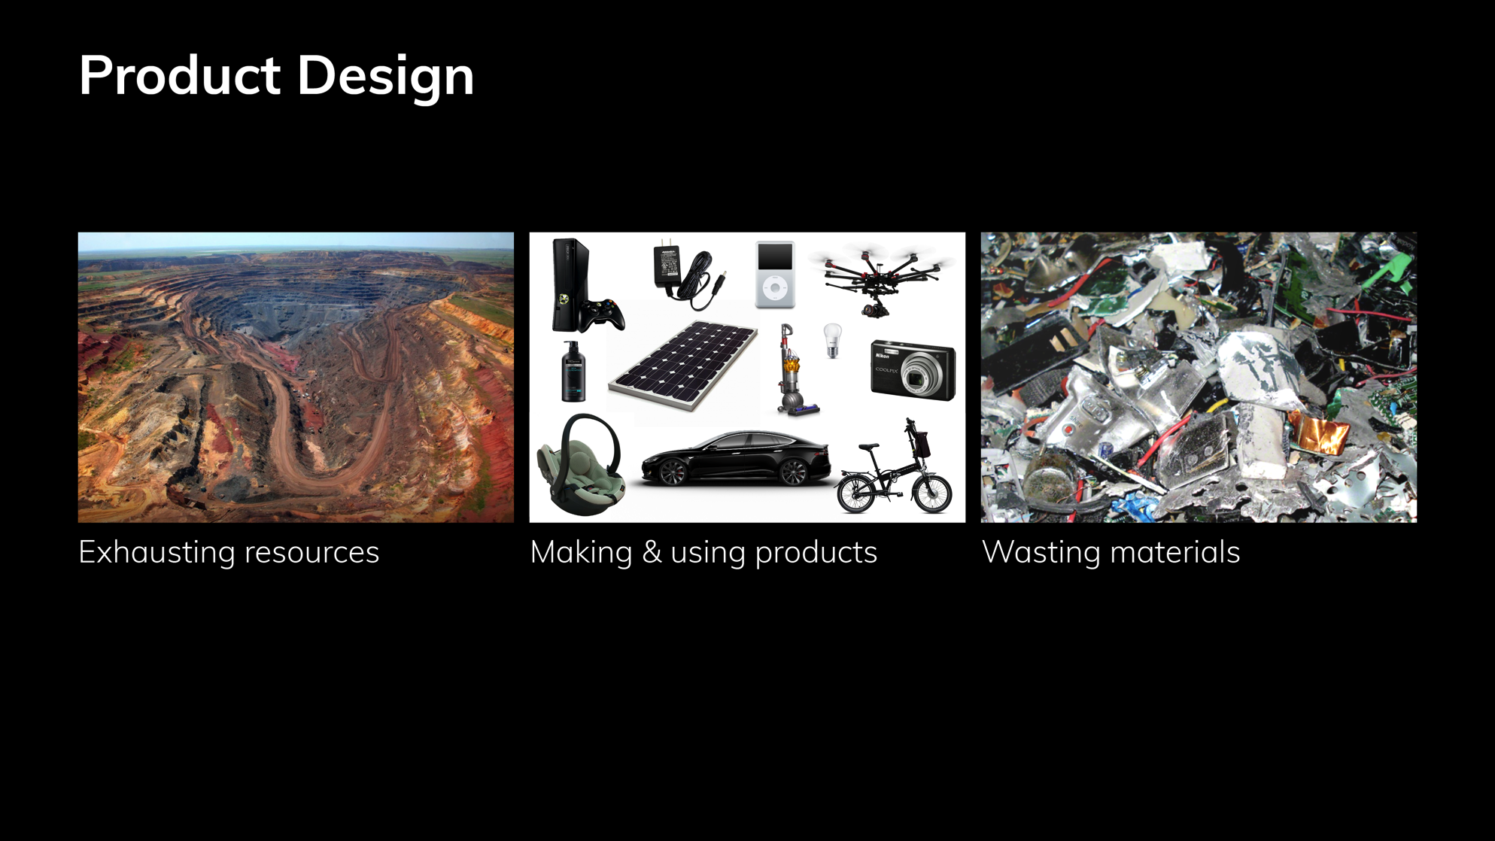
Product Design
© Ruud Balkenende, 2019
Notes:
Products are made from resources, usually taken from virgin resources. At the end of life products turn into waste. But product design should enable the reuse of products, thus avoiding extraction of resources and pollution of the environment.

Slide 5
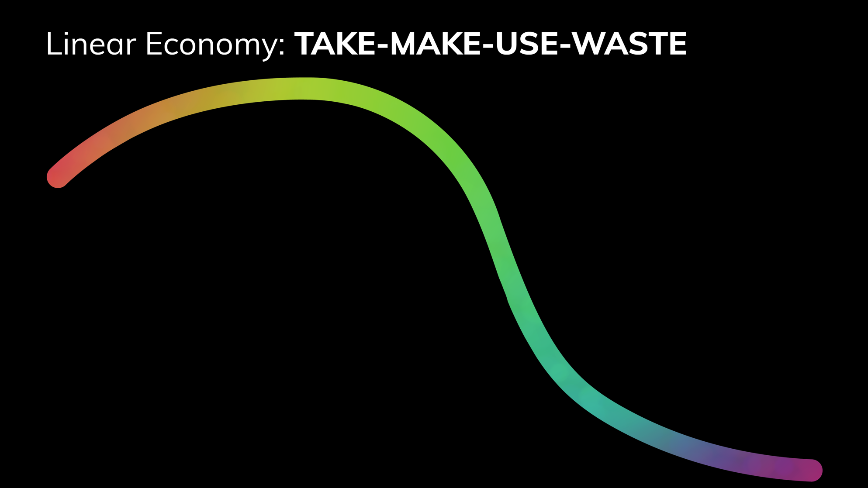
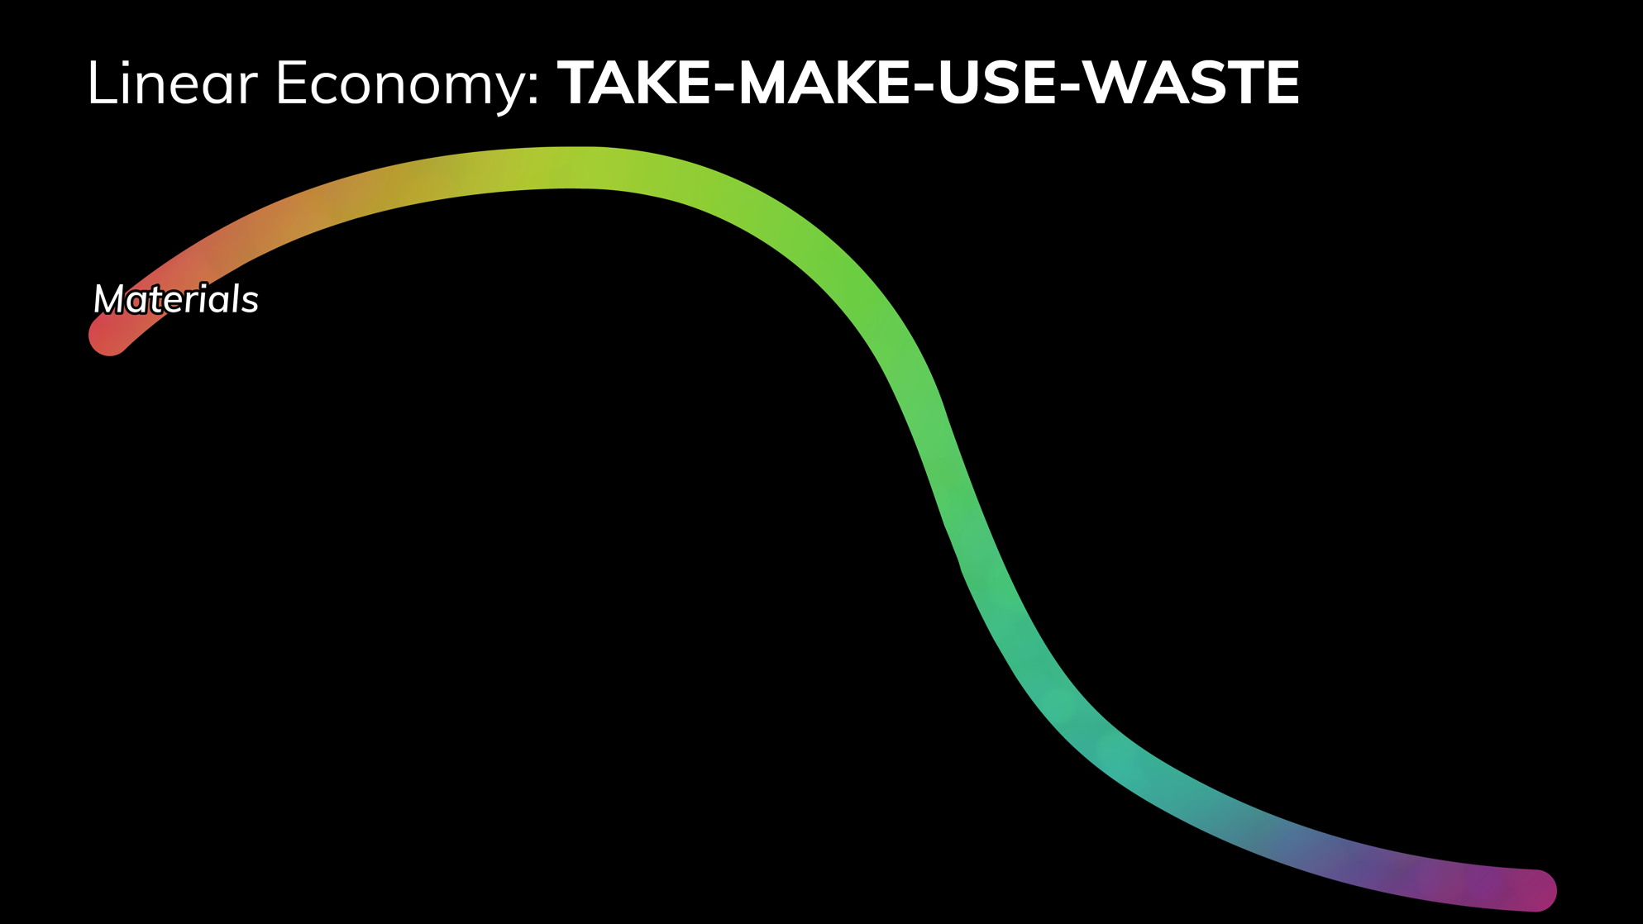

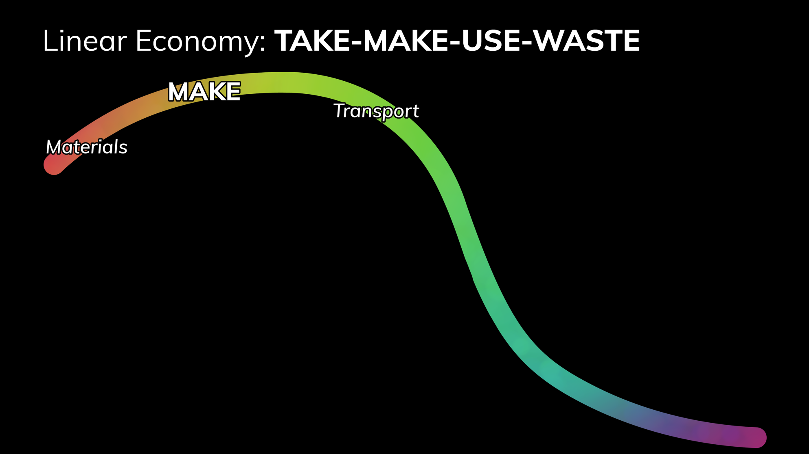
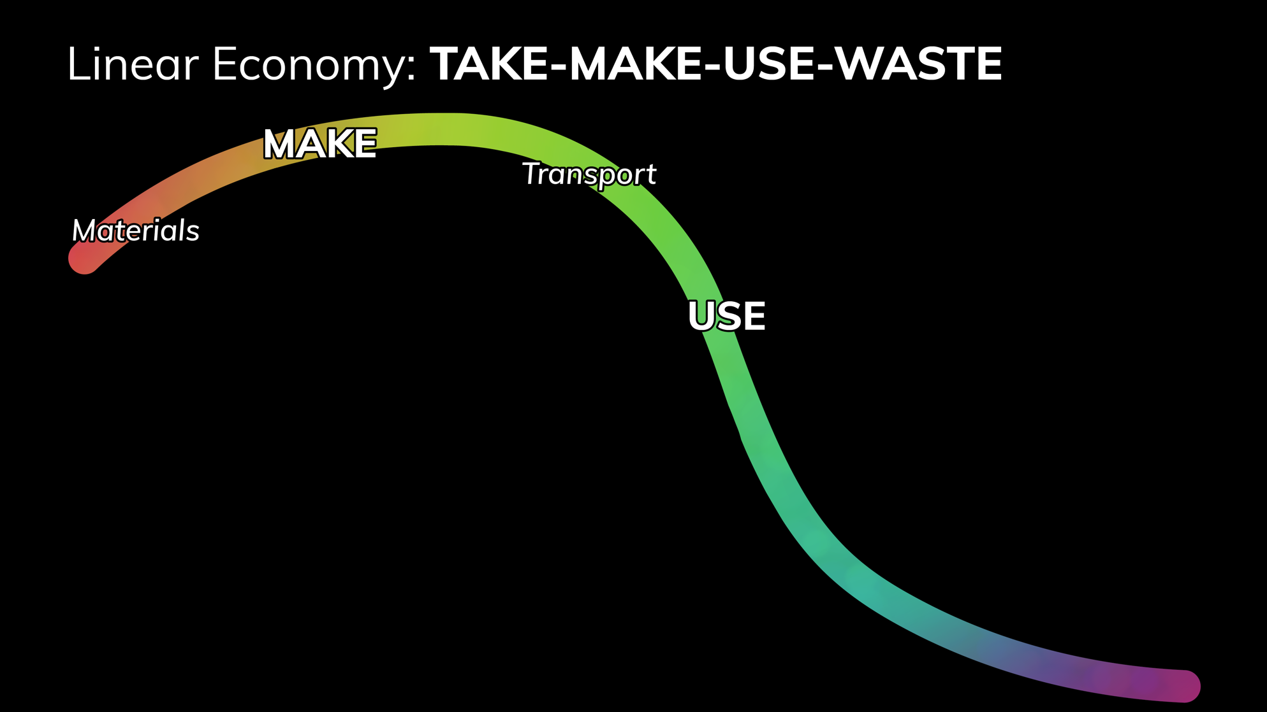
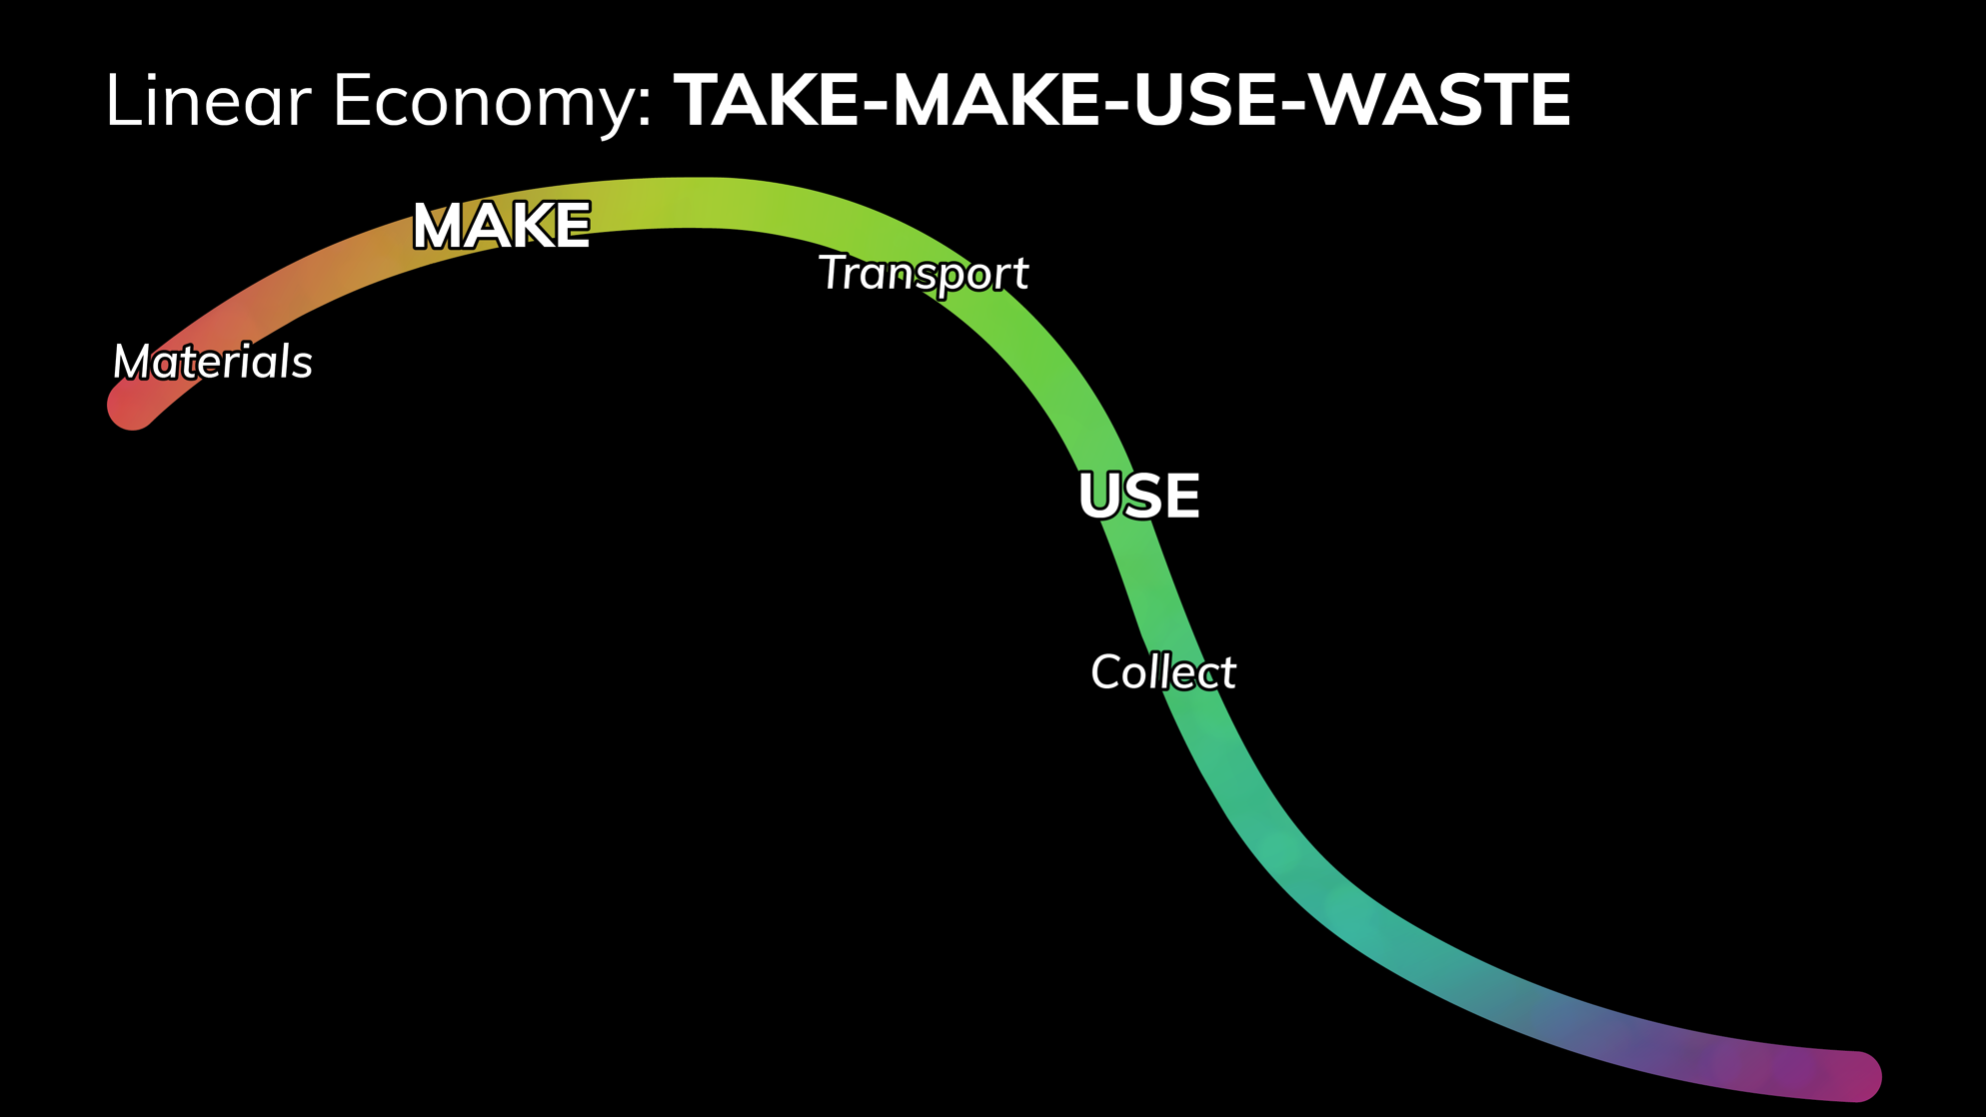

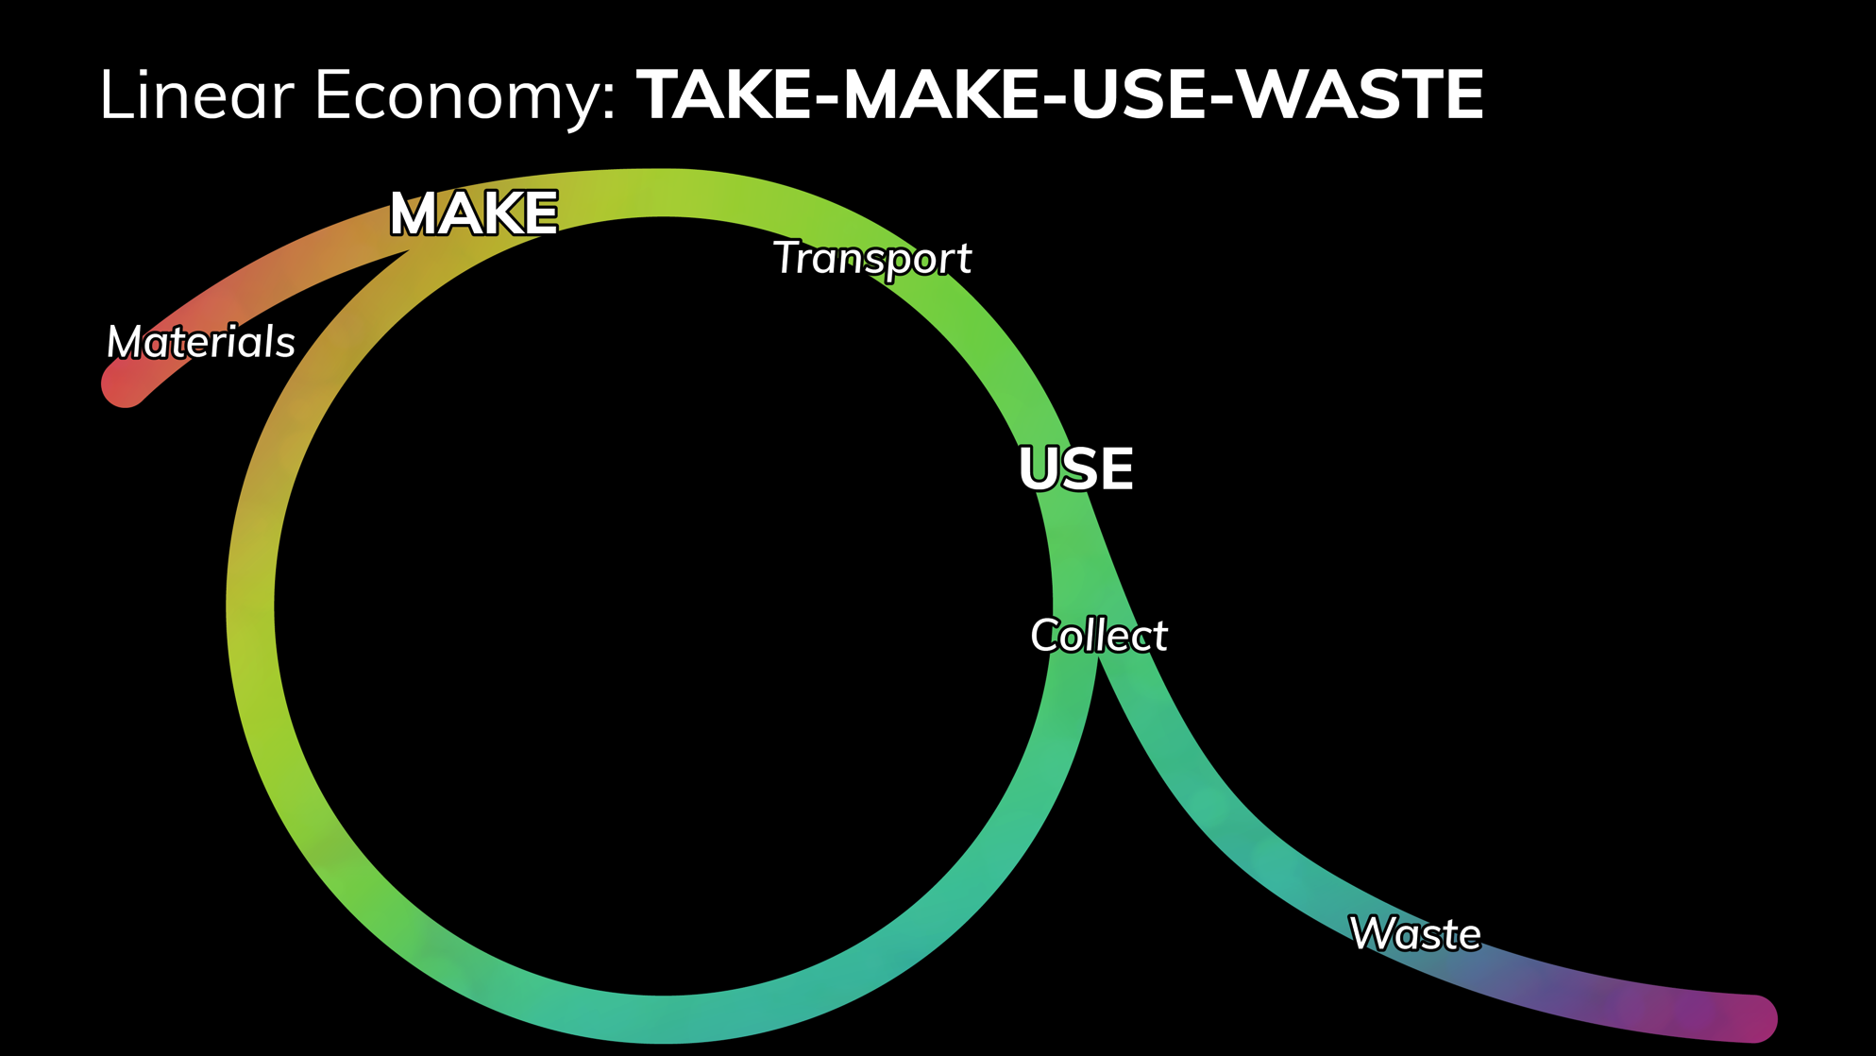
Linear Economy: TAKE-MAKE-USE-WASTE
© Ruud Balkenende, 2019
Notes:
Sequence typical for linear economy: take, make, use, waste.
This is directly related to the way products are designed and the business models that are used to put them in the market.
Although some recycling of materials occurs, this is largely coincidental from a design perspective as the ability to separate the materials from which the product is made are not considered during the design stage.

Slide 6
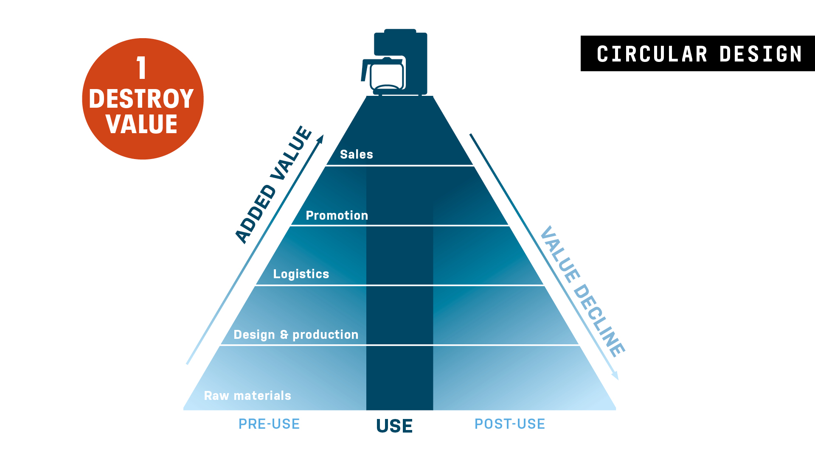
© Ruud Balkenende, 2019
Notes:
The value loss is depicted in the value hill:
At the end of the use phase almost all value that was initially generated is lost at once

Slide 7
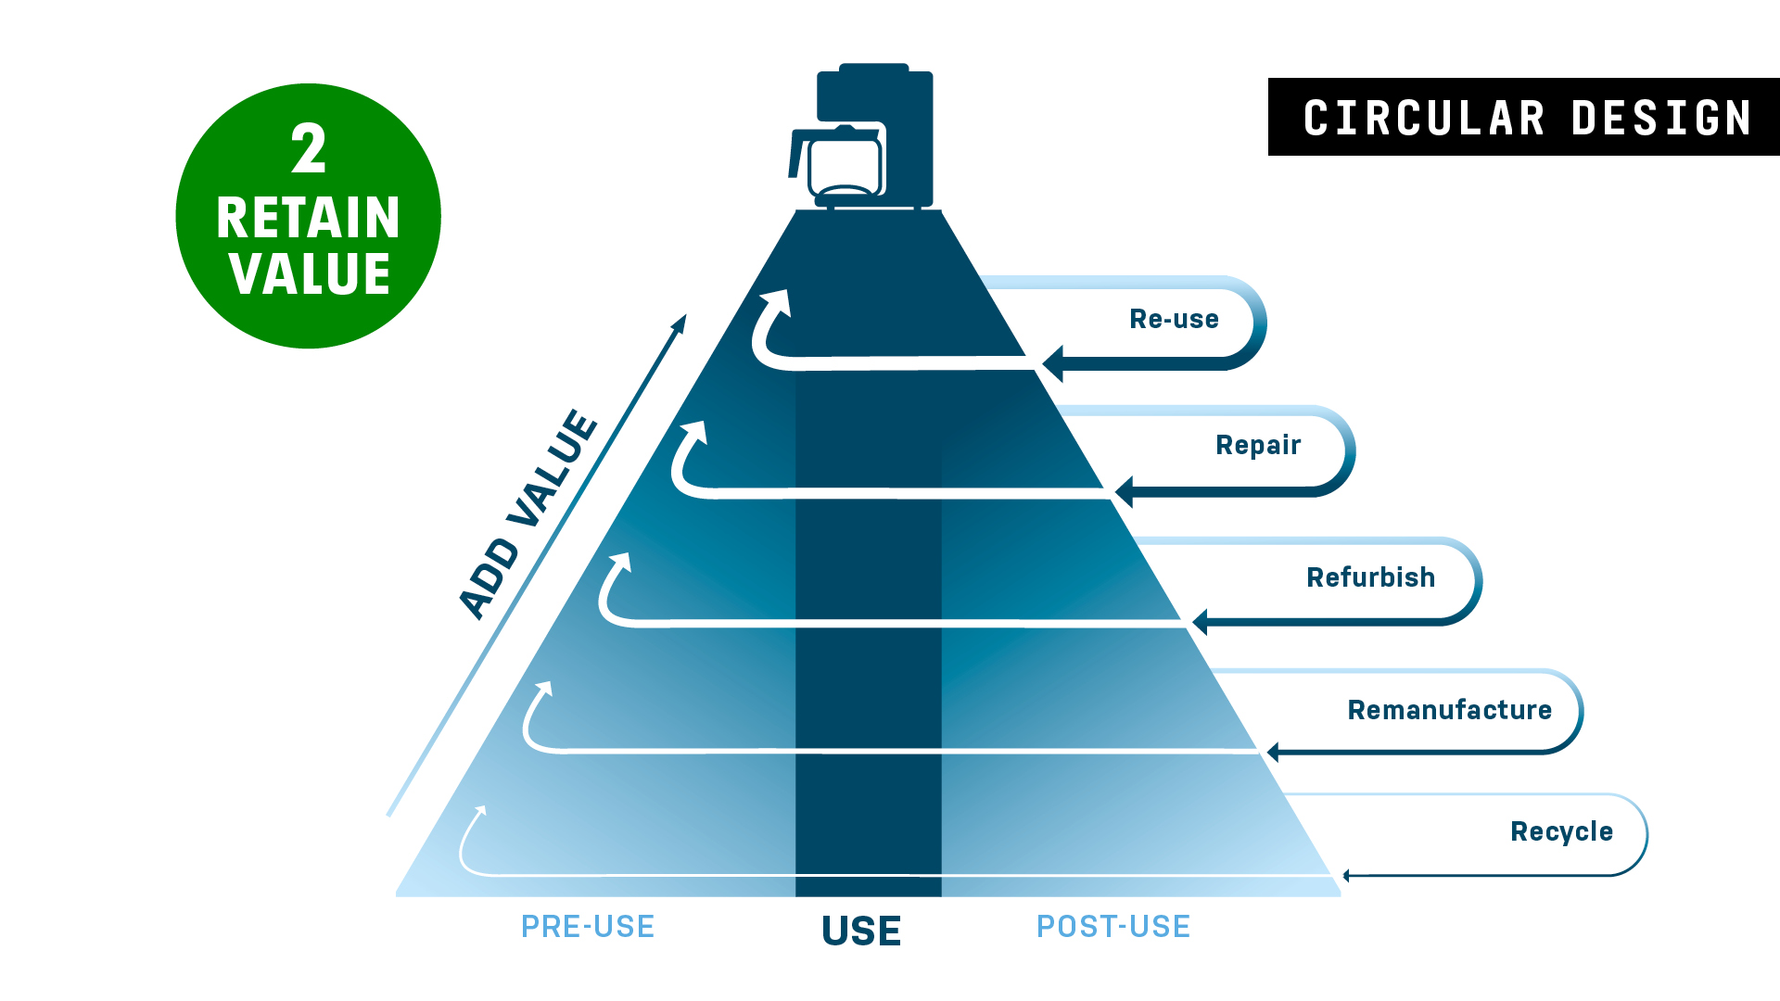
© Ruud Balkenende, 2019
Notes:
The alternative is that we keep products alive, by reusing, repairing, refurbishing and remanufacturing and eventually that we at least recover the materials through recycling.

Slide 8
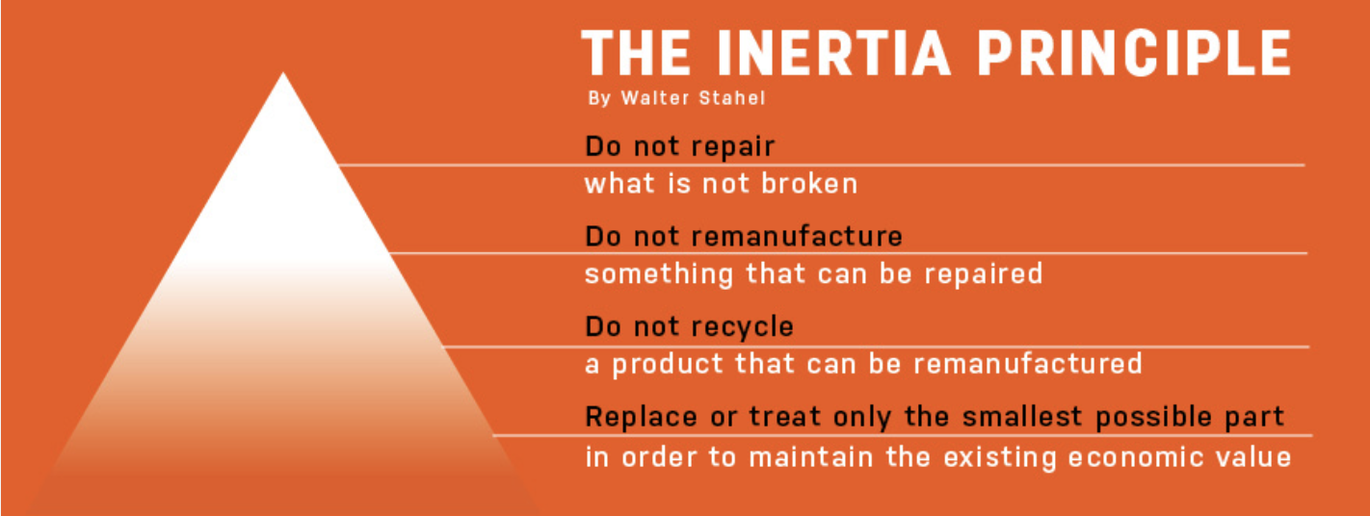
© Ruud Balkenende, 2019
Notes:
This basically comes down to the Inertia Principle as formulated by Walter Stahel (read).
Maintaining product integrity at the lowest environmental and energy cost is crucial.
Product integrity can be maintained by resisting, postponing or reversing obsolescence.
Let’s zoom into the various steps and briefly discuss what this implies for design (next slides).

Slide 9
Design for Product Integrity: resisting obsolescence
Inherently long product use
Physical durability:
designing a product that is
resistant to degradation over time.
Emotional durability:
designing a product that
stimulates feelings of attachment.
© Ruud Balkenende, 2019
Notes:
Text self-explanatory

Slide 10
Design for Product Integrity: postponing obsolescence
Design for Product Integrity : postponing obsolescence
Extended product use
Maintain:
designing a product that, with regular servicing, easily retain its functional capabilities
and/or cosmetic condition.
Upgrade:
enhancing a product’s functional capabilities and/or cosmetic condition,
relative to the original design specification.
.
© Ruud Balkenende, 2019
Notes:
Text self-explanatory

Slide 11
Design for Product Integrity : reversing obsolescence
Product recovery
Recontextualise:
designing a product to be re-usable
in a different context than it was originally designed for, without any remedial action.
Repair, refurbish and remanufacture:
designing a product to be easily brought back to working condition.
In the case of remanufacture,
the product is brought back to at least OEM original specification.
In the case of repair and refurbish,
the condition of the repaired or refurbished product may be inferior to the original specification.
© Ruud Balkenende, 2019
Notes:
Text self-explanatory

Slide 12
Design for Material Integrity: reversing obsolescence
Material recovery
Recycle
Ensuring it is easy to separate a
product’s materials from potential
sources of contamination during the
recycling process.
The reprocessed materials have equivalent properties compared to the original materials
© Ruud Balkenende, 2019
Notes:
Text self-explanatory

Slide 13

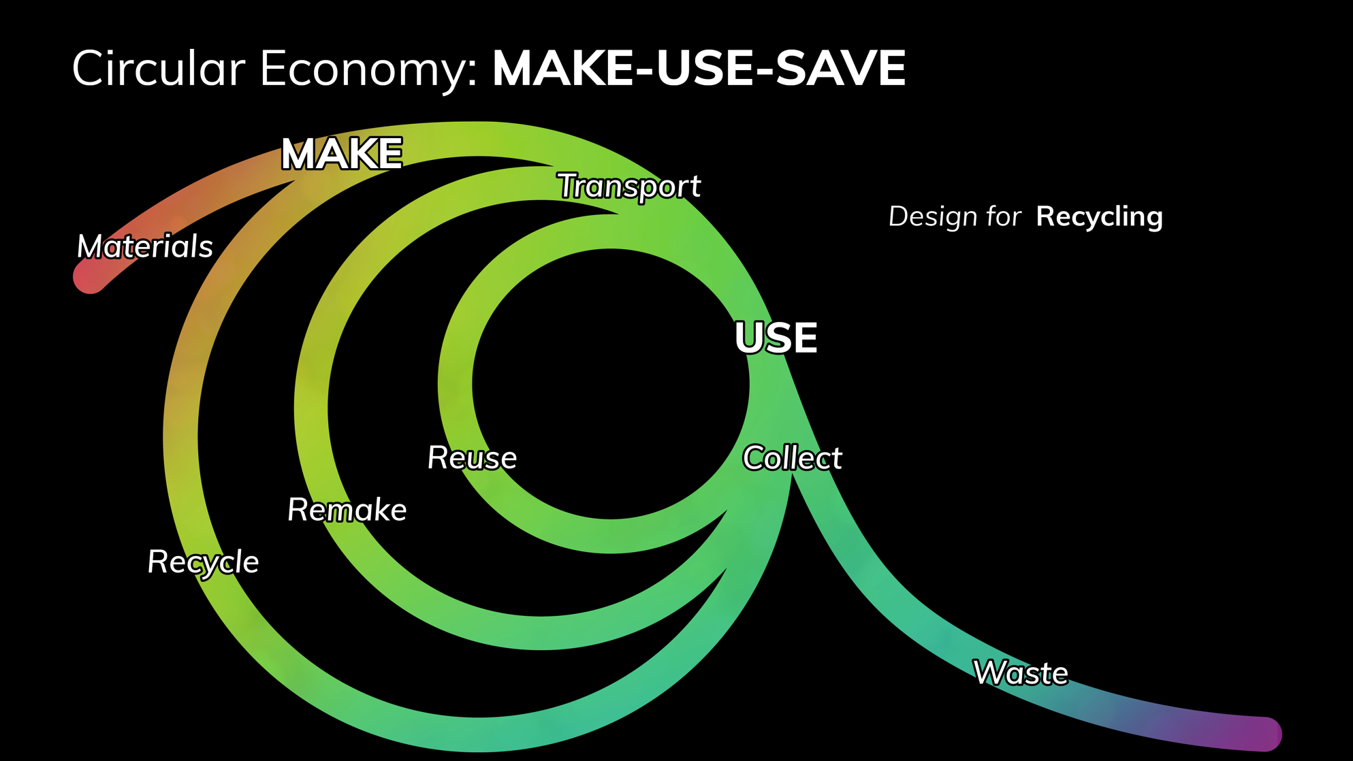
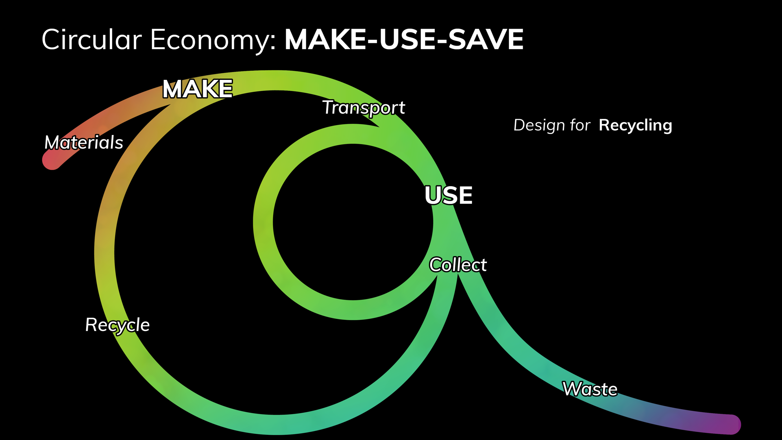
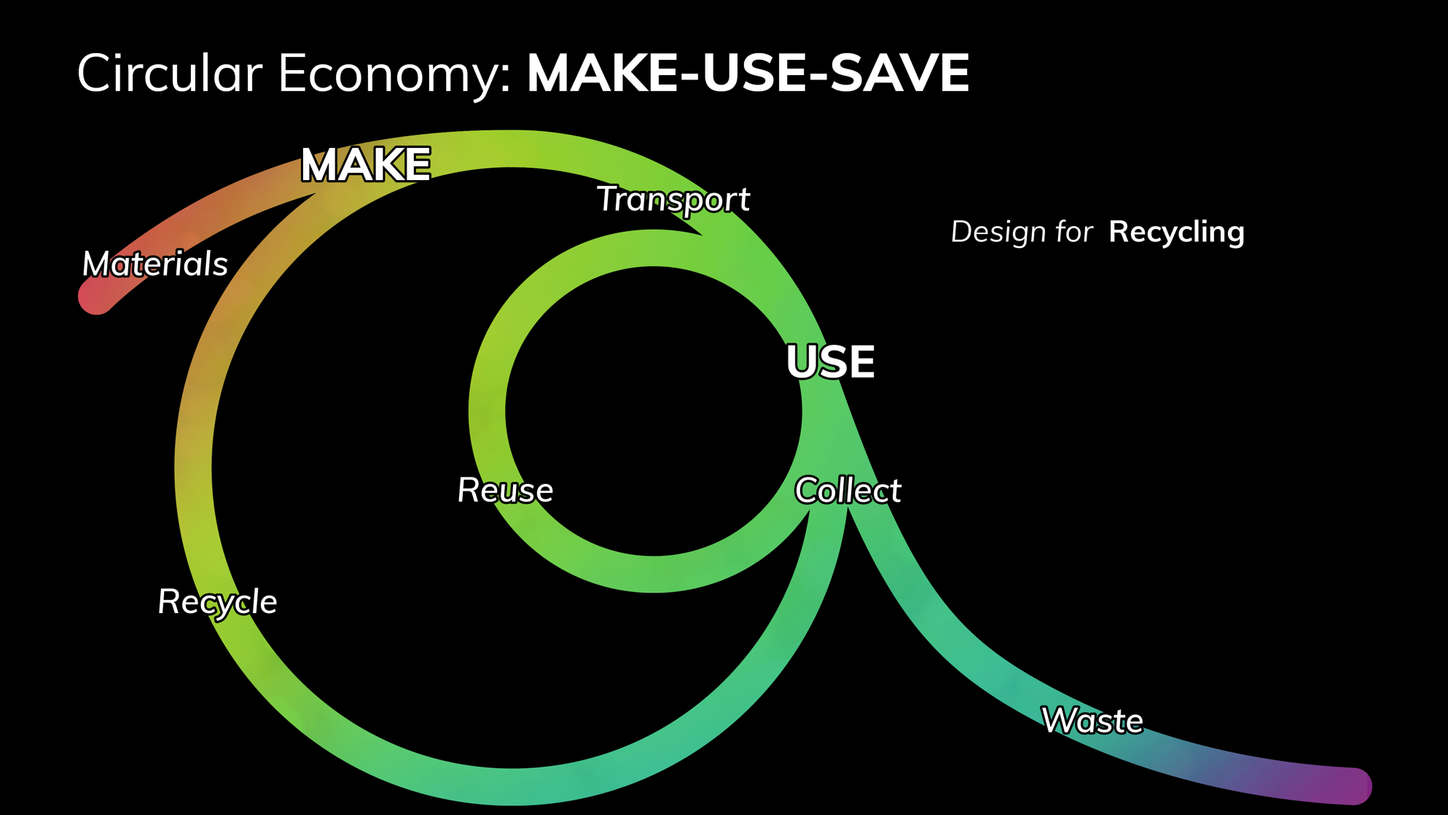

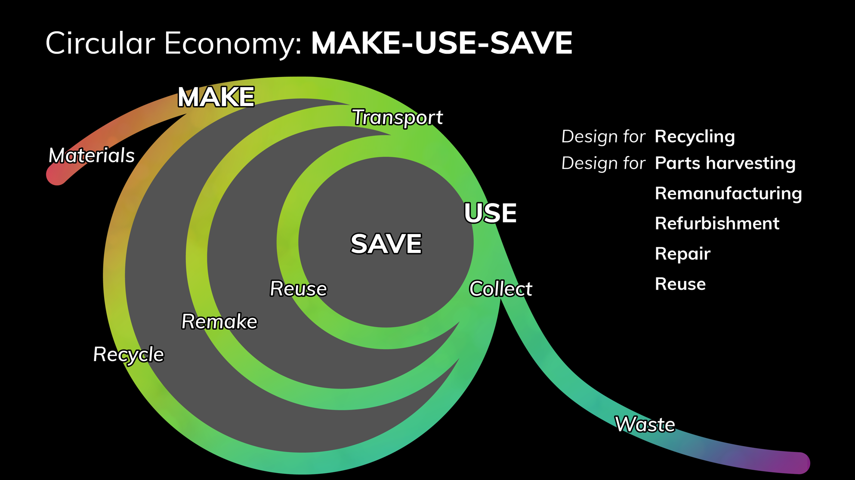
Circular Economy: MAKE-USE-SAVE
© Ruud Balkenende, 2019
Notes:
This brings us to an entire set of ways to close the loop and maintain product integrity.
The outer loop of recycling is a necessity to maintain materials, but also should be considered as a last resort, because product integrity is lost.
It is important to realize that we cannot just consider this from the technological perspective, but that recovery strategies should also be part of business strategy, as there are many economic incentives for companies to limit the lifetime of their products. In a circular economy it is key to not only design products, but also business approaches hat incentivise avoiding obsolescence. Although not the core of the current presentation some business aspects will be addressed when discussing repair and product-service systems.

Slide 14
© Ruud Balkenende, 2019
Notes:
Ellen MacArthur Foundation distinguishes bio-cycle and techno-cycle. Here we will mainly focus on the techno-cycle, which is especially useful to consider more durable and complicated products. But realize that the cascading way of dealing with renewable materials as depicted in the bio-cycle is a very interesting source of information for fast moving consumer goods.

Slide 15
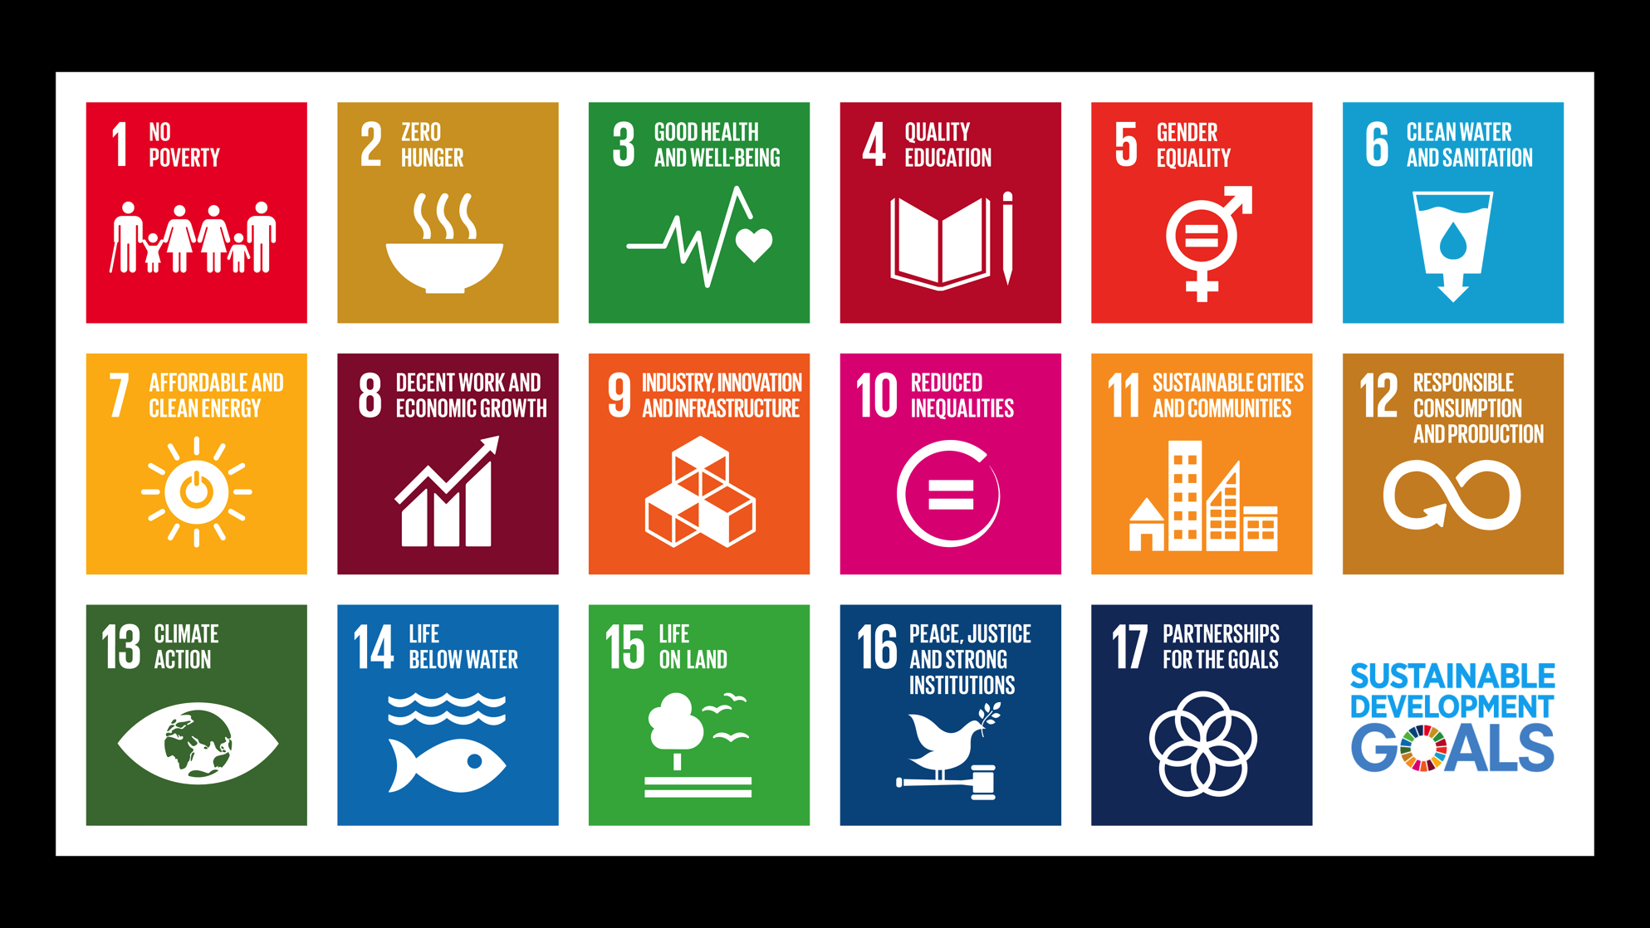
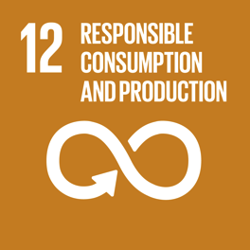
© Ruud Balkenende, 2019
Notes:
Take a step back and look at the principles underlying a circular economy.
These are based on the SDGs, and for design especially SDG 12 on responsible consumption and production is important.

Slide 16
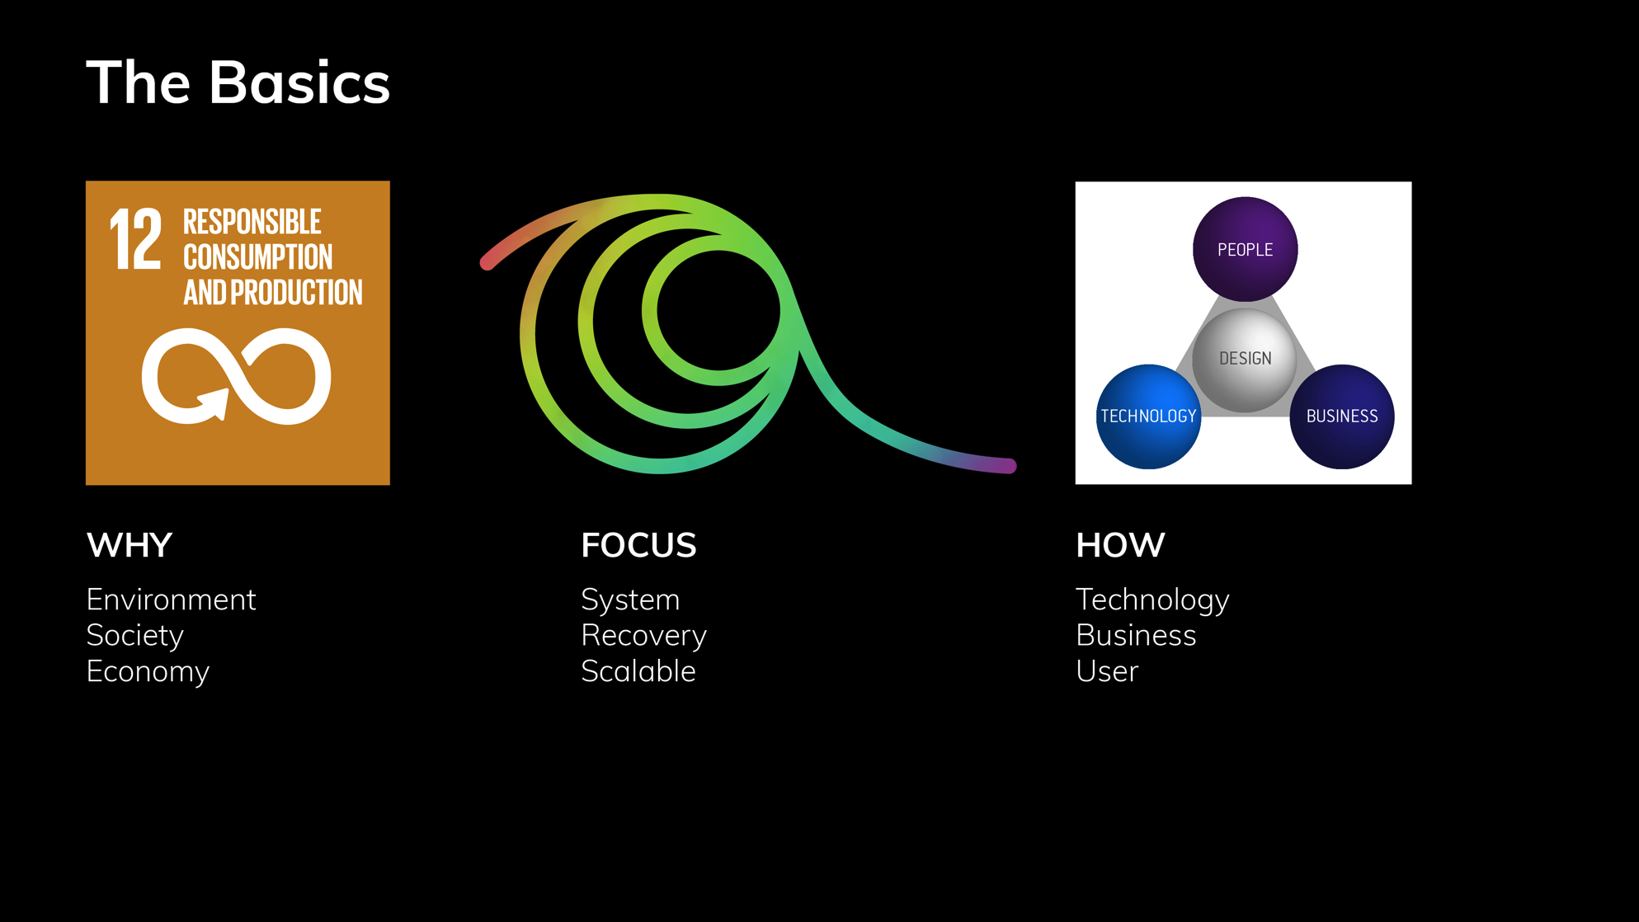
The Basics
© Ruud Balkenende, 2019
Notes:
Basics can be found in the triple bottom line on sustainability, main challenges are to consider impact at system level, taking recovery into account and reaching a large scale. As designers we approach this by integrating human, societal, business and technological perspectives by exploring solutions.

Slide 17
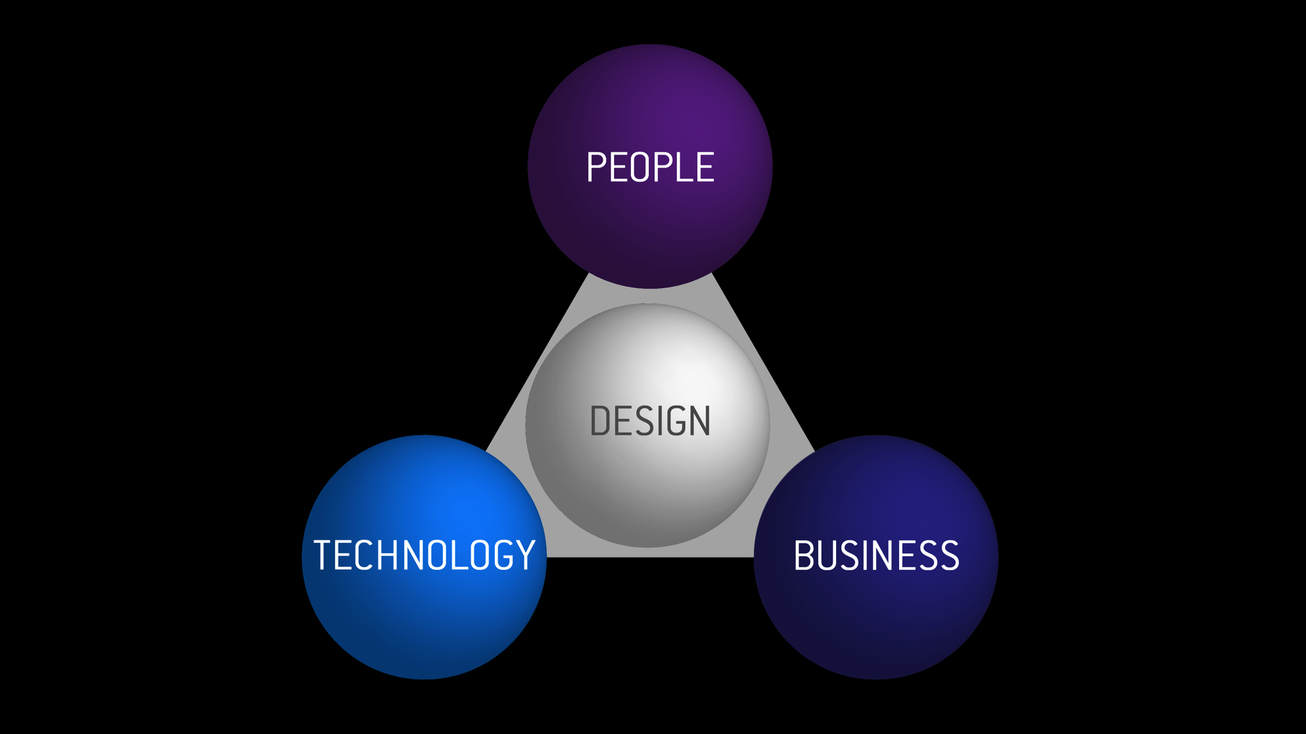
© Ruud Balkenende, 2019
Notes:
Circular Product Design
With user, business and technology, we have the three pillars of design as we distinguish them within our faculty. But our current way of designing misses out on sustainability. Therefore to me, the two basic questions are:
What should we do differently in the design process of products and services to make sustainability considerations an integral part of design?
And how can we implement this in the actual design process as it takes place within companies?

Slide 18
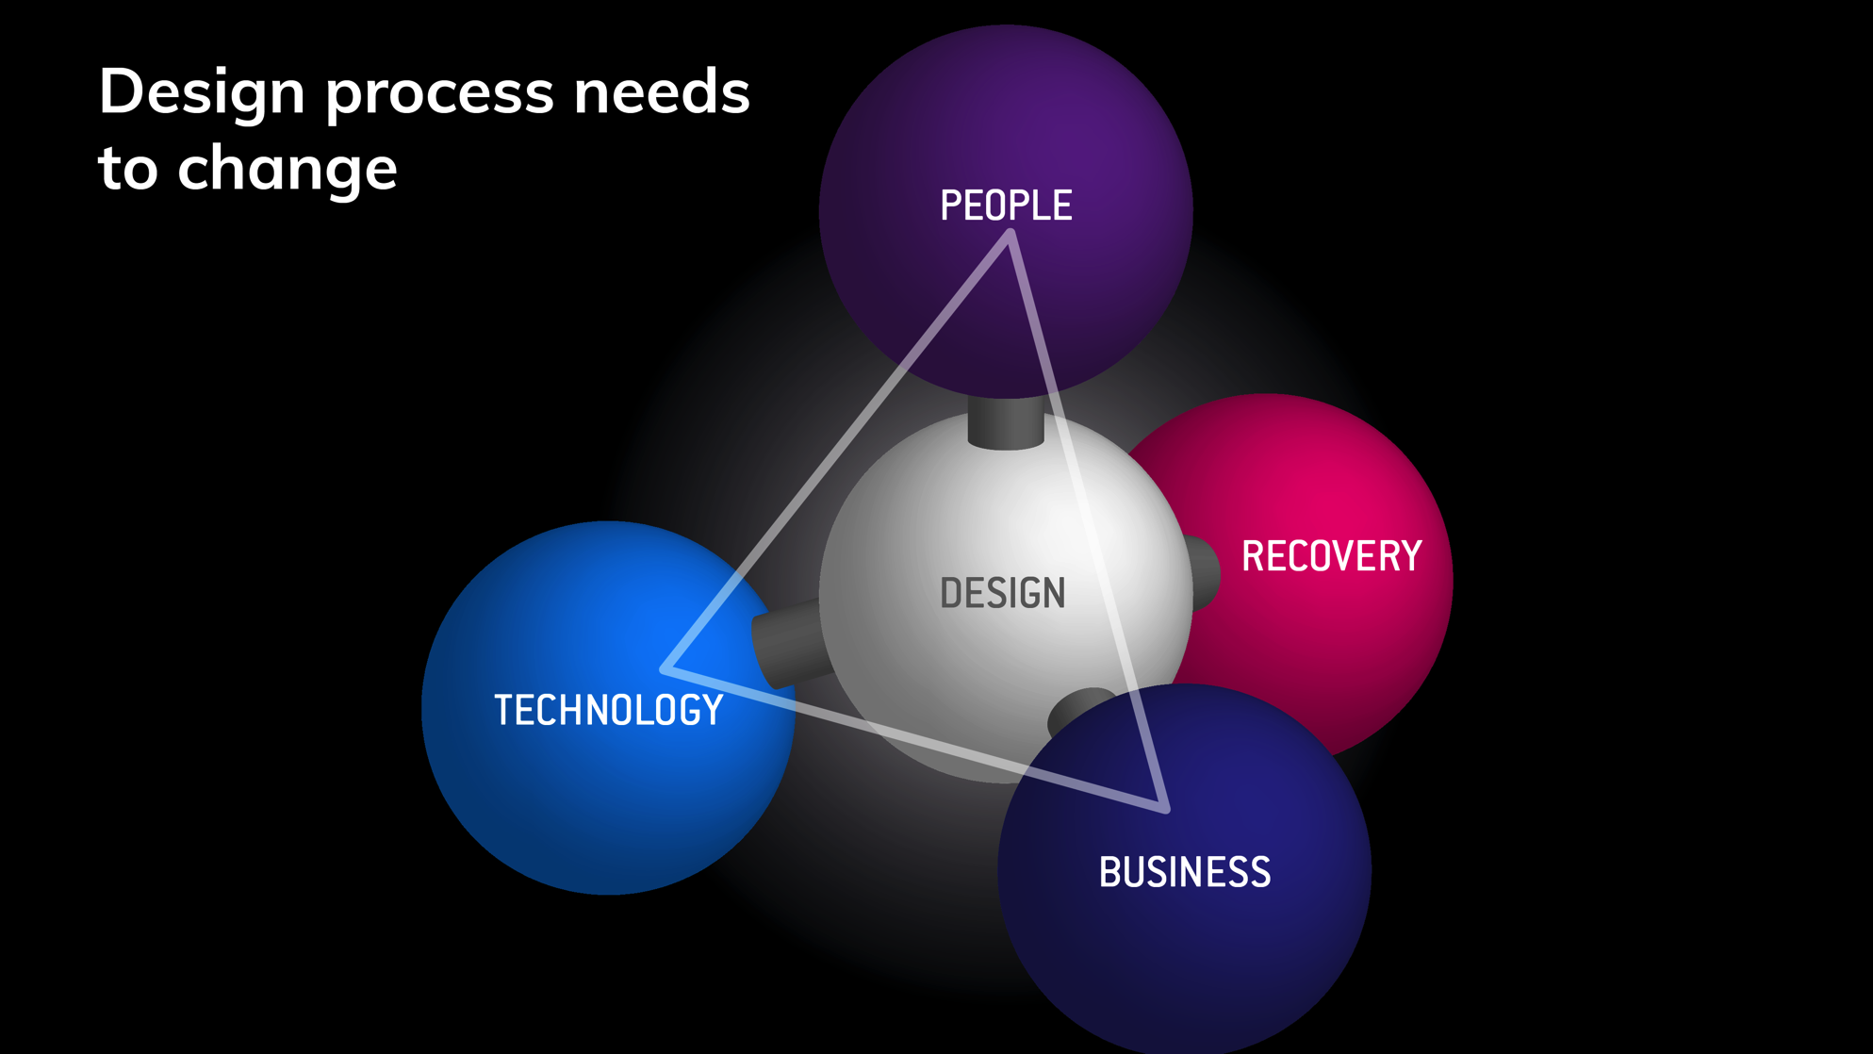
© Ruud Balkenende, 2019
Notes:
Explicitly address Recovery
To answer that, let’s look again at the design triangle. The focus is on how to design a product, applying technology, in such a way that it is interesting to manufacture and attractive to a user, considering things like the manufacturing process and cost, the performance, quality and price of a product. But what happens when the performance of a product is no longer desired by the user? In this model it is not considered how we can recover a product. So, we have to change our perspective and then we will see that this triangle is actually the face of a pyramid that also includes recovery, that is; all actions that might be needed after disposal of a product to reverse its obsolescence. What we should add to the design process is thus to explicitly take into account the treatments at the end of a product lifecycle, so that we can start a new lifecycle instead of wasting the product.

Slide 19
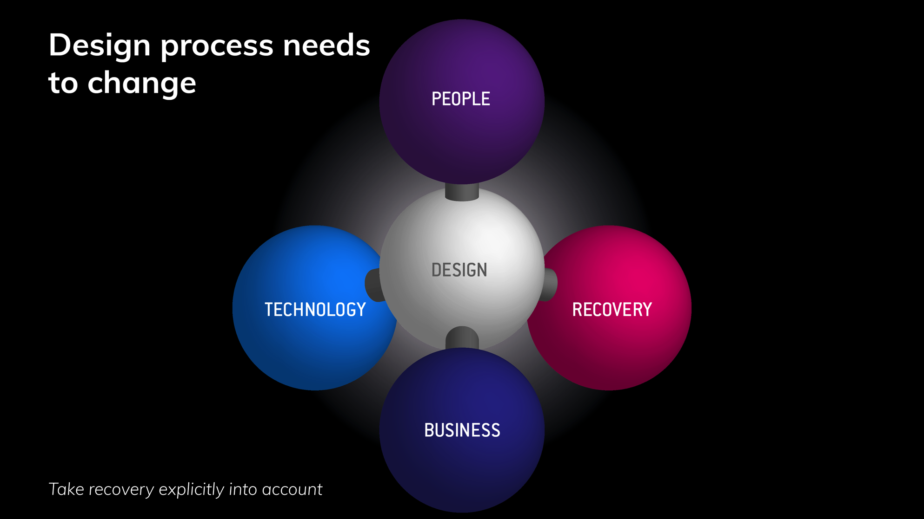
© Ruud Balkenende, 2019
Notes:
How can we achieve this? Here many answers and approaches are possible. I will in the following mainly focus on some different approaches

Slide 20
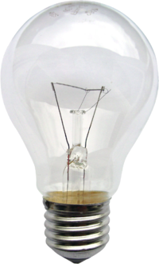
Sustainable?
Energy:
10-15 times more efficient
Lifetime:
30000 iso 1500 h
Optimal recyclability
New technology
© Ruud Balkenende, 2019
Notes:
Let’s start this with some quizzing;
Which lamp mis most sustainable: the left LED-lamp or the right incandescent lamp. (hand raising)
(Text provides benefits LEDs): in this case applying new technology was driver.

Slide 21
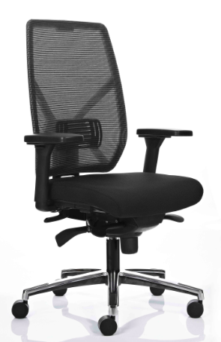
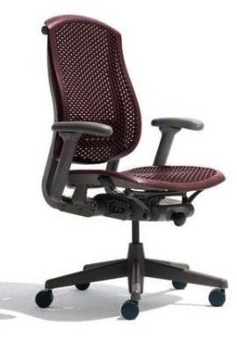
Sustainable?
Materials:
recycled and recyclable
Rapid disassembly
Parts of pure materials
Design choices
© Ruud Balkenende, 2019
Notes:
Left chair or right one.
(Text provides benefits Herman Milllar chair): in this case design choices enabled recovery.

Slide 22


Sustainable?
Fair trade materials
Business model:
leasing
New business model
© Ruud Balkenende, 2019
Notes:
Left or right pair of jeans?
(Text provides benefits Mud Jeans): in this case attention to fair sourcing of materials, but main differentiator is the business model that stimulates recovery.
So, we have now seen examples in which respectively technology, design choices and business model had emphasis, but in practice these 3 are usually closely related.

Slide 23
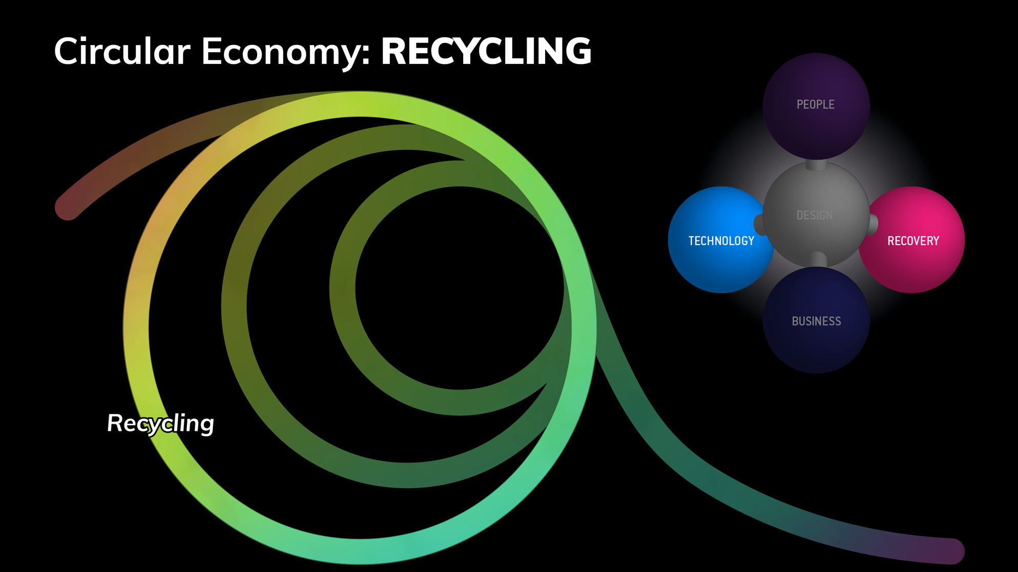
Circular Economy: RECYCLING
© Ruud Balkenende, 2019
Notes:
Let’s now go into some more detail and start by looking into recycling

Slide 24
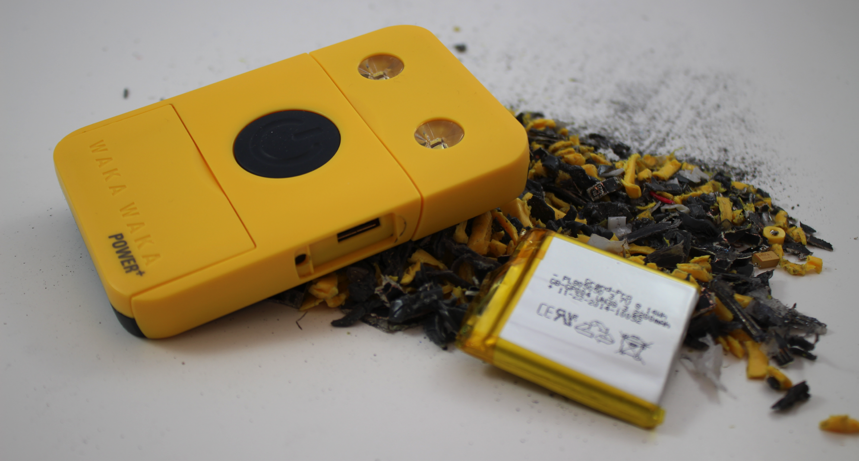
© Ruud Balkenende, 2019
Notes:
This is a flashlight with solar cell and the result after shredding. The fragments have mixed compositions and the value is then negative, as disposing the materials costs money. How can we improve on this?

Slide 25
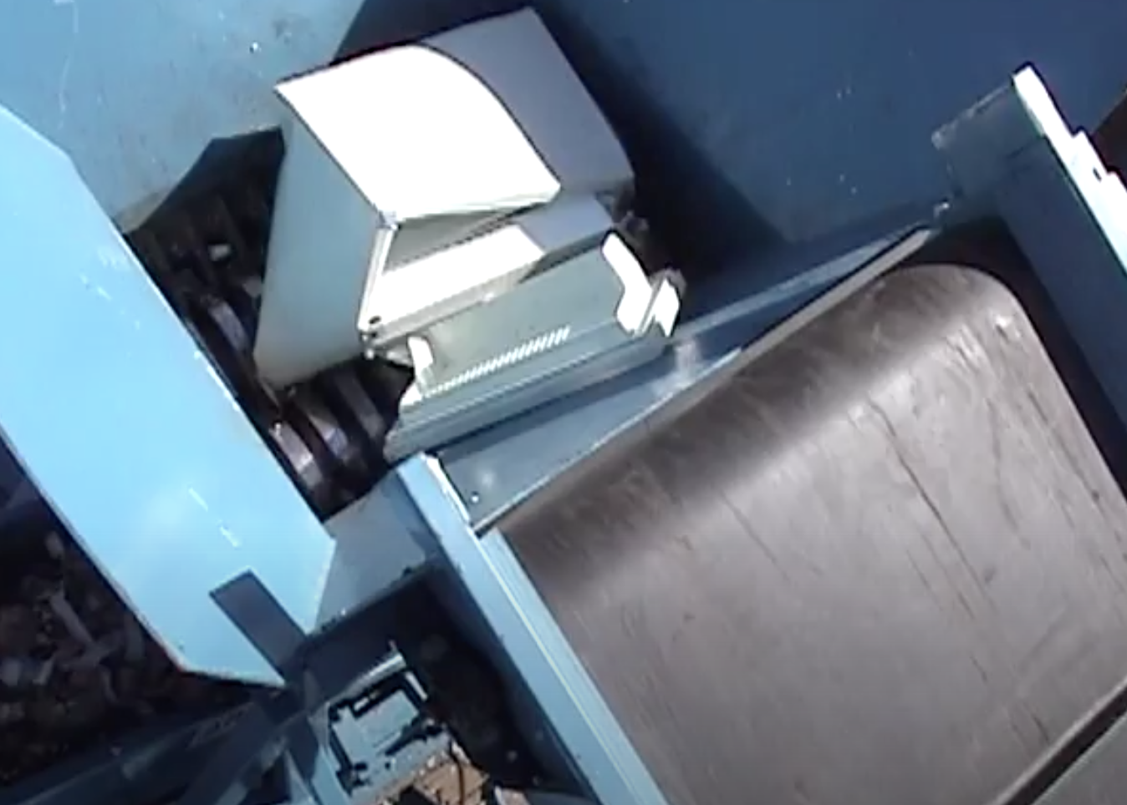
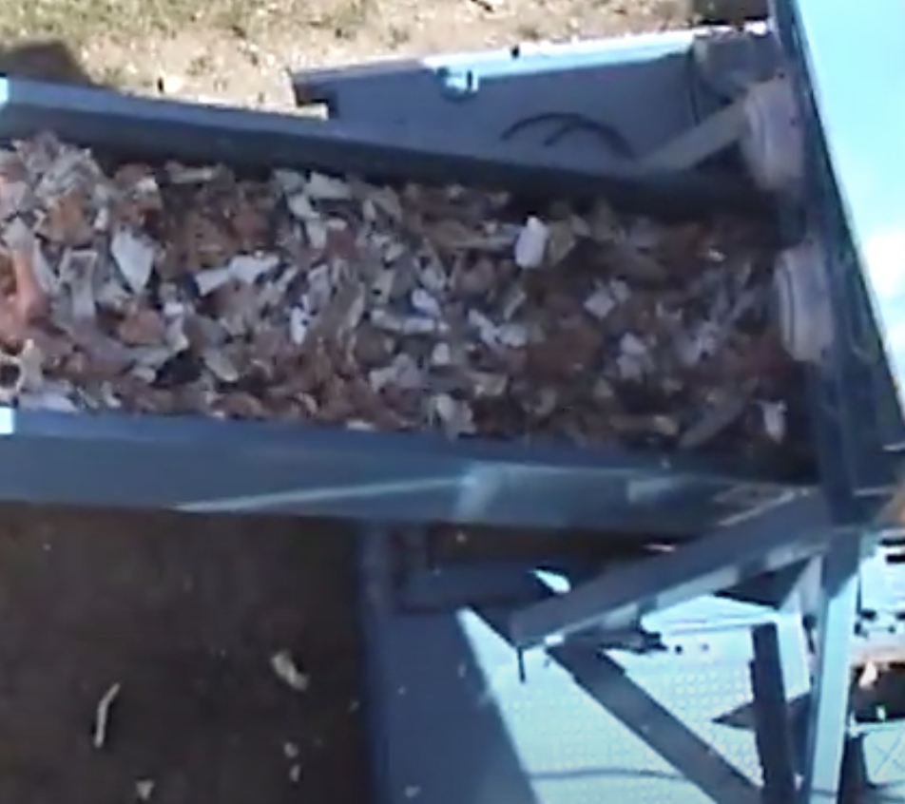
Recycling process
Shredding of a fridge
Resulting fragments
© Ruud Balkenende, 2019
Notes:
Looking at the recycling process, we should first realize that recycling is a rough destructive mechanical process [movie]. Almost all consumer goods, whether it is phone a hairdryer or a fridge, end in this way. So, designing for recycling means that we need to know what happens during the most likely recycling processes.

Slide 26
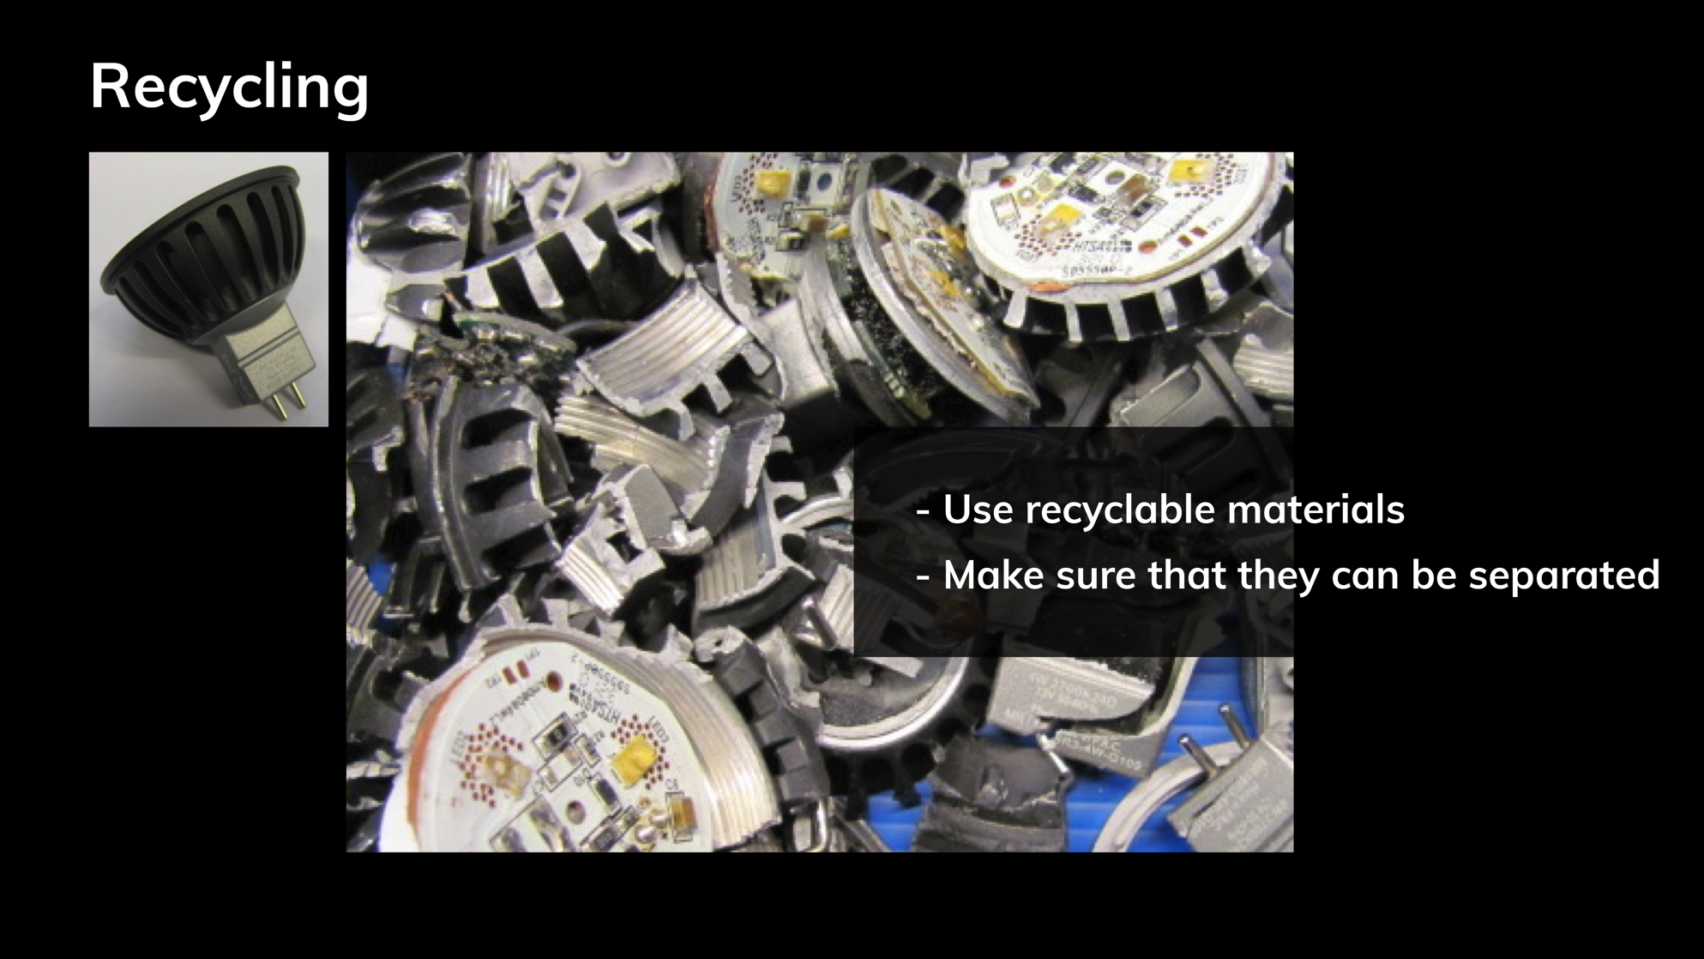
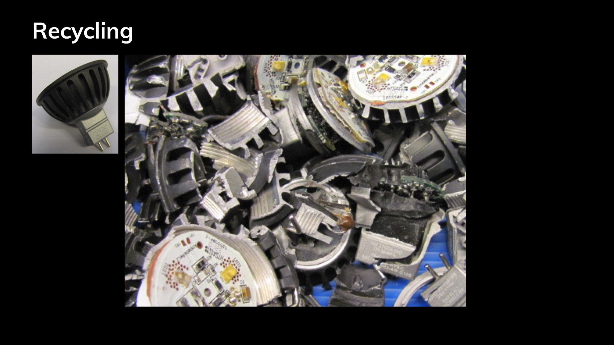
Recycling
© Ruud Balkenende, 2019
Notes:
Let’s take an electronic product, in this case a lamp, and see what happens when it goes through a shredder. We get fragments that still contain many different materials that cannot be recycled simultaneously. The electronics largely remain fixed to the aluminium heat spreader and during separation will likely end in the aluminium fraction. This not only contaminates the aluminium stream, but also causes the loss of copper and other precious metals present in the electronics. With this specific product about 40% of the weight is recycled, mainly because we have quite a lot of aluminium, which is quite easily separated.

Slide 27
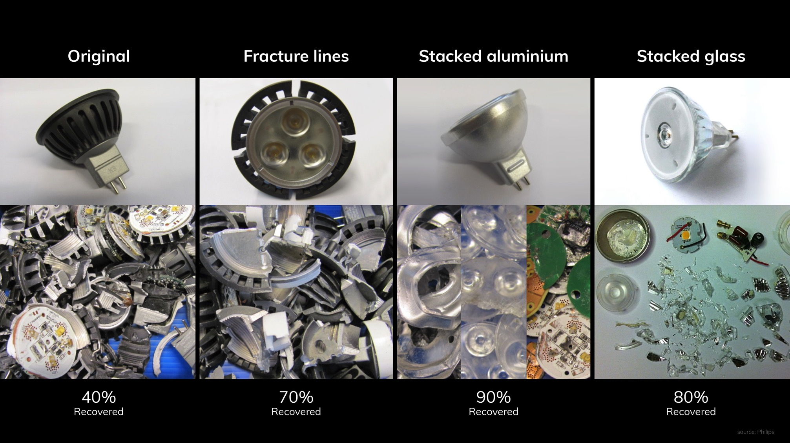
© Ruud Balkenende, 2019
Notes:
Within Philips a number of different strategies was followed to achieve this. The most simple one, hardly involving any changes in the manufacturing process: fracture lines in the aluminium heat spreader. As the aluminium and electronics remained fixed due to a screw connection, an obvious line of thought is: breakdown the screw connection during shredding. Without compromising reliability of the lamp during its operating life, this can be done by introducing fracture lines in the heat spreader. The results in a shredding test are very convincing: almost all PCBs are released and can be separated and recycled. So, this is a great improvement at exactly the same cost in manufacturing.
By really redesigning the lamp, in one case removing all internal connections, in the other case by using a brittle housing and removing internal connection even better results are obtained.

Slide 28
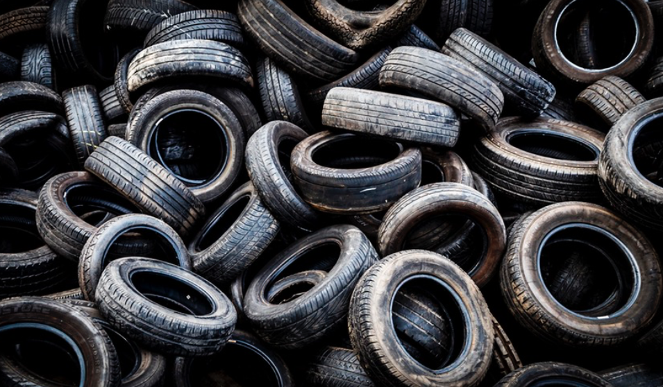
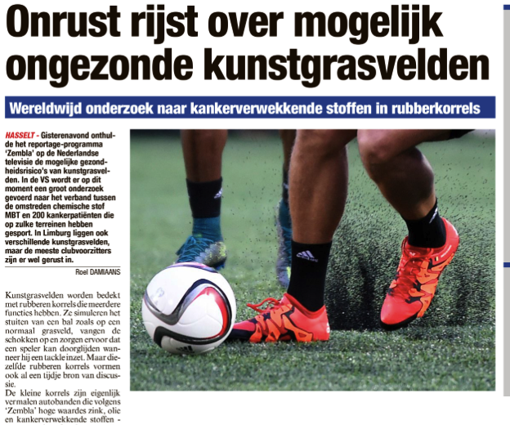
© Ruud Balkenende, 2019
Notes:
However, when products are not made for recycling, using the recycled materials can be tricky. Here an example of tires which were grinded and used as a kind of additive on artificial lawn. When it became clear that these particles contain carcinogenic materials and that children playing on them, this became a big issue.

Slide 29
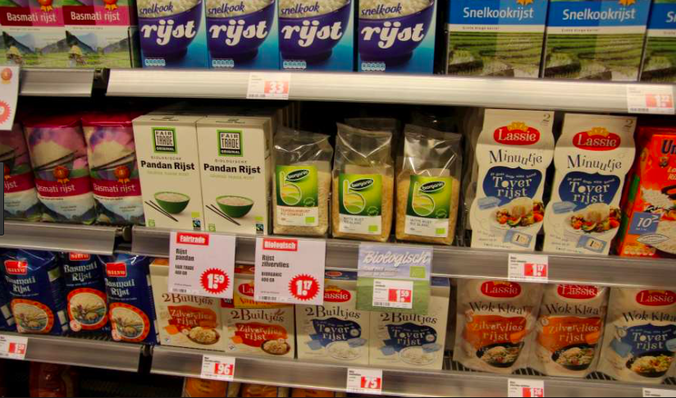
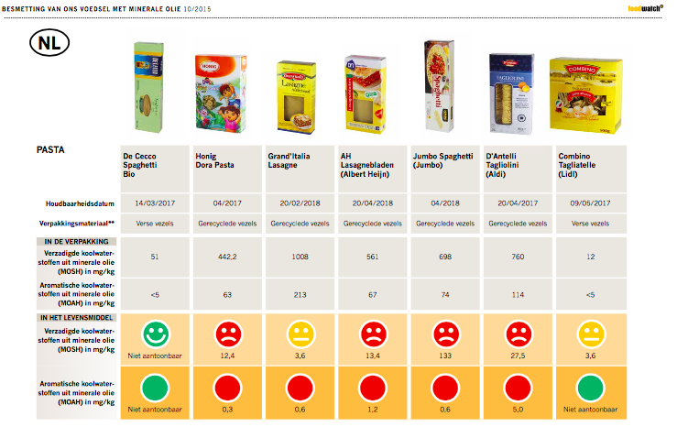
© Ruud Balkenende, 2019
Notes:
Also recycled cardboard can be contaminated with chemicals, for instance from printing ink, that subsequently was shown to contaminate food.
This doesn’t show that we shouldn’t use recycled materials, but it demonstrates that we need to take the recyclability of materials into account already when we design the original product.

Slide 30
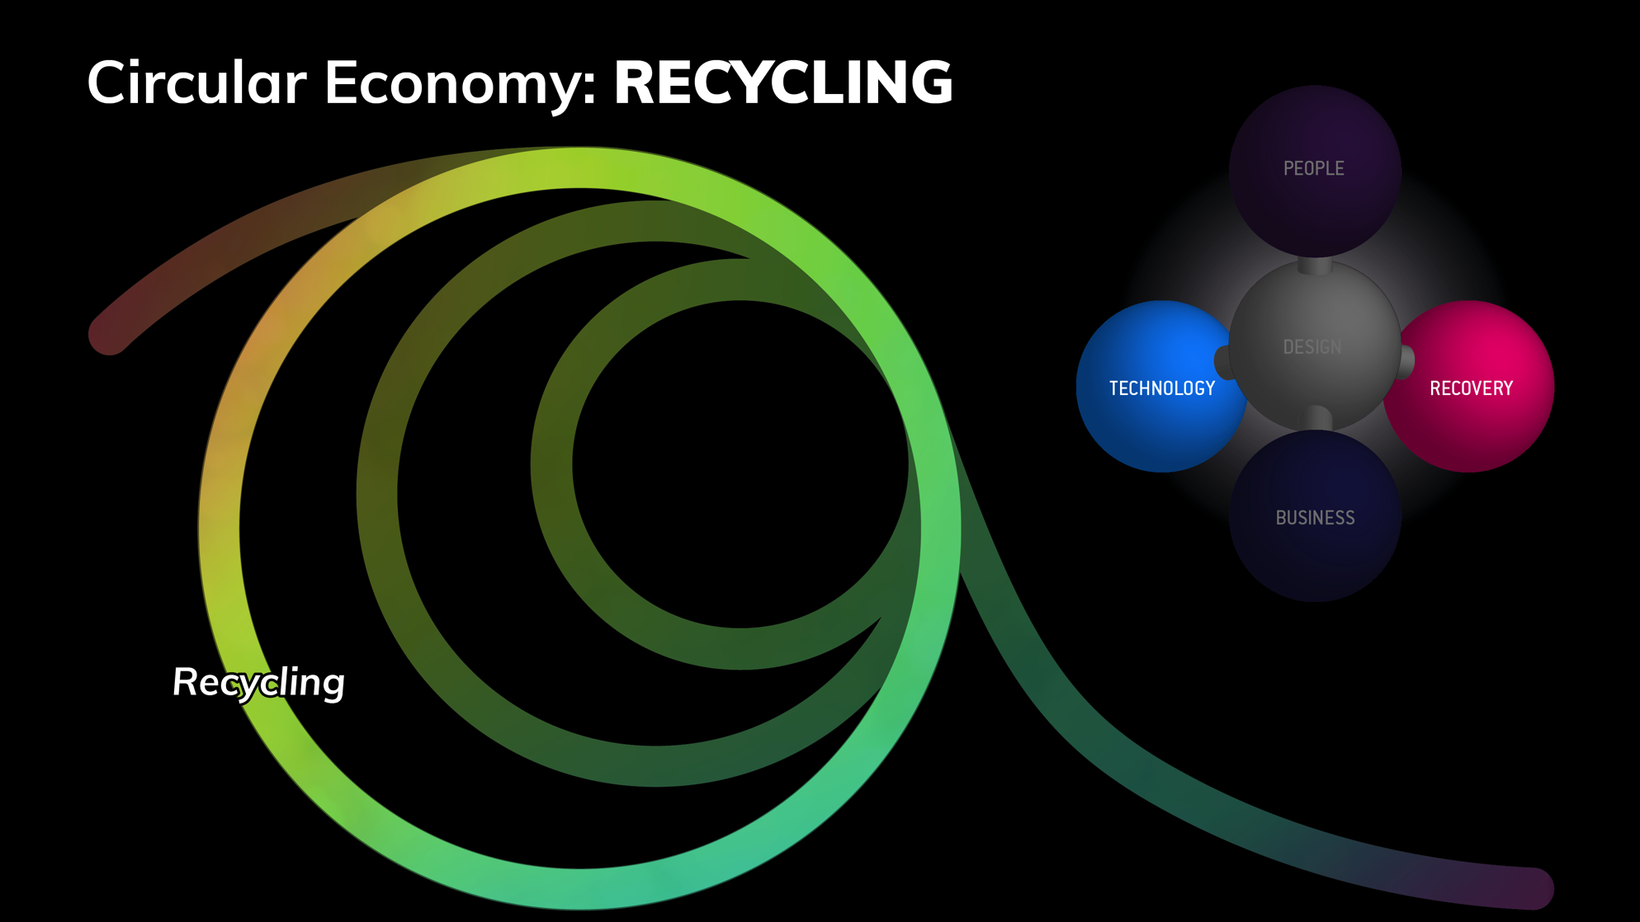
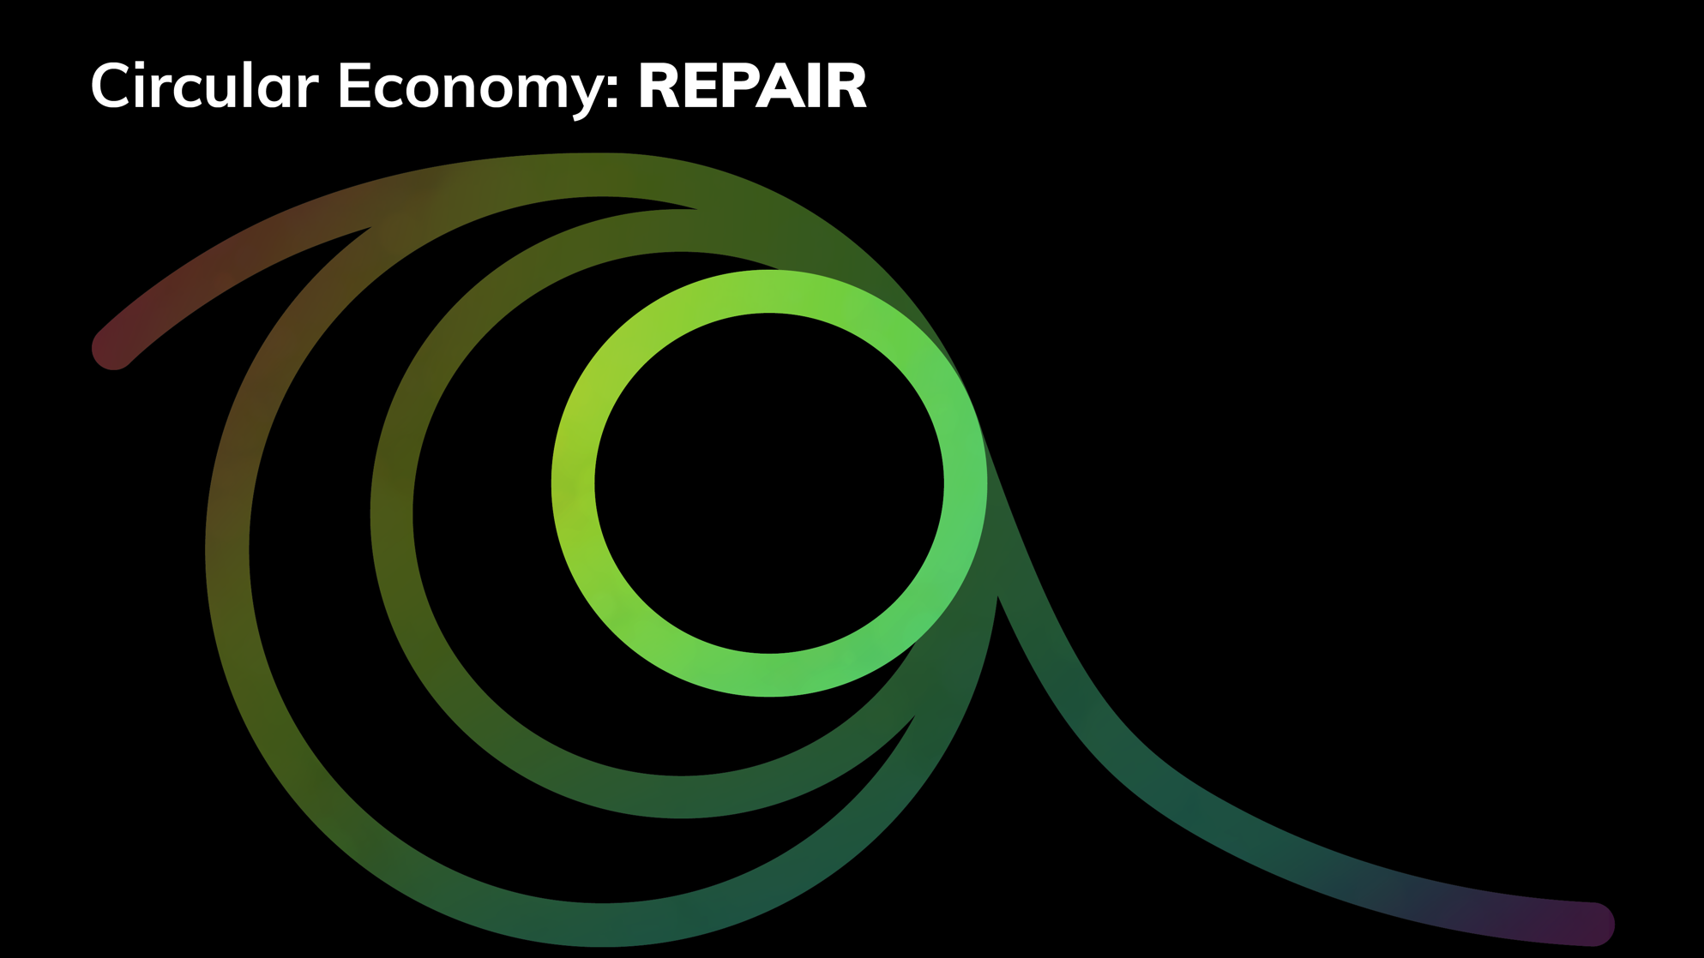
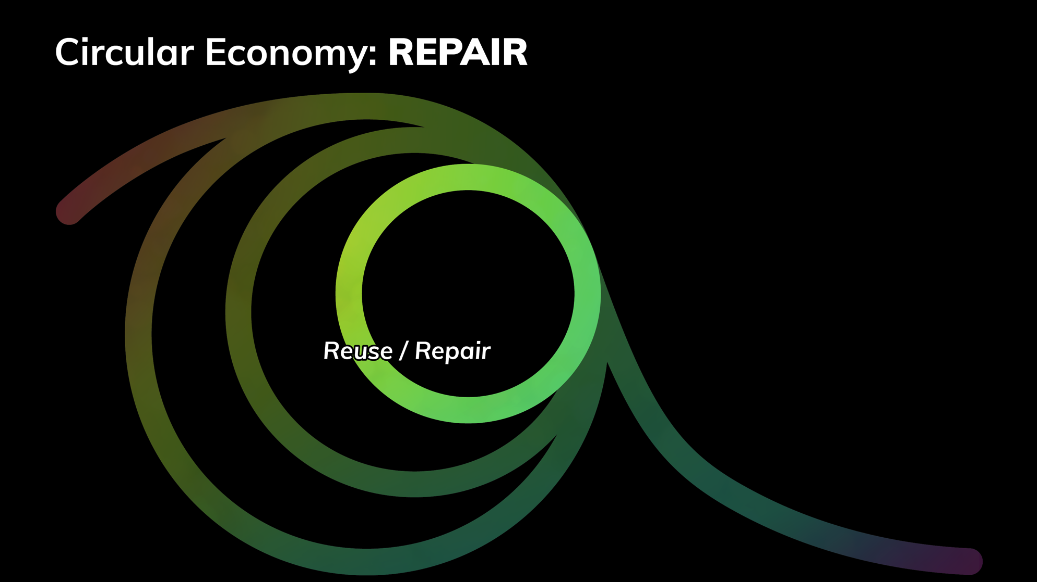
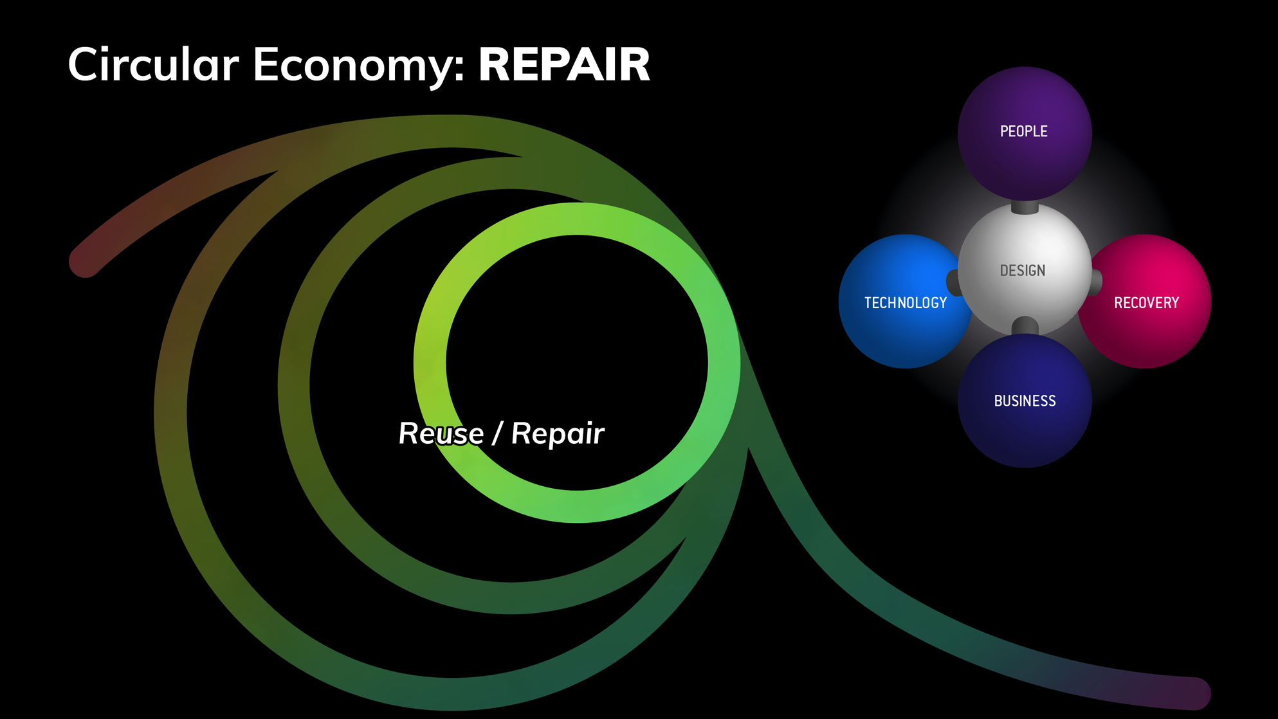
Circular Economy: REPAIR
© Ruud Balkenende, 2019
Notes:
Let’s step from the outer loop to the inner loops
To recover not only materials, but also functionality and value, we need to close the loop at the level of the user, the level of a service provider or the level of the manufacturer. Although on a technological level repair and refurbishment can be enabled, for actual implementation combined action involving business approach and user behaviour is required.

Slide 31
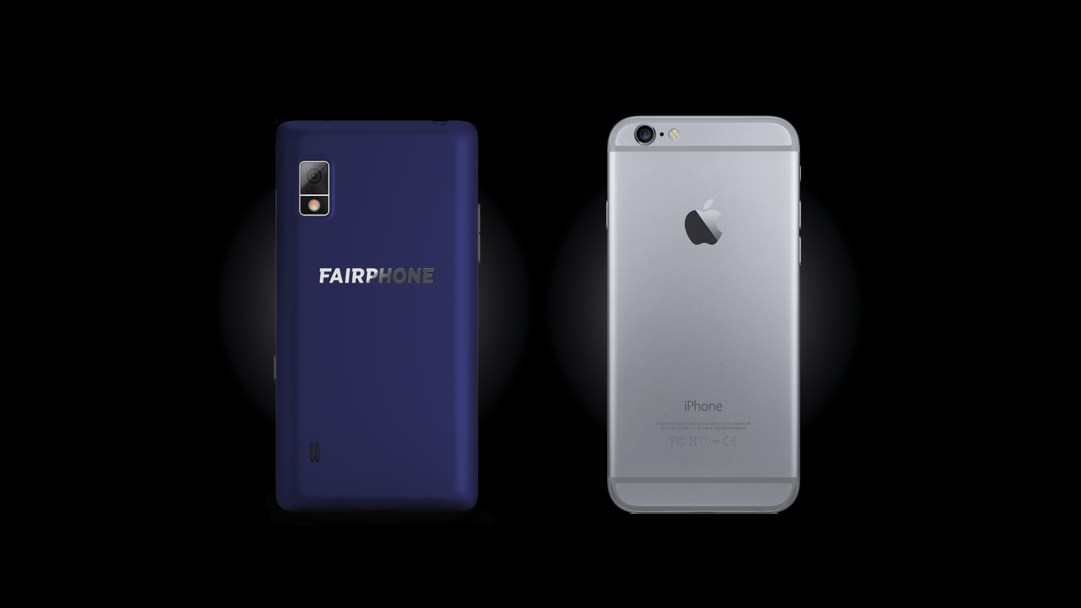
© Ruud Balkenende, 2019
Notes:
Apple vs Fairphone; robot vs manual; company vs user
Let’s take as an example two different smart phones. Fairphone pays special attention to the sourcing of its materials, thus emphasising a social aspect of sustainability. The phone is further built in a modular way, with a relatively low level of integration and easy accessibility of all modules. This allows easy repair or even upgrading of parts by the user. This should allow the phone to be used for at least 4 years, which is about twice the average for smart phones. Apple also has a durable design, to a lower extent even modular, but accessibility of inner pats is made very difficult.

Slide 32
Fairphone slides open
iPhone is glued
© Ruud Balkenende, 2019
Notes:
(disassembly) movie. However, the interior of the product is almost inaccessible unless you take special actions that are beyond the abilities of an ordinary user. Even if you get to the interior level, integration and the way in which modules are connected make this product almost impossible to repair for the user. However, due to the high quality of its built and the parts used, as well as the appeal of its design to users, the product is durable and also considered attractive as refurbished product in a second life. From a technological perspective both companies have followed completely different routes towards a longer than average product lifetime. Which approach is preferable from a sustainability point of view?

Slide 33
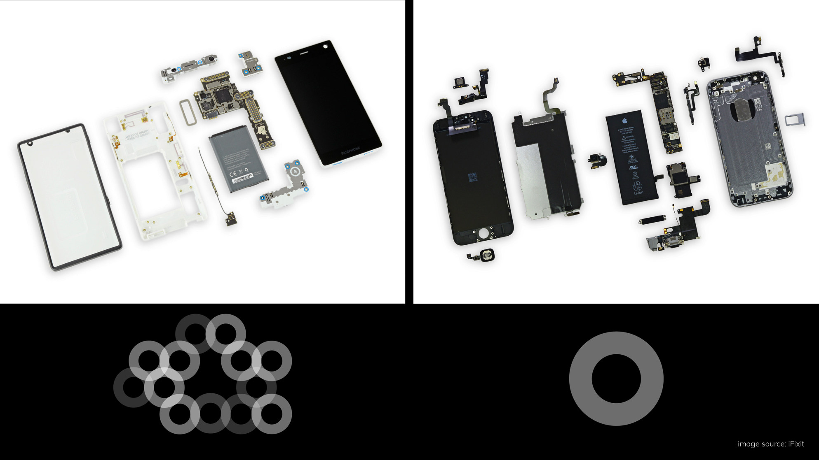
© Ruud Balkenende, 2019
Notes:
Responsibility and empowerment
Interestingly, both approaches can be valid. It will depend on the business model as well as on the behaviour of the user. Fairphone targets users that are motivated and enables those users to prolong the lifetime of their products. Fairphone enables users who want to take responsibility. But basically, products that are built in this way can and probably will be repaired by most users. The disadvantage might be that consumers can tweak the phone, thus risking performance issues. Also in heavy-duty situations the easy accessibility might conflict with reliability. But anyhow, Fairphone explicitly has taken into account in its design what actions to enable when a product becomes obsolete. This also creates awareness with users.
Apple targets users that go for a slick high-end phone, which is built for performance. In many cases the product will be used for 1-2 years and then be transferred to another user for a similar time. However, when the product breaks down and needs repair after expiration of the warranty period the only thing that is clear, is that repair will probably be very expensive. So users dispose of their phone and only a limited number will be refurbished. The users are not triggered to awareness of sustainability and Apple doesn’t empower their users to prolong the phone’s lifetime. It is not clear to the user which action needs to be taken to extend the product lifetime when the product becomes obsolete. The user is made responsible, but has no means to determine the most appropriate actions. Apple therefore should take that responsibility, which for instance could imply prolonging the warranty period to e.g. 5 years or to make the phone part of a service systems, in which Apple keeps the final responsibility. Such steps, by the way, will probably lead to some changes in the design of the product to enable e.g. easier repair and refurbishment.
Two completely different design approaches, both can be successful from the perspective of lifetime extension. But to be successful, they should both explicitly take into account the recovery opportunities for recovery at the end-of-life of the product. And that does not only mean technological feasibility, but also enabling those who are responsible for the recovery process, either through enable self-repair, or by enabling transparent and affordable professional repair.

Slide 34
Circular design strategies
© Ruud Balkenende, 2019
Notes:
In the two phone examples shown we recognize different strategies towards a more sustainable design.
Fairphone aims for ease of maintenance and repair, focuses on dis- and reassembly and the design benefits from standardization and compatibility.
Apple makes a relatively robust and product, focusing on durability and through its iconic design creates attachment.
It will be dependent on the user target group and the business model which strategies are most useful.

Slide 35
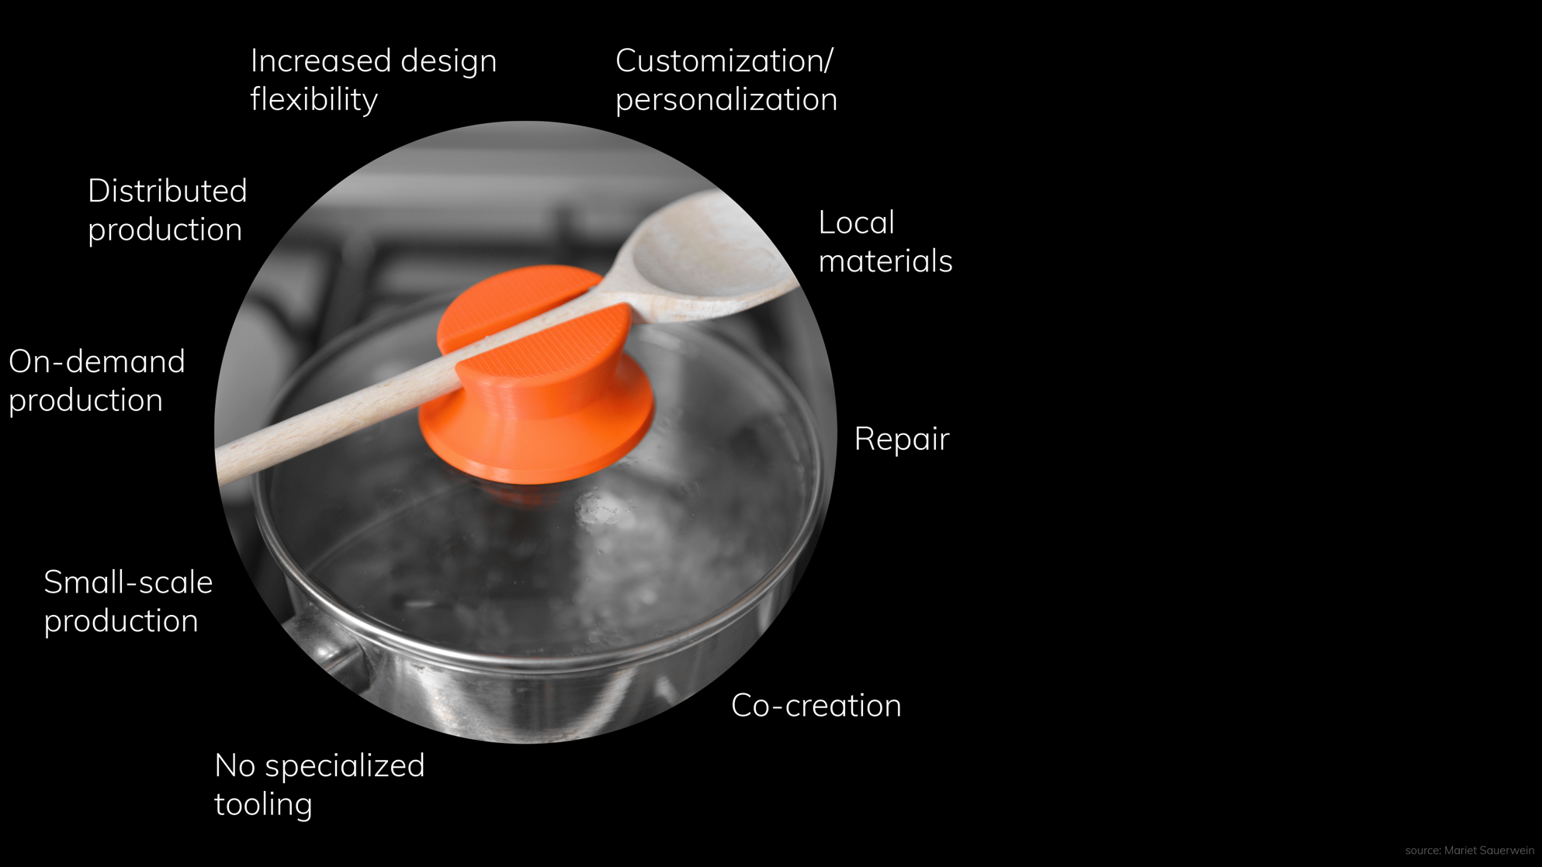
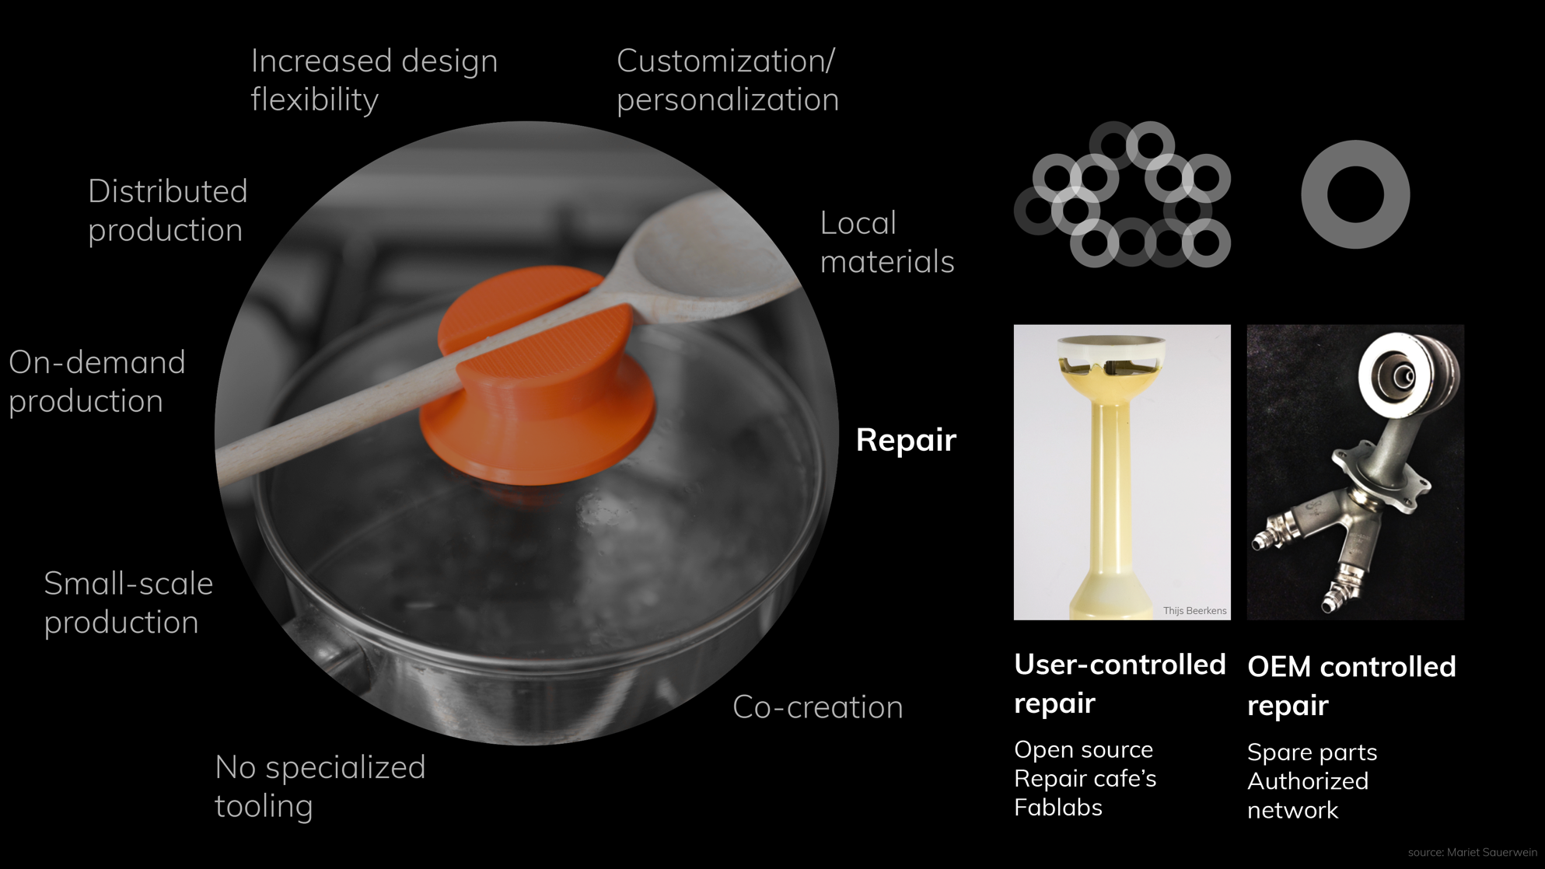
3D-Printing
© Ruud Balkenende, 2019
Notes:
3D printing is often claimed to be a solution for CE. However, things like local production and personalization do not automatically lead to a reduced environmental impact.
But 3D printing does offer interesting possibilities for repair as in that case the ability to take local action makes sense, e.g. by the opportunity to locally print spare parts. Different design approaches are needed for professional parts (via certified partners) and non-professional repair (with potential liability issues). In the latter case design enabling such repair should take into account safety aspects. Currently this isstill explorative, but demonstrating high potential versatility. The examples in the next sidesd have been taken from a series of repaired products demonstrated by Marcel den Hollander and Conny Bakker under the name ‘Value Added Repair’.

Slide 36
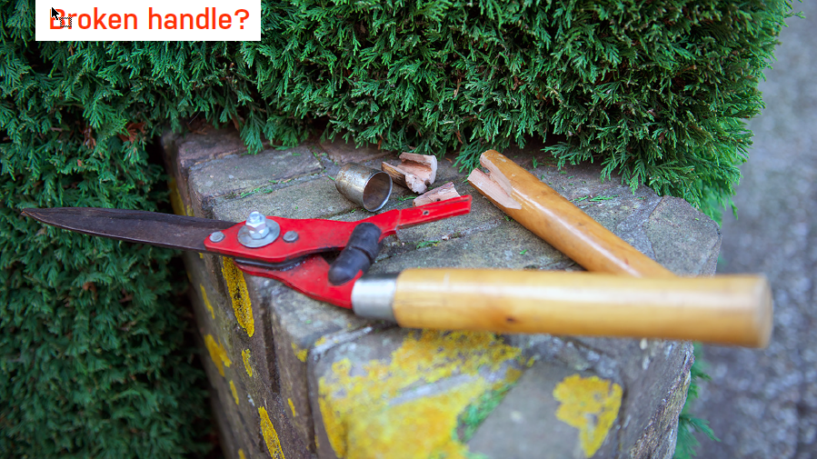
© Ruud Balkenende, 2019
Notes:
Some examples. Broken handle.

Slide 37
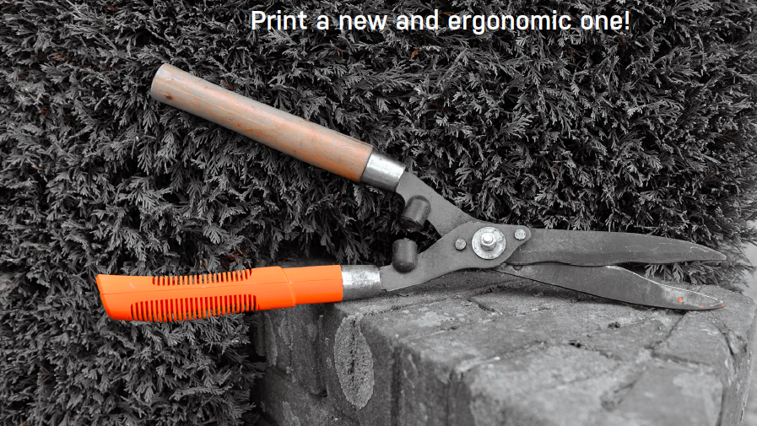
© Ruud Balkenende, 2019
Notes:
The handle in this case is not just repaired, but also has improved grip. This illustrates that 3D printed repair can also be used to improve or customize a product

Slide 38
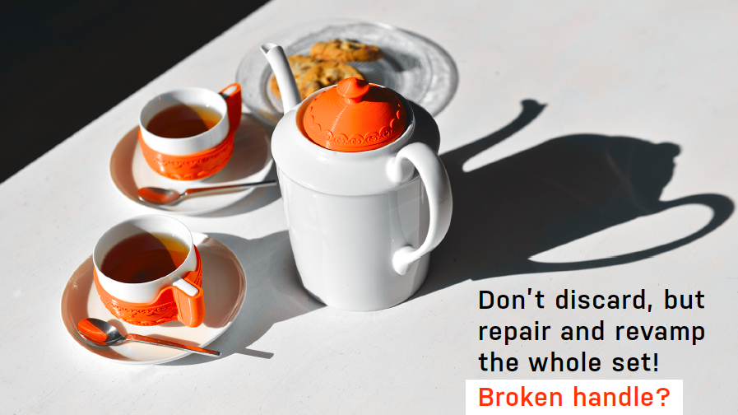
© Ruud Balkenende, 2019

Slide 39

© Ruud Balkenende, 2019
Notes:
Another example from the same series with the broken grip from a lid, were the grip has been replaced by a grip that also holds a spoon

Slide 40
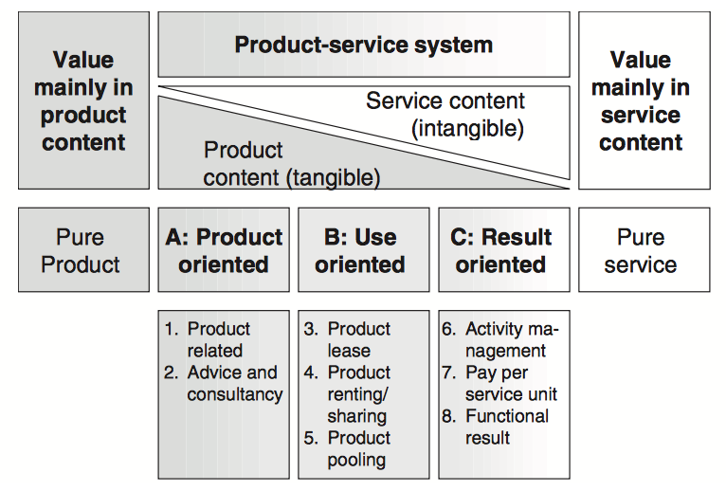
© Ruud Balkenende, 2019
A.Tukker, Bus. Strat. Env. 13, 246–260 (2004)
Notes:
In the previous part we focused on tangible products, but it is very worthwhile to expand our view from products to product-service systemns.
If the pure product would be a car, the product oriented service might be a maintenance contract, a use oriented service would be leasing or renting a car, while a taxi-service would be result otriented. The pure service would just be transportation from A to B.

Slide 41
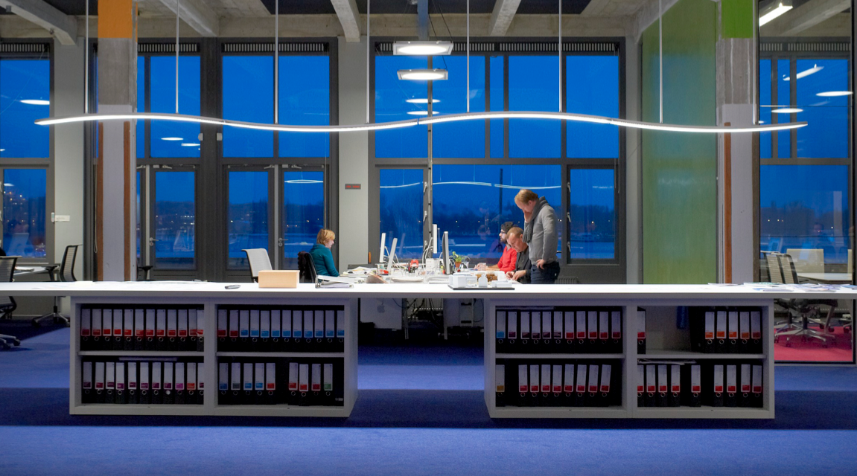
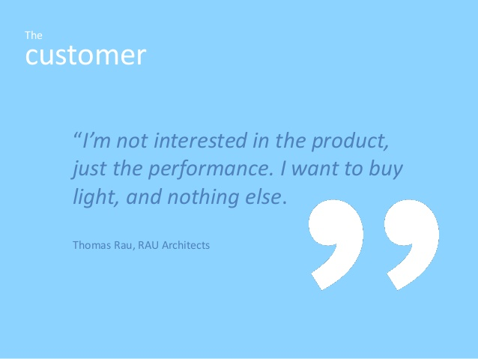
Light as a Service
© Ruud Balkenende, 2019
Notes:
An example is Light-as-a-Service, in which the manufacturer keeps ownership, is responsible for maintenance and end-of-life treatment and even the energy bill.
This shift of responsibility during and after use, leads to different design incentives.
First example office of architect Thomas Rau. Now also a departure hall at Schiphol Airport.

Slide 42

Light as a Service
Schiphol in focus
Schiphol, Cofely and Philips have entered into a collaboration for Light-as-a-Service in the terminal buildings at Amsterdam Airport Schiphol.
3700 LED fixtures
Schiphol pays for the light it uses
Philips remains owner of the installation
50% reduction in electricity consumption
Fixtures optimized for Circular Economy
Philips and Cofely responsible for the
performance and re-use and recycling
Real-time performance management
Jos Nijhuis, CEO Schiphol: "It is Schiphol's ambition to become one of the most sustainable airports in the world. With this innovative, out-of-the-box solution, we set a new standard that matches the ambition level of the airport."
© Ruud Balkenende, 2019
Notes:
(see text)

Slide 43

Light as a Service: Operation and performance guaranteed - from plan to end-of-life management
No CapEx
due to unique business model with financing solutions and upgrade options
Hassle-free
performance based managed lighting solution and service
Savings
on energy, maintenance and depreciation costs
Responsibility
to minimize CO2 emissions and waste of materials
© Ruud Balkenende, 2019
Notes:
Customers want Philips to ensure hassle-free operation of their lighting equipment, with a lower operating expense and a guarantee of current technology without capital investment.
Clients are very interested in achieving certain business outcomes and want Philips to be ‘in the game’ sharing risk and assuring positive returns.
Many customers have challenging sustainability targets. Philips can support them by adding a Circular Economy dimension through the concept of ‘Light as a Service’.

Slide 44


Philips concept lamp
© Ruud Balkenende, 2019
Notes:
Different design incentives for the light sources. Shown here is a concept product that illustrates this.
Different materials: recyclable or renewable
Energy efficient LEDs
Modular built with most vulnerable parts easy accessible for repair
Longer lifetime, mainly through higher performance electronics

Slide 45





© Ruud Balkenende, 2019
Notes:
Resulting concept lamp. This lamp is modular in build, with even the ability to replace just the LED-strip for one with other colour temperature or a higher efficiency

Slide 46

© Ruud Balkenende, 2019
Notes:
Another example of a product-service system: easy access to bicyles that are widely available all over a city. Especiually very popular with students who don’t need to care about parking their bike, which is too often stolen.
The bikes should be robust and also other aspects of the design are tweaked, like the luggage carrier at the front instead of at the rear, which prevent overloading by dual occupancy

Slide 47

© Ruud Balkenende, 2019
Notes:
However, this service is not necessary sustainable. Often too cheap bicycles are used with a life time just sufficient to make a nice profit. Then this type of service can actually become rather wasteful. Again, business model and design should have circularity at the core of their strategy to make this a worthwhile proposition from a sustainability perspective.

Slide 48

© Ruud Balkenende, 2019
Notes:
Taking recovery and preferably continued functional performance as a key strategic principle leads to a new design challenge that needs further exploration: considering the behavior of a product over time, taking into account that products should have multiple life cycles. This poses challenges at different level. Here highlight one.

Slide 49

© Ruud Balkenende, 2019
Notes:
As an example we will take a stroller. This product consists of many different parts, al with their own aging behavior and lifetime.

Slide 50

© Ruud Balkenende, 2019
Notes:
To achieve multiple lifecycles not just look at the product, but also at the service. As n example, in this case we could choose for a cascading business model: high-end product during first use, and then cascading to lower-end in subsequent leases. At every lease some parts need to be replaces and some refurbishment might be necessary. To optimize this from a business perspective, lifetimes should be matched to (multiple of) lease period.

Slide 51







© Ruud Balkenende, 2019
Notes:
Aligning business model with design strategies and technological approaches is key to circ. As this is not an easy thing, this slides actually stresses that experimenting, exploring and learning is key. Learn through small scale experiments.
Crucially for designers: take multiple lifecycle into account through the entire design process.

Slide 52
Navigate ambiguity
Have the right people at the right time,
not necessarily the “right” answer
Name the unknowns, the tensions, and the fears
Explore existential questions from a place of curiosity and opportunity, frame them as “What ifs?”
Start doing, find small experiments to get started.
Source: IDEO
Take multiple lifecycles into account, already in the initial design stages
© Ruud Balkenende, 2019
Notes:
As this is not an easy thing, this slides actually stresses that experimenting, exploring and learning is key. Learn through small scale experiments.
Crucially for designers: take multiple lifecycle into account through the entire design process.

Slide 53

© Ruud Balkenende, 2019

Slide 54


















www.suscritmat.eu
Sustainable Management of Critical Raw Materials

