Slide 1

cobalt and lithium: potential supply from the urban mine
Ester van der Voet
Leiden University, Institute of Environmental Sciences
© Ester van der Voet, 2020

Slide 2
Co and Li: potential supply from the urban mine
The urban mine: has it potential as a (future) source of cobalt and lithium?
very little literature on the topic yet
presentation based mainly on students’ research
no attempt to reconcile discrepancies
three scale levels: global, EU and local (Dutch municipality of Den Haag)
© Ester van der Voet, 2020
Notes:
One of the potential ways out of the ever increasing need to boost supply is to move towards a circular economy and start urban mining. There is a separate teaching package on urban mining for an understanding of that concept.
In this presentation we focus on Li and Co.

Slide 3
Co and Li resources and reserves
EU, CRM factsheets, 2017: geological reserves and resources
Estimates of global level resources and reserves
Cobalt: 7,100,000 tonnes of Co
Lithium: 16,300,000 tonnes of Li
European level: bad data, but considerable amounts indicated (though not produced)
© Ester van der Voet, 2020
Notes:
A tour through the data base for these two raw materials at these three scale levels.

Slide 4
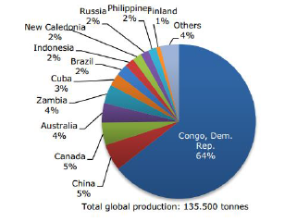
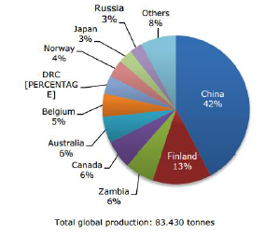
Co primary production (tonnes/year)
EU CRM factsheets, 2017: global Co production
mined refined
© Ester van der Voet, 2020

Slide 5
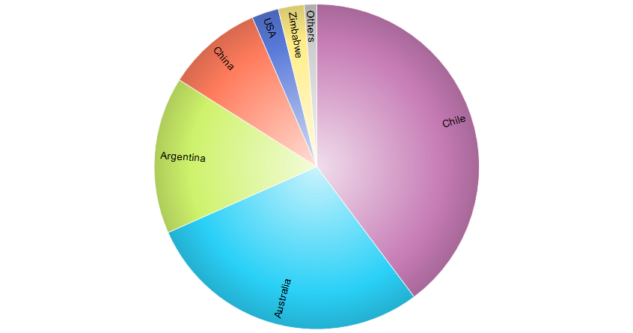
Li primary production (tonnes/year)
EU CRM factsheets, 2017: Li production
Total of 78,549 tonnes of LiO2 EU production 200-300 tonnes
© Ester van der Voet, 2020

Slide 6
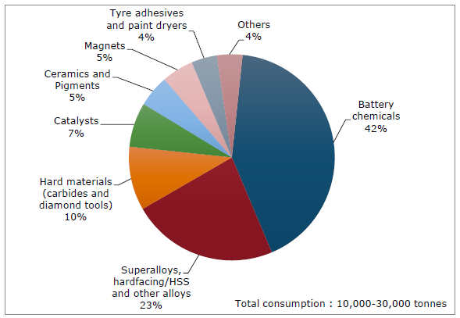
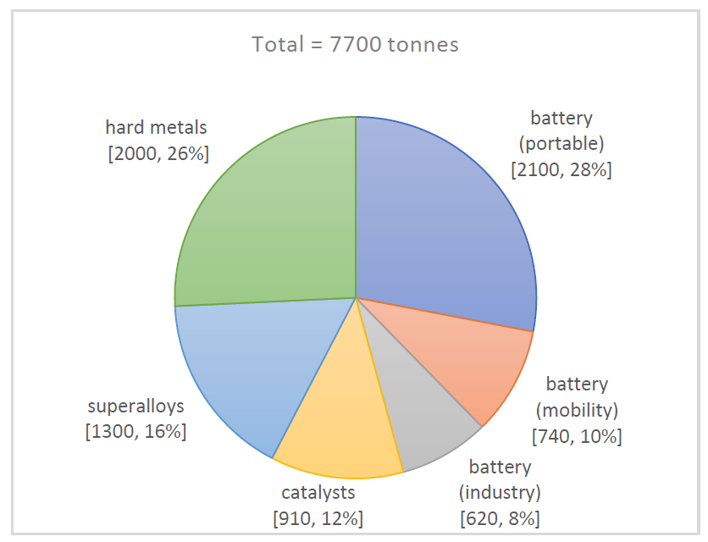
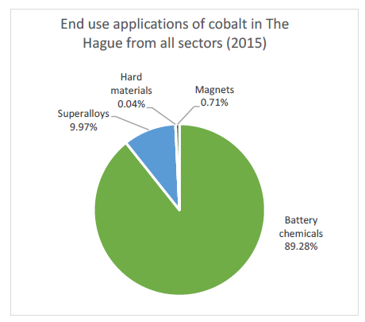
Co end-use (tonnes/year)
World (CRM factsheets, 2017) EU (Yang, 2018) Den Haag (Kotnis, 2018)
Total = 24 tonnes
© Ester van der Voet, 2020
Notes:
The figures show the different uses of cobalt at the three scale levels. The differences between global and EU level probably have to do with the different economic systems – industrial structures as well as the employment of certain products. At the local level of The Hague there is hardly any industry, therefore, industrial uses are absent. Also, at the local level there is a lack of data and this graph is the result of known end-uses of consumers and assumptions on the cobalt content of these end-uses.
Yang and Kotnis are Master students who did their Master thesis research on cobalt in the EU resp. in the Dutch city of Den Haag (The Hague)

Slide 7
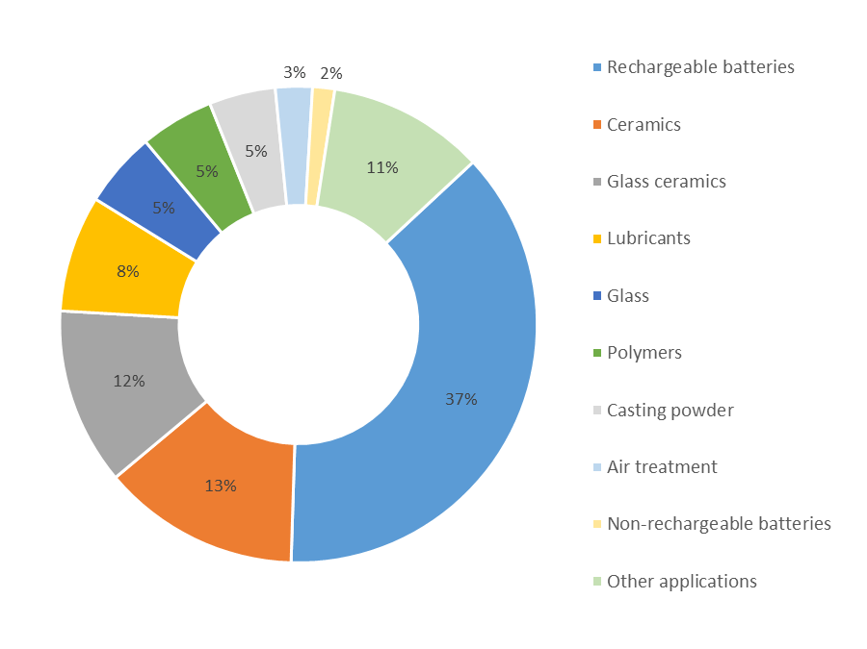
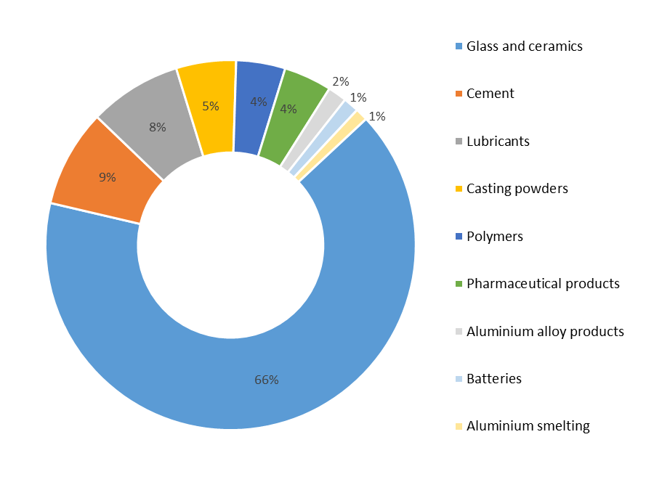
Li end-use (tonnes/year)
CRM factsheets, 2017
world (300,000 tonnes LCE, 2015) EU (2500-3000 tonnes Li, 2015)
© Ester van der Voet, 2020
© [Name], 2018
Notes:
Similar information for lithium. Here, the local level is missing.

Slide 8
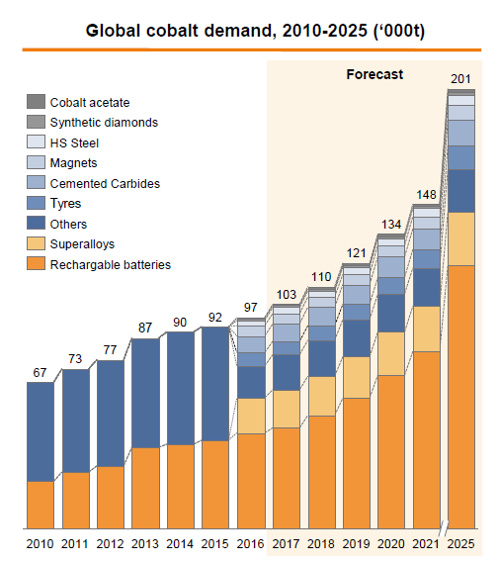
Co demand projections
Global level (Roskill, 2018)
© Ester van der Voet, 2020
Notes:
Demand projections for Cobalt only for the VERY near future. Already here we can see an expected rapid rise.

Slide 9
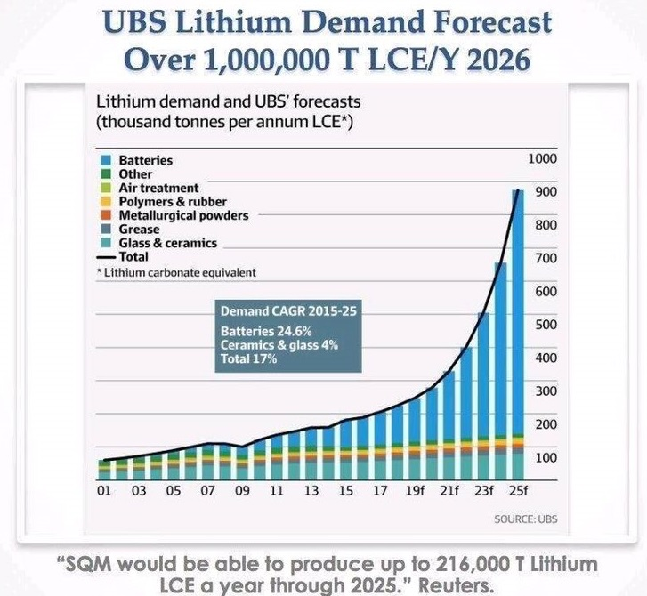
Li demand projections
Global level
© Ester van der Voet, 2020
Notes:
And the same for lithium:

Slide 10
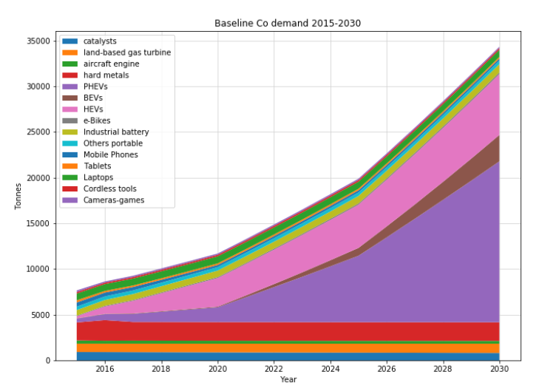
Co and Li demand projections
EU level (Yang, 2018) Co projections – Li used in same batteries.
© Ester van der Voet, 2020
Notes:
Student research can be a bit bolder in extending the time horizon. Yang shows demand projections for cobalt until 2030, with a rapid rise especially of Co-application in batteries. Lithium is used in those same batteries, so a similar rise can be expected for Li as well.

Slide 11
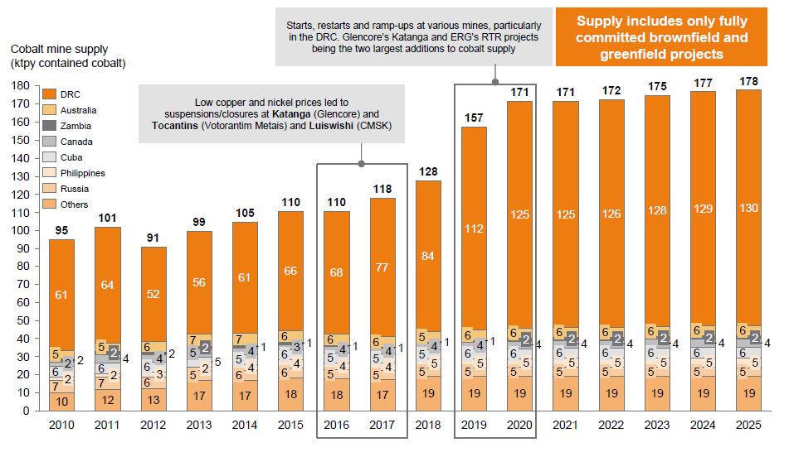
Co supply projections
global level (Roskill, 2018)
© Ester van der Voet, 2020
Notes:
Supply projections even for the shorter term, based on present mining endeavours and present knowledge only.
Comparing supply and demand projections indicate there may be a problem for Cobalt already in the near future.

Slide 12
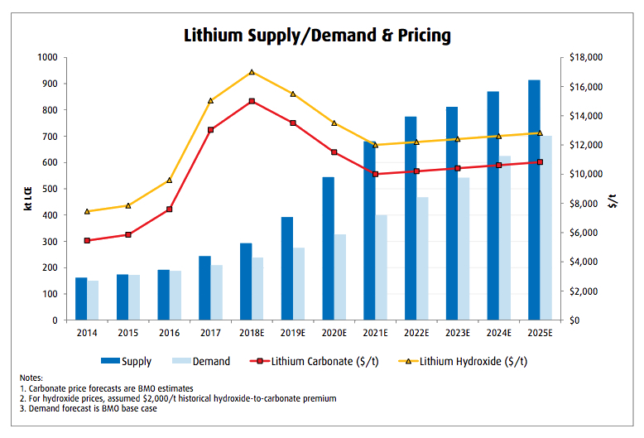
Li supply projections
global level
© Ester van der Voet, 2020
Notes:
For lithium, the situation is different. Here we see a supply that is larger than the demand, also expected for the (near) future. This already has an impact on Li prices.

Slide 13
The urban mine of cobalt
For cobalt: already in the near future potential supply issues
What about the urban mine?
First step: how large is the urban mine actually?
Second step: how much comes out of it annually?
Third step: how much of that can be used for secondary Co production?
(.... and what would the EoL RIR be if it was?)
© Ester van der Voet, 2020
Notes:
Can the urban mine be a solution? That exploration needs various steps.

Slide 14
Estimations of the size of the urban mine
How large is the urban mine?
Urban mine: stocks of materials that presently are in use (and will become available in due time as waste)
Global level (UN-IRP): only one estimate of in-use stocks for Japan, 0.8 kg Co/cap
if multiplied with global population this would be 5000-6000 ktonnes Co
but will likely be much lower, as the Japan number is probably not representative for the world.
© Ester van der Voet, 2020
Notes:
Exploration of the existing information on the urban mine, i.e. the presently used applications in the in-use stock in society. Again at the three scale levels. In this slide, the scarce information at global level is presented. The main source is the report from 2010 on stocks in society published by the International Resource Panel, a first comprehensive attempt to quantify in-use stocks for a broad array of elements.

Slide 15
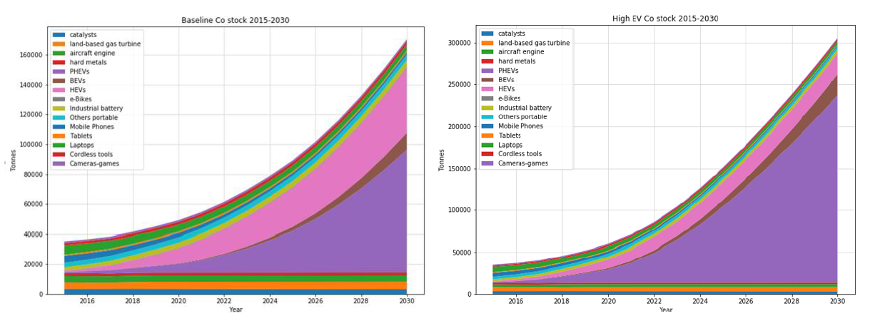
Estimations of the size of the urban mine
How large is the urban mine? Yang, 2018: EU Co in-use stocks rising rapidly from 35 ktonnes at present to 150 or even 300 ktonnes in 2030, especially in car batteries
© Ester van der Voet, 2020
Notes:
This is assuming there will not be any supply restrictions, and also assuming the cobalt content of the applications will not change. Those are most likely both untrue assumptions, but making more sophisticated assumptions is very difficult.

Slide 16
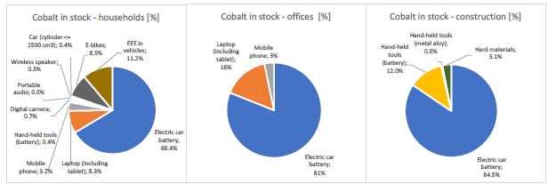
Estimations of the size of the urban mine
How large is the urban mine? Kotnis, 2018: in-use stocks of Co in Den Haag 60 tonnes 6 tonnes 1 tonne
© Ester van der Voet, 2020
Notes:
Kotnis’ main focus was to estimate the in-use stock of cobalt. She used information on the use of household and office appliances and the associated carbon contents, as well as cobalt in steel used for construction.

Slide 17
Estimations of the size of the urban mine
Urban mine global: < 5000 ktonnes Co (<0.8 kg/cap)
  Geological mine global: >7000 ktonnes (reserves)
Urban mine EU: 35 ktonnes Co (0.07 kg/cap), rapidly rising
  Geological mine EU: reserves 10-100 ktonnes (bad data)
Urban mine Den Haag: 67 tonnes Co (0.1 kg/cap)
  No geological mine in Den Haag
we may at least conclude that the urban mine for cobalt is significant!
© Ester van der Voet, 2020
Notes:
These rough numbers show at least that the urban mine may be in the same order of magnitude as the geological mine. From this investigation it may also be suspected that the per capita cobalt use is rather in the 0.1 kg/cap order than in the 0.8 kg/cap order, as following from the estimate for Japan.

Slide 18
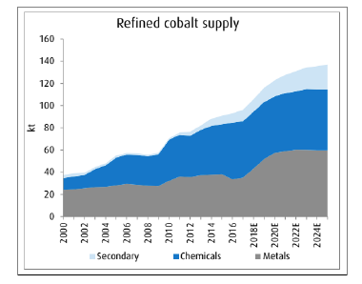
Outflow out of the urban mine
How much comes out of the urban mine?
global level: 2.2 ktonnes Co / year secondary production
(https://datamarket.com/data/set/zy0/cobalt-statistics#!ds=zy0!8o7=6&display=line)
(compare to demand: 100 – 400 ktonnes Co/y)
© Ester van der Voet, 2020
© [Name], 2018
Notes:
What is in stock, is the magnitude of the urban mine. However contrary to geological mines, additional information is needed on to what extent the urban mine can be exploited. The material is, after all, in use. So, what we can expect to come out of the urban mine, to be available for secondary production? Again the three scale levels, and the global level on this slide. At global level, the scarce information indicates that secondary production presently is very small compared to demand.

Slide 19
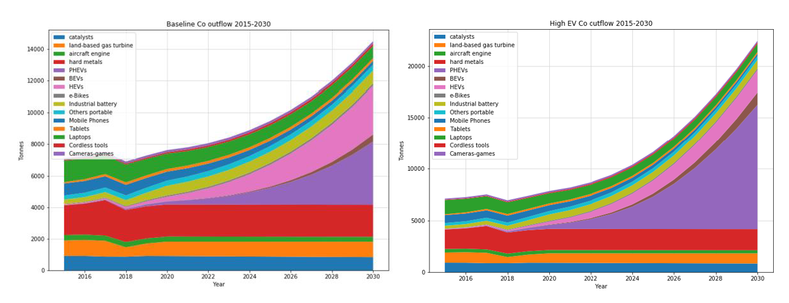
Outflow out of the urban mine
Yang, 2018: outflow out of urban mine presently 7 ktonnes Co/year in EU, rising to 15-22 in 2030 (compare to demand: 35 ktonnes Co/year)
© Ester van der Voet, 2020
Notes:
At EU level, the amount of cobalt presently coming out of the urban mine is 7 ktonnes, more than secondary production at world scale. Note that the outflow from the urban mine is not the same as secondary production. What happens to the outflow is not very well known, but it is quite possible that most of it ends up in waste streams from which Co is not retrieved.

Slide 20
Outflow out of the urban mine
Kotnis, 2018: presently 8 tonnes Co/year flows out of the urban mine of Den Haag
© Ester van der Voet, 2020
Notes:
And here the same observation: this number does not tell us what happens to the waste, and probably very little of it is recycled right now.

Slide 21
How much urban mine material is used?
Present recycling rates, global level:
  UN-IRP: EoL RR of 68%, RC 32% (but data for USA only)
  Hamilton, 2017: RC presently a few % at global level
Very uncertain, very different estimates
Large data gaps
© Ester van der Voet, 2020
Notes:
Next question: how much of what flows out of the urban mine is, or can be, used? Very uncertain and contradictory information at all scale levels. The recycling rates at global level are presented here. Note that the estimates differ from a few percent to two thirds. The high percentages refer to the USA so are probably not representative of what happens in the world. The estimate of Hamilton refers to the Recycled Content: the fraction of supply that comes from recycling. Whereas the End of Life Recycling rate refers to the fraction of waste that is being recycled. This is not the same.

Slide 22
How much urban mine material is used?
EU: EoL RIR = 0% (CRM factsheets 2017)
EU: EoL RIR = 35% (EC Report CRMs and the Circular Economy)
Den Haag: unknown!
© Ester van der Voet, 2020
Notes:
For the EU, there are also two widely different estimates. Both refer to the End of Life Recycling INPUT Rate, which is similar to the Recycled Content, the fraction of supply that comes from recycling. The main conclusion to be drawn here is that there is too little information. For The Hague, there is no number at all.

Slide 23
How much urban mine material could be used?
Probably much more could be used than actually is used
Recyclable applications large part of total
  demand expected to increase rapidly
  recyclable is not the same as actually recycled
© Ester van der Voet, 2020
Notes:
Technically it is probably possible to increase EoL recycling rates, as the recyclable applications form a large part of the total.

Slide 24
Urban mining for Lithium
Situation for Lithium is different:
no (primary) supply problems expected anytime soon
potential very large source in future: sea water
urban mining not urgent from supply point of view
present recycling rates close to 0
Discussion:
other reasons to go for urban mining?
© Ester van der Voet, 2020
Notes:
The incentive to start mining the urban mine for lithium is very low, as in the present there is already an oversupply situation and prices are dropping. There may, however, be other reasons to prefer the urban mine over primary production. For example, environmental reasons.

Slide 25
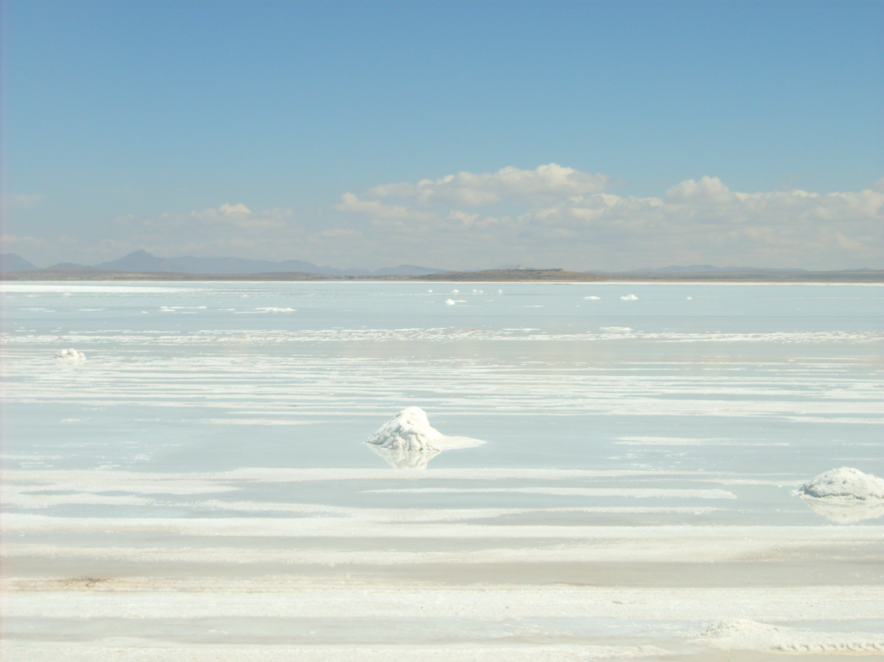
Urban mining for Lithium
© Ester van der Voet, 2020
Notes:
This picture shows the salar near Uyuni, a small town in the Andes mountains in Bolivia. It is presently a quiet and remote area, difficult to go to, and part of a fragile and valuable ecosystem. This location is considered as a potential source of large scale lithium production.

Slide 26
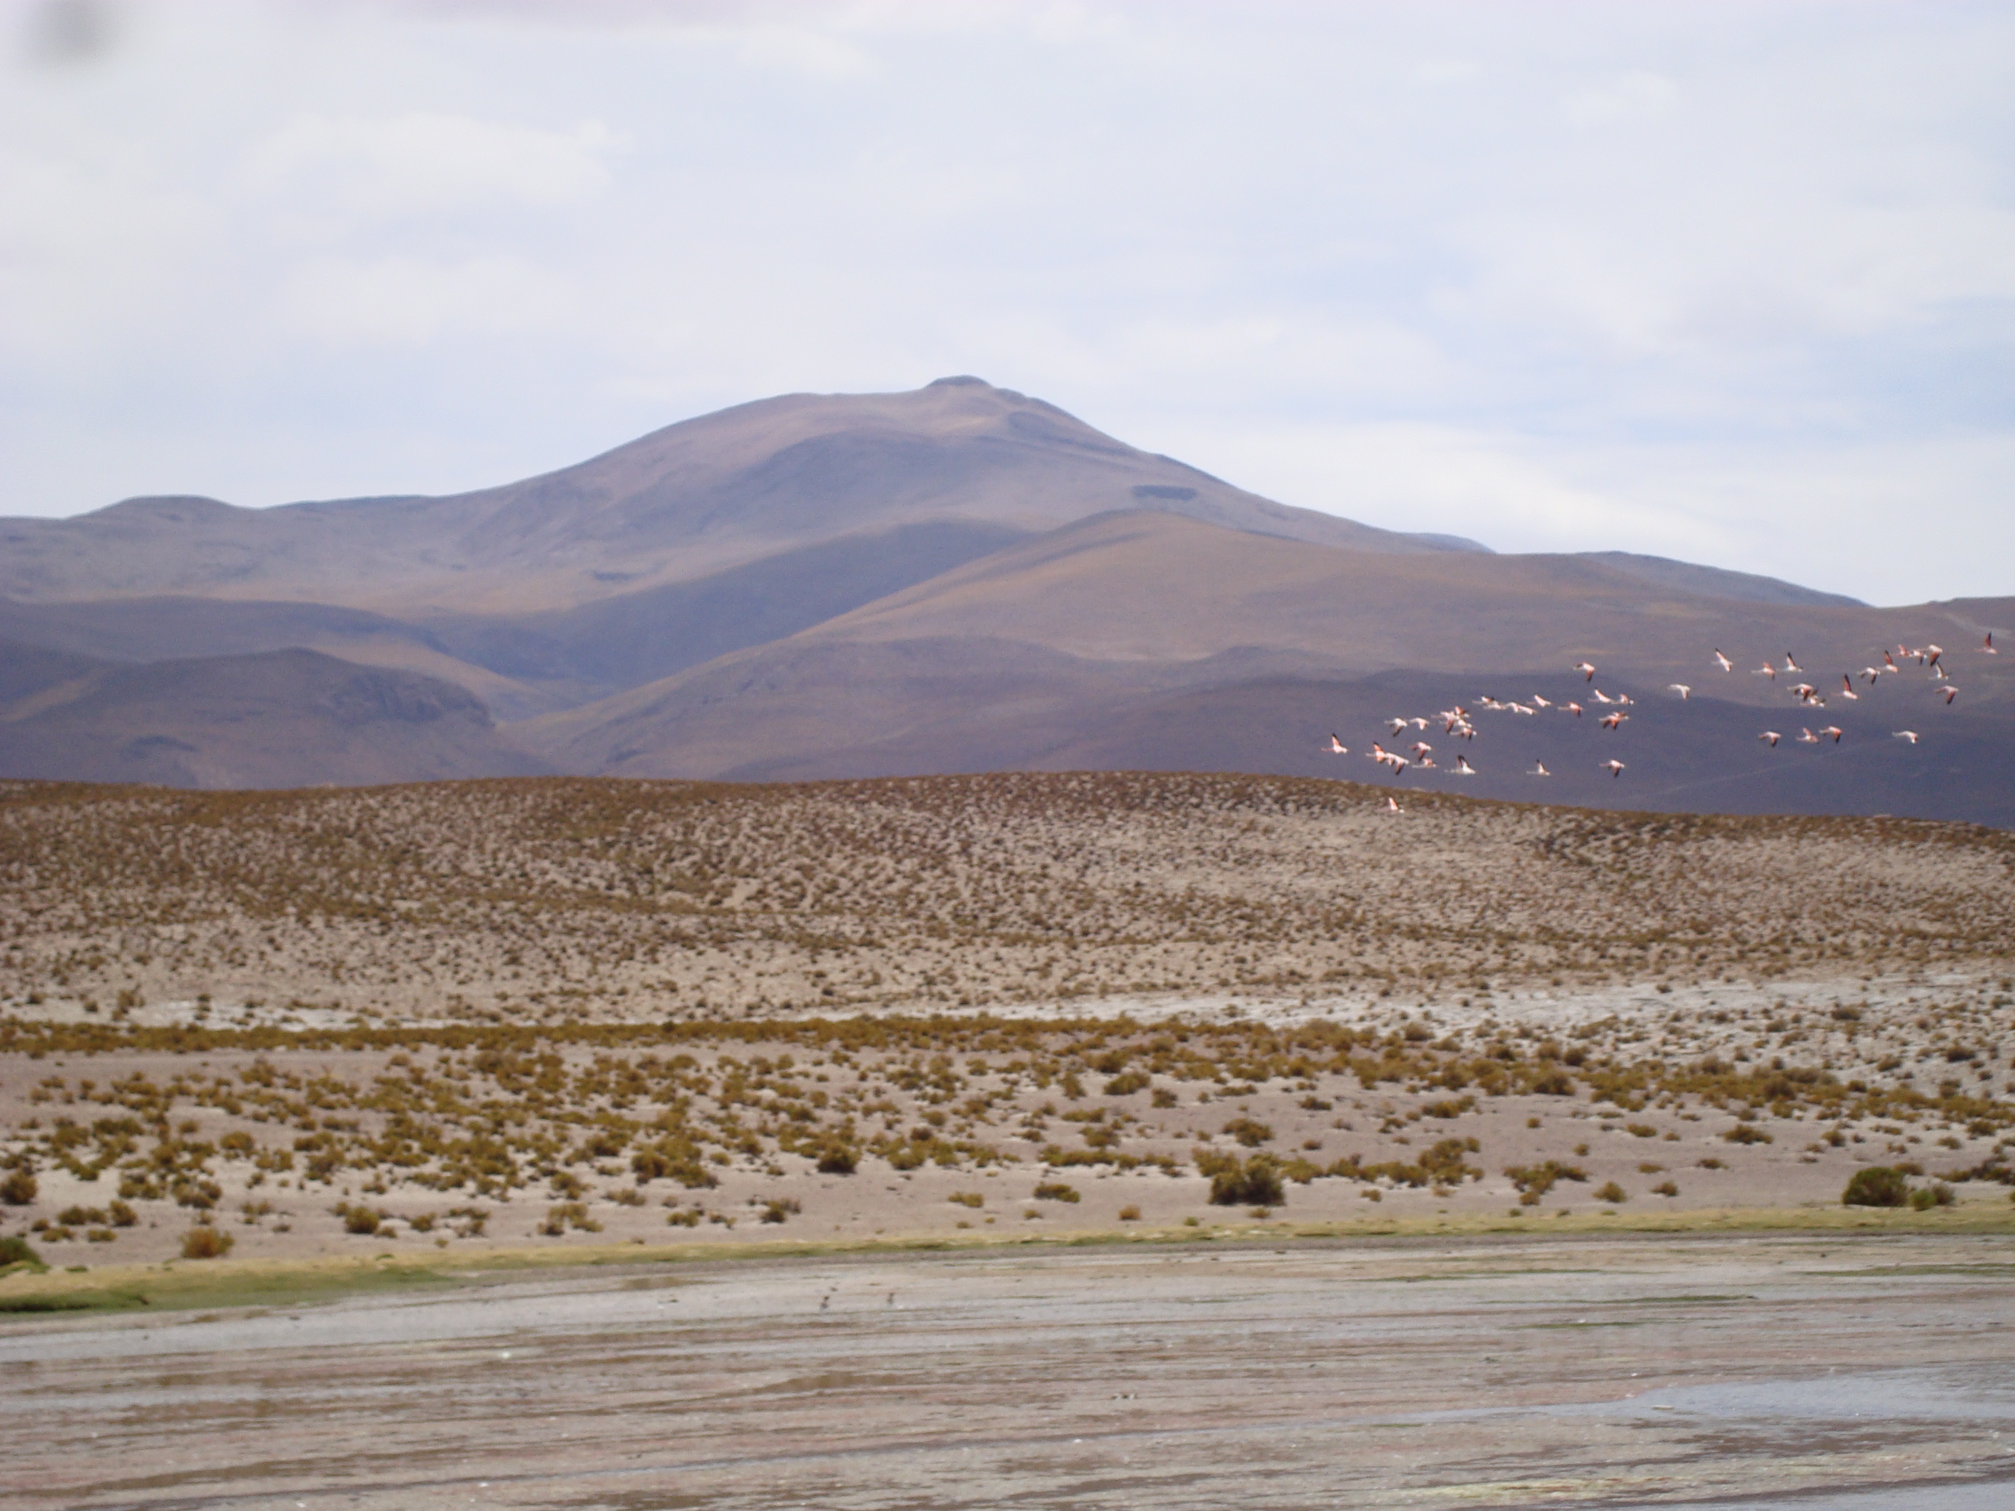
Urban mining for Lithium
© Ester van der Voet, 2020
Notes:
Exploiting the salars would imply a lot of changes: roads and other infrastructure has to be built, production plants have to be constructed, towns have to be built or expanded. This would probably mean the end of these ecosystems – here, a flock of flamingos can be seen that breed in these remote areas. Avoiding such destruction could be another reason to shift attention to urban mining.

Slide 27
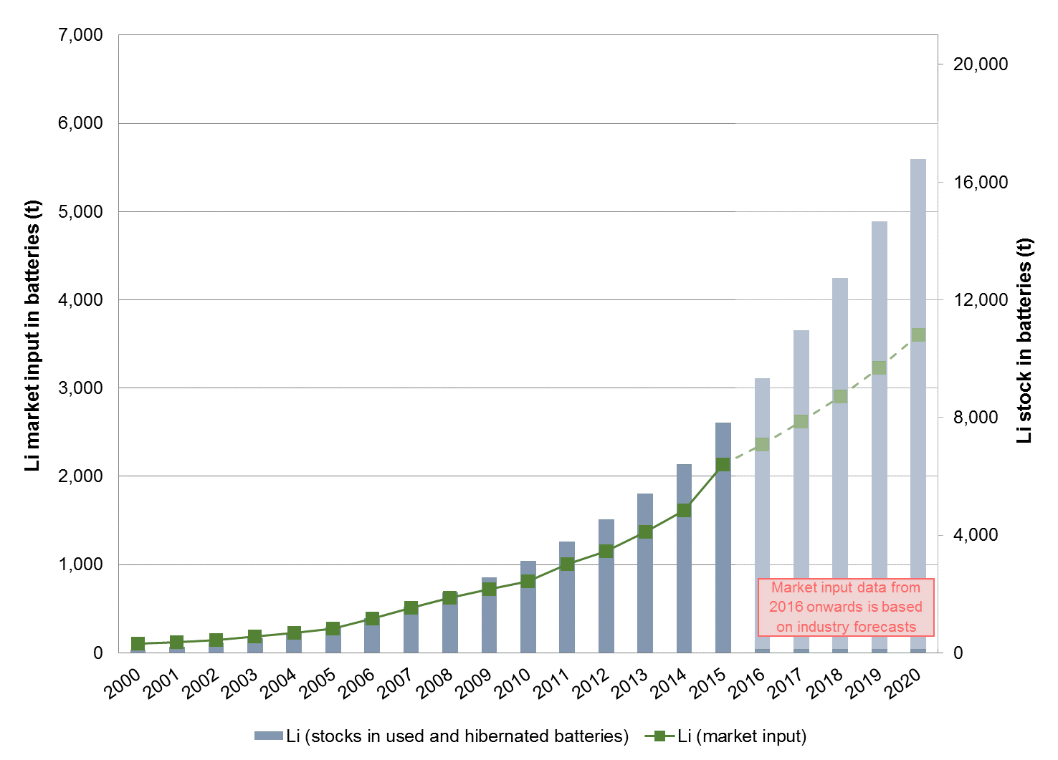
Li stock-in-use in EU (tonnes)
CRM factsheets, 2017 (from ProSUM project)
© Ester van der Voet, 2020
Notes:
In the ProSUM project, some (short-term) estimates are made of the urban mine for EU and member states.

Slide 28
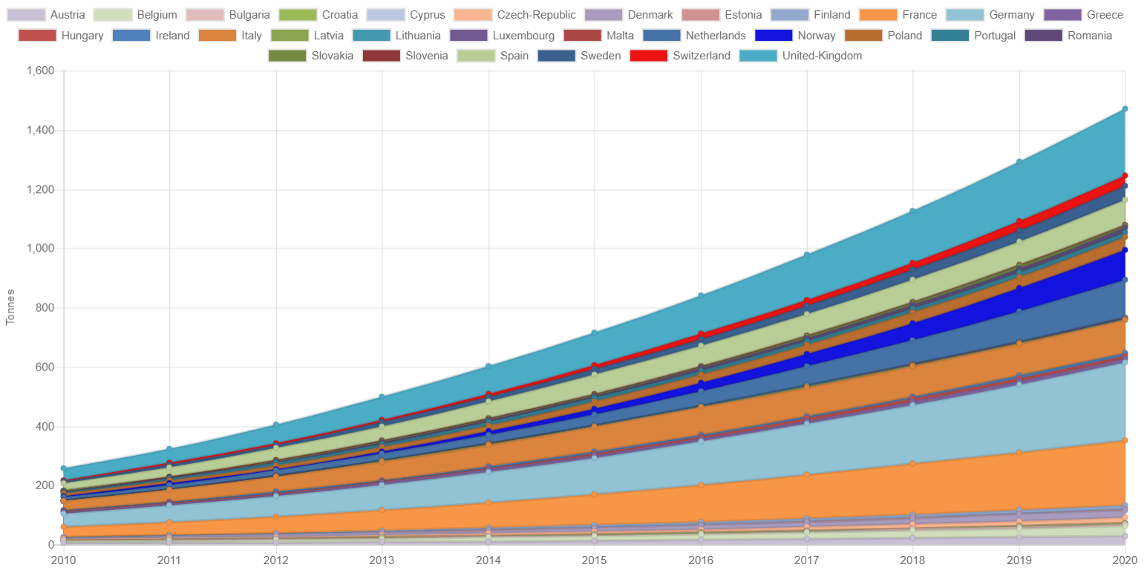
Li outflow from stock in Europe (tonnes/year)
CRM factsheets, 2017 (from ProSUM project)
© Ester van der Voet, 2020
Notes:
This figure also is a result of the ProSUM investigations: the outflow out of the in-use stock, also for the very near future, can be seen to rapidly rise. For the more distant future, it is difficult to find information at present.

Slide 29
Conclusions
The urban mine for cobalt at all scale levels is significant: same order of magnitude as geological reserves
The urban mine is growing rapidly and will probably continue to do so over the next decades
The urban mine will become more relevant as a source of materials
The information on the urban mine is poor and urgently needs to be expanded and taken up in “official” investigations and statistics
Geological surveys and national statistics bureaus seem indicated as institutions to take this up.
© Ester van der Voet, 2020
Notes:
Preliminary conclusions: for supply security as well as environmental reasons it is worthwhile to start exploring the possibilities for urban mining. Information on the urban mine is scarce at the moment. Probably the most relevant actors to host the information base for the urban mine are the geological surveys, that already have the information on geological stocks. Statistical offices could be indicated to keep track of waste streams, trade and recycling. If we want to move towards a circular economy, it is essential to strengthen the database on the mines of the future.

Slide 30
References
EC, DG Growth, 2017. Study on the Review of the List of Critical Materials. Critical Raw Material factsheets. Luxembourg, ISBN 978-92-79-72119-9
Yang, Y. 2018: Estimating European demand and recycling potential of cobalt until 2030. MScIE thesis report, Leiden/Delft Universities.
Kotnis, J. 2018: Critical Raw Materials in the City: recycling perspectives for cobalt in The Hague. MScIE thesis report, Leiden/Delft Universities.
Roskill, 2018: Presentation Battery Supply Chain Europe 2018
Hamilton, C. 2017: Cobalt: Solving for a Supply Constrained market. BMO capital markets, Global Commodities, 4 december 2017
European Commission Staff Document Report on CRMs and the circular economy. Brussels, 16-1-2018, SWD(2019)36 final
ProSUM project: http://www.prosumproject.eu/
© Ester van der Voet, 2020

Slide 31
Conclusions
Thank you!
© Ester van der Voet, 2020

Slide 32


















www.suscritmat.eu
Sustainable Management of Critical Raw Materials

