Slide 1

Scenarios for critical raw materials, the case of cobalt
Ester van der Voet
Leiden University, Institute of Environmental Sciences

Slide 2
Scenarios
Various definitions of scenarios (dictionaries)
a predicted sequence of events
an imagined sequence of events
an outline or model of an expected or supposed sequence of events
Scenarios are plausible, challenging, and relevant stories about how the future might unfold, which can be told in both words and numbers. Scenarios are not forecasts, projections, predictions, or recommendations. They are about envisioning future pathways and accounting for critical uncertainties. (source: UNEP)
© van der Voet, 2019
Notes:
Make clear scenarios are NOT predictions, despite what the dictionaries say. Scenarios are about the future, and therefore by definition inaccurate. We use the UNEP definition.

Slide 3
Scenarios
Scenarios are not precisely defined
different scale levels
different actors
different purposes
different types of (or no) quantification
different starting points
Scenarios are NEVER predictions
They are (plausible)(relevant)(extreme)(possible) stories that help us think about the future
© van der Voet, 2019
Notes:
To illustrate the breadth of the concept of scenario analysis

Slide 4
Scenarios for raw materials
Why scenarios for raw materials?
To explore solutions to the resource challenge:
  The world becomes more populous and richer: demand for resources grows
  Supply struggles to keep up, bottlenecks may arise
    supply problems
    waste
    environmental impacts
  These bottlenecks form the boundary conditions for our use of resources
© van der Voet, 2019
Notes:
Scenarios for raw materials, or materials in general, do not yet exist. Some first attempts have been made by the International Resource Panel and the OECD (see Additional reading materials). These are quite preliminary and to date (2020) only include a baseline scenario. The baseline for raw materials is already challenging at global level. The three challenges mentioned here may be different for each specific raw material.

Slide 5
Scenarios for raw materials
Resource scenarios do not yet exist
At global level, these are being developed
  by OECD (first effort published at WCEF Oct 2018)
  by UN-International Resource Panel
How will / can / might future resource demand develop?
What will be consequences if we do nothing / if we take action for
  supply
  waste
  environmental impacts?
Critical materials not (yet) part of these global level efforts
© van der Voet, 2019

Slide 6
Scenarios for raw materials
Scenarios for (critical) raw materials:
  storyline development
  quantification / modelling
There is an exercise on storyline development
Modelling: for all raw materials but ESPECIALLY critical raw materials it is important to distinguish between modelling DEMAND and modelling SUPPLY
© van der Voet, 2019
Notes:
This point is really important and though quite simple apparently not self-evident. Even at global level, where it can be maintained (roughly) that supply equals demand, it is still very important to distinguish the two. Supply scenarios specify the “mix” of the different supply routes. Supply scenarios therefore are the entrance point for environmental assessments. They are also relevant for scenarios of the circular economy. A circular economy does not imply the demand is reduced, just that the supply is secondary supply for a considerable part. In addition, for critical raw materials, there is often a disconnection between supply and demand, since these materials are often produced as co- or by-products of other materials.

Slide 7
Scenarios for raw materials
Modelling demand:
Two possible approaches: “top-down” and “bottom-up”
Top down demand modelling:
  using time series information of resource demand, and of relevant driving forces
  comprehensive
  enables linking with economic (CGE) models
  flow-based, Input Output tables as main resource module
  used by OECD in their energy scenarios and also in their resource scenarios (tbp)
  suitable for BAU, difficult for non-trend scenarios
  often lacking in detail, not suitable for CRMs
© van der Voet, 2019
Notes:
We see two different approaches emerging now for resource scenarios: top-down and bottom-up. The top-down approach originates in macro-economic analysis and often uses CGE models. Economists think such modelling is the main, or even the only, way to go. The bottom-up approach originates from engineering and starts out from technologies and individual products. Engineers think such modelling is the main, or even the only, way to go. In fact, both have their strong points as well as their limitations, and we need elements of both to compile meaningful scenarios for resources.

Slide 8
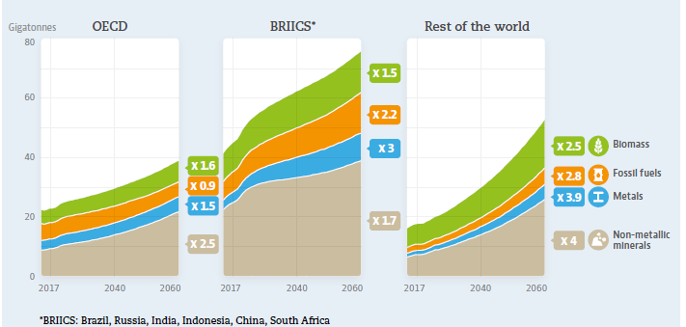
Scenarios for raw materials
Top down scenarios of metal resp. raw material demand, 2010-2050 resp. 2015 - 2060
source: Elshkaki et al., 2018 source: OECD, 2018
© van der Voet, 2019
Notes:
This is a top-down approach using only GDP and population as driving forces. Such an approach can, as can be seen here, also be used at the level of individual materials. For CRM it doesn’t work so well as a (cor)relation between such drivers and the production of these materials cannot be established.

Slide 9
Scenarios for raw materials
Modelling demand
Bottom up:
  building it up from most detailed level of resource applications and using driving force variables to forecast these applications
  captures essential stock dynamics
  enables including CRMs and other minor materials
  used by PBL in their IMAGE-TIMER models to forecast energy systems
  suitable for non-trend scenarios
  stock-based, dynamic Material Flow Analysis, Life Cycle Assessment
  data intensive, database quite incomplete
© van der Voet, 2019
Notes:
CRM are only visible in a bottom-up approach. A top-down approach is too crude to enable following small-scale materials. It is however possible to take a bottom-up approach also with global level IAMs, as the examples from Deetman et al. and Marinova et al. show (see further slides).

Slide 10
Scenarios for raw materials
bottom-up scenario of steel stock development for buildings in China, 2010-2050
source: Marinova et al., forthcoming
© van der Voet, 2019
Notes:
An example of bottom-up modelling of construction materials. This example refers to China but in fact these results exist for all 26 global IMAGE regions (IMAGE being one of the major climate models used for the IPCC assessments).

Slide 11
Scenarios for raw materials
Modelling supply: specify how demand is supposed to be met
  different mines / countries
  different shares of secondary production (circular economy)
  different production routes, different efficiency of production processes
Separate supply modelling essential
  when supply and demand are not automatically connected
  when an assessment of waste generation and environmental impacts is required: this depends on technologies.
© van der Voet, 2019
Notes:
The relevant point here is that for CRM, as these are often co- of by-products of other materials, there is no automatic connection between supply and demand. Their supply depends on the demand for the “host” material.

Slide 12
Scenarios for critical raw materials
Critical materials are a special case
Questions to be answered seem to be mostly industry related, and mostly short-term BAU:
  will specific industries be able to meet their raw materials requirements in the next few years
  how can we develop a business case for the production of certain CRMs
more general questions, industry and government, are out there as well:
  will there be sufficient raw materials to upscale specific technologies
  how can we increase supply / develop substitutes / develop alternative technologies / create markets / temporise demand / go circular / .....
© van der Voet, 2019
Notes:
CRMs are particularly difficult to capture in long-term forecasts. They are mostly new markets and suffer under supply constraints. If for example as a result of the increase in renewable energy technologies the demand for these materials would explode, it may not be possible to raise supply accordingly. In that case it is likely that the application will not persist and different technologies will be developed.

Slide 13
Scenarios for critical raw materials: demand
Modelling demand of critical materials:
top-down modelling usually impossible
  no data
  production often disconnected from demand
  no correlating driving force
so bottom up modelling is the only option
  modelling of demand for applications
  assuming the CRM will be used according to plan
© van der Voet, 2019
Notes:
Modelling of applications of CRM is done and some examples are shown below. Such modelling assumes technologies will remain as they are now. This is most probably not a true assumption, but it is also very difficult to make a different assumption as it is quite uncertain or even unknown what will be the replacement.

Slide 14
Scenarios for critical raw materials : demand
Bottom-up modelling of CRM demand
  demand for applications of CRMs
  combined with information on CRM content in applications
large data gaps and high uncertainties
  data stops at raw material level: mining, production, and to some extent imports and exports of the raw material
  following materials up the supply chain not possible – or not public
  Input Output models covering supply chains not suitable
    translation from/into monetary terms doesn’t make sense
    insufficient level of detail in sectors
  material content data absent, or partial, or rapidly changing over time
© van der Voet, 2019
Notes:
In Input Output modelling, attempts are being made to include materials. This may be feasible for large-scale materials such as concrete or steel. It is futile for CRMs.

Slide 15
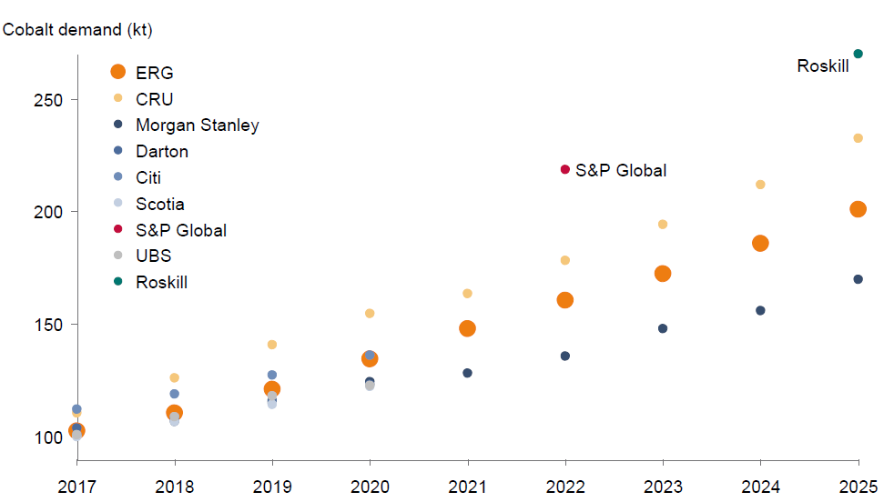
Scenarios for critical raw materials: demand
Industry Co demand scenarios: short term trends (source: Roskill, 2018)
© van der Voet, 2019
Notes:
Here starts the new material, with some specific demand scenarios for cobalt. This one from the industry – only until 2025.

Slide 16
Scenarios for critical raw materials: demand
bottom-up scenario of Co demand
world, SSP2 scenario, until 2050
with assumptions on Co content
and on climate policy
Co demand in 2050: 90 – 700 kt/y
Source: Deetman et al., 2018
© [Name], 2018
Notes:
This scenario is also shown in the slides of the general Raw materials scenarios lecture. It refers to cobalt and shows results until 2050, under assumptions of constant technology.

Slide 17
Scenarios for critical raw materials: demand
What is the composition of products?
Some data on “where does the material end up in”
But very little data on product composition
ProSUM project first attempt to systematically collect such data (http://www.urbanmineplatform.eu/homepage)
  for batteries, vehicles and consumer electronics
  including changes in composition over time
  unfortunately, database not published
© van der Voet, 2019
Notes:
ProSUM is really a very relevant project and presents lots of materials that can be used for a bottom-up scenario development for CRM.

Slide 18
Scenarios for critical raw materials: supply
Modelling supply of CRMs?
Dependent on many things besides demand
  prices
  demand for host material
  share of secondary production
  .....
Models of little use
  supply chain resilience models?
Some estimates for the short term based on present situation
In scenario exercises, focus is usually on demand
© van der Voet, 2019
Notes:
It is even more difficult to forecast supply as there are many unknowns. For CRMs, supply = demand is way too simplistic.

Slide 19
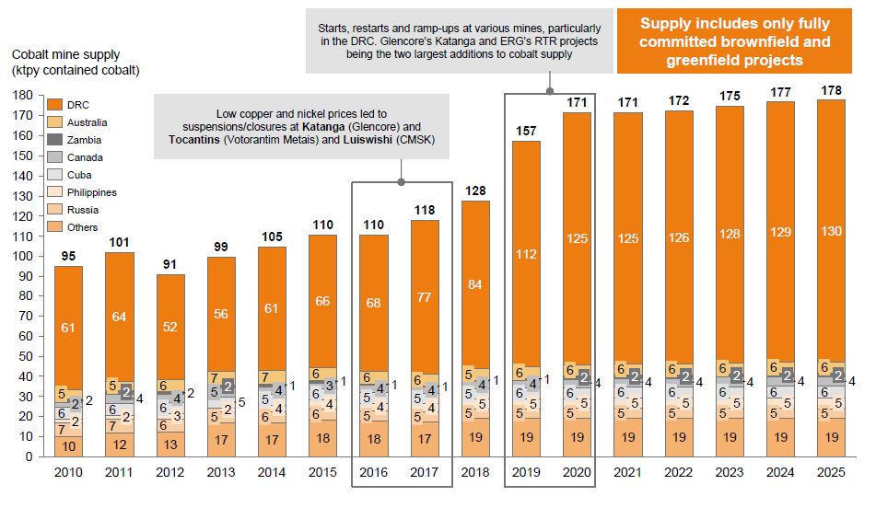
Scenarios for critical raw materials: supply
supply scenario for Co (Roskill, 2018)
© van der Voet, 2019
Notes:
Supply projections only cover very short periods and depend on present mining operations only.

Slide 20
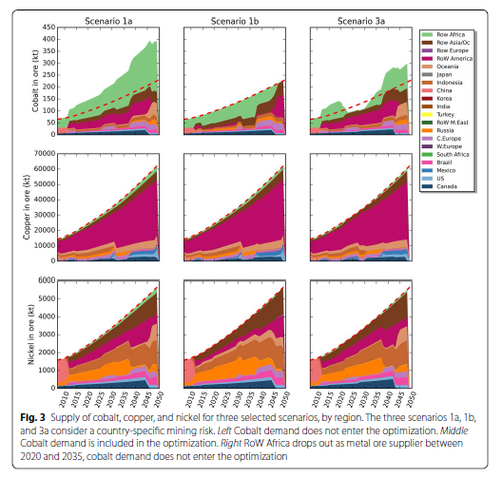
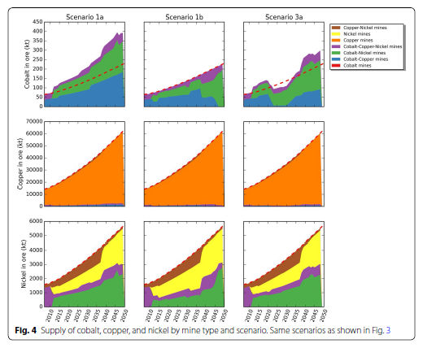
Scenarios for critical raw materials: supply
supply scenario for Co (Tisserant & Pauliuk, 2016)
© van der Voet, 2019
Notes:
This shows results from a bold scenario attempt for cobalt supply scenarios until 2050. Various eventualities have been explored here.

Slide 21
References
OECD, 2018: Global Material Resources Outlook to 2060 – Economic Drivers and Environmental Consequences (highlights brochure)
Elshkaki et al., 2018: Environ Sci Technol. 2018 52 (5), 2491-2497
Roskill, 2018: Presentation Battery Supply Chain Europe 2018
Deetman et al, 2018: Environ Sci Technol. 2018 52(8):4950-4959
Tisserant & Pauliuk, 2016: Economic Structures (2016) 5: 4. https://doi.org/10.1186/s40008-016-0035-x
© van der Voet, 2019

Slide 22
Scenarios for critical raw materials: classroom exercise
Exercise Scenarios for cobalt:
Develop with your group a storyline for future cobalt demand and supply
Make an assessment of cobalt demand and supply under this scenario
Identify problematic issues and speculate on whether these could be solved
Don’t worry about being accurate or realistic, this is NOT the purpose of this exercise
See hand-outs!
© van der Voet, 2019
Notes:
The explanation of the scenario exercise can be found in the hand-out: the Word document called Scenario Storyline Development Exercise.

Slide 23
Scenarios for critical raw materials: classroom exercise
There are four different types of scenarios (each group selects one via the envelope):
rapid energy transition scenario
circular economy scenario
strict sourcing policies scenario
black swan (some disaster happens)
Scale is global, time horizon is up to 2050
A business-as-usual is provided, see handout, to use as a reference.
© van der Voet, 2019
Notes:
The envelope: little slips of paper with the scenario titles on them are folded and put into an envelope, to be drawn by the different groups like lots.

Slide 24
Scenarios for critical raw materials: classroom exercise
Step 1. specify the “background” system for your scenario
socio-economic developments (population, welfare)
technology developments
(geo)political developments
other relevant developments
Pay special attention to deviations from trends.
© van der Voet, 2019
Notes:
A step-by-step approach is introduced. Checking back after each step is recommended, especially for groups that are not used to these brainstorming type exercises. Frequent reassurances that there is no need to be realistic or accurate are recommended as well. It is all about the thought experiment.

Slide 25
Scenarios for critical raw materials: classroom exercise
Step 2. Specify demand (bottom-up)
how will demand for Co containing applications develop in your scenario
just relative trends is good enough: more / less than BAU
drops or surges are especially interesting
© van der Voet, 2019

Slide 26
Scenarios for critical raw materials: classroom exercise
Step 3. Speculate on consequences. You can use all information you have obtained in this course, or any other, or none, to support you
are supply bottlenecks to be expected, and could something be done about that
what are consequences for society at large
© van der Voet, 2019

Slide 27
Scenarios for critical raw materials: classroom exercise
Step 4. Visualise: draft 1 figure to characterise your scenario
Think of a name for your scenario
Include demand and supply development for cobalt in this figure
Step 5: present your scenario in 1 minute
© van der Voet, 2019
Notes:
Usually this is a timeline where demand and supply of cobalt are drafted.

Slide 28


















www.suscritmat.eu
Sustainable Management of Critical Raw Materials

