Slide 1

Scenarios for critical raw materials
Ester van der Voet
Leiden University, Institute of Environmental Sciences
© Ester van der Voet, 2020

Slide 2
Contents of lecture
Scenarios
Scenarios for raw materials
Scenarios for critical raw materials
  Demand scenarios
  Supply scenarios
Some observations
© Ester van der Voet, 2020

Slide 3
Scenarios
Various definitions of scenarios (from dictionaries)
a predicted sequence of events
an imagined sequence of events
an outline or model of an expected or supposed sequence of events
Scenarios are plausible, challenging, and relevant stories about how the future might unfold, which can be told in both words and numbers. Scenarios are not forecasts, projections, predictions, or recommendations. They are about envisioning future pathways and accounting for critical uncertainties. (source: UNEP)
© Ester van der Voet, 2020
Notes:
Make clear scenarios are NOT predictions, despite what the dictionaries say. Scenarios are about the future, and therefore by definition inaccurate. We use the UNEP definition.

Slide 4
Scenarios
Scenarios can be used to explore consequences of actions
What happens if we do nothing? What challenges will we meet?
What will happen as a result of certain decisions? Does it solve the challenges? Might there be new challenges?
© Ester van der Voet, 2020
Notes:
The added value of scenario analysis is not to try and be as “correct” as possible about the future, but to use scenarios as a tool to envision consequences of certain decisions or identify a “desirable” way to go.

Slide 5
Scenarios
To explore future possibilities we can define
  A reference or baseline, often “business-as-usual”
  A best and/or worst case
  Other possible pathways, neutral or in between
Starting point can be
  Present, exploring developments for the future (forecasting)
  Future, making explicit what needs to be done (backcasting)
© Ester van der Voet, 2020
Notes:
Explain different types of scenarios, to make clear there is not just one. A BAU is useful as a reference, to offset the other scenarios that may show more extreme developments. Forecasting vs backcasting: forecasting starts from the present and explores pathways into the future, while backcasting starts from the future – often w desired future – and explores pathways back to the present. Forecasting answers questions like: what would happen if …? Backcasting answers questions like: what is needed to get where we would like to be?

Slide 6
Scenarios
Scenarios can be used at any scale level
  Personal: economic decisions at household level
  Local governments: development of neighbourhoods, decisions around construction activities
  Companies: to support decisions on large scale investments
  National governments: to support economic, social or environmental policies
  Continental and global level: to signal global challenges and constraints
© Ester van der Voet, 2020

Slide 7
Scenarios
Scenarios for different questions
  Long-term vs. Short-term
  Baseline vs. Transition
  Quantitative vs. Qualitative
  Partial / local vs Comprehensive / global
  Forecasting vs. Backcasting
  Normative vs Exploratory
© Ester van der Voet, 2020
Notes:
This is to scope the breadth of things that can be categorised under the heading of Scenarios. Note that often a baseline scenario is used to offset the other, more transition oriented scenarios. Especially relevant to acknowledge that quantification is not always necessary: sometimes, the storyline may already be sufficient information. All depends on who wants to use scenarios for what purpose. For large-scale policy supporting scenarios such as the IPCC climate scenarios, quantification is needed. We want to know the effectiveness of certain changes, and the magnitude of necessary changes to stay within the 2 degrees. For such scenarios, it is important to have some (policy) goal, aim, or target as a reference point.

Slide 8
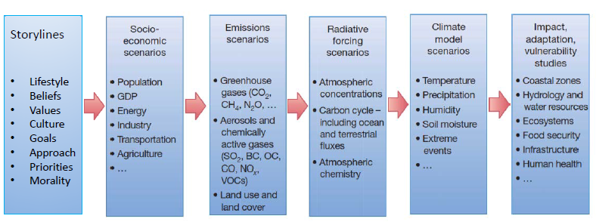
Scenarios
Most experience with scenarios for climate change
© Ester van der Voet, 2020
Notes:
This is the sequence of modelling events for the climate scenarios. They clearly follow the DPSIR approach embedded in the main global level Integrated Assessment models. The R (Responses) is missing here, a crucial item in any scenario that has to support policy decisions.

Slide 9
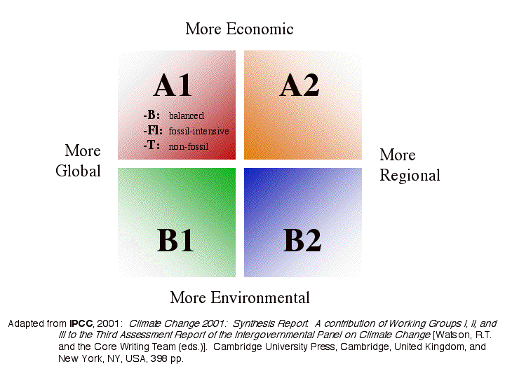
Scenarios
© Ester van der Voet, 2020
Notes:
Many scenario efforts use the Quadrants approach to typify the main underlying developments in two axis. This helps in visualisation but also in understanding the main influential variables. This quadrant picture comes from the 2001 IPCC report on climate change scenarios. It is based on two axes: scale level of decision making, and emphasis on economic development vs environmental sustainability. In a later stage this Quadrants approach has been abandoned by IPCC in favour of the SSP scenarios that describe different socio-economic developments without an environmental axis. Each of those SSP scenarios has a two-degree variant.

Slide 10
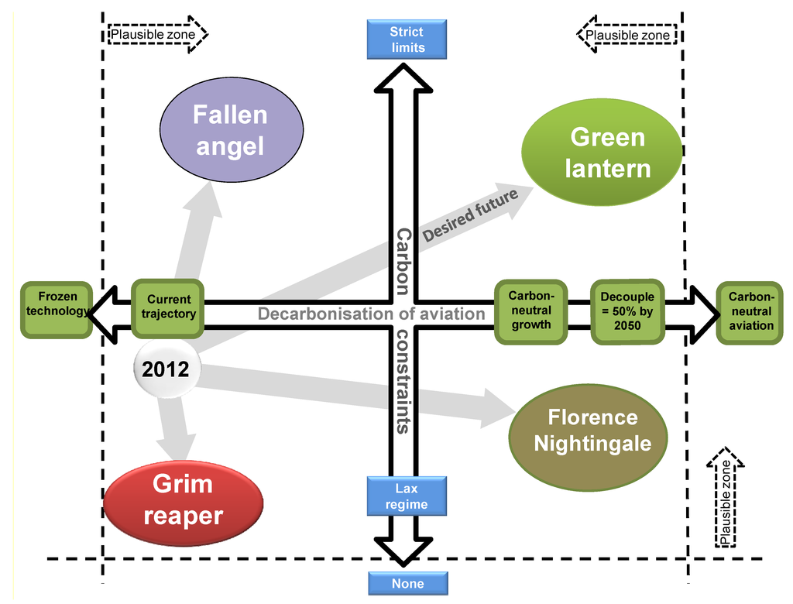
Scenarios
© Ester van der Voet, 2020
Notes:
Examples of quadrants, including the characterisation of the scenarios following from it

Slide 11
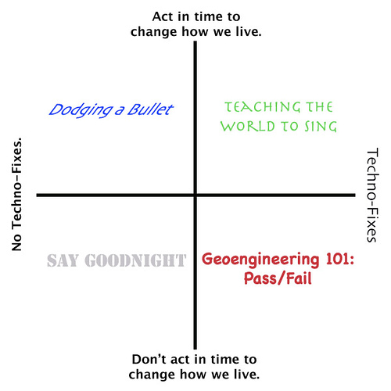
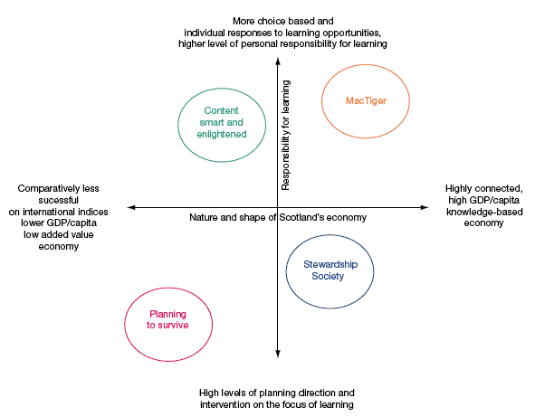

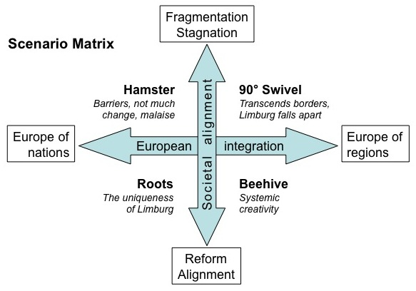
Scenarios
© Ester van der Voet, 2020
Notes:
More examples, note the funny names used to characterise the scenarios. Again helpful for visualisation.

Slide 12
Scenarios
The need for scenarios for raw materials: the resource challenge
The world becomes more populous and richer: demand for resources grows
Supply struggles to keep up, bottlenecks may arise
  supply problems
  waste
  environmental impacts
These bottlenecks form the boundary conditions for our use of resources
© Ester van der Voet, 2020
Notes:
Scenarios for raw materials, or materials in general, do not yet exist. Some first attempts have been made by the International Resource Panel and the OECD (see Additional reading materials). These are quite preliminary and to date (2020) only include a baseline scenario. The baseline for raw materials is already challenging at global level. The three challenges mentioned here may be different for each specific raw material.

Slide 13
Scenarios
source: British Geological Survey, 2018
© Ester van der Voet, 2020
Notes:
This is the past: a powerful rise in iron ore production during the last decades. Though not so fast, this rise is expected to continue well into the future.

Slide 14
Scenarios
source: van der Voet et al., 2019
© Ester van der Voet, 2020
Notes:
This slide shows how environmental impacts are related to primary material production. Aluminium shows more differentiation in the developments of the impacts than iron. The reason is the changes (improvements) that have been implemented in the aluminium production processes. For iron and steel, the processes have not changed so much.

Slide 15
Scenarios
Resource scenarios do not yet exist: how will / can / might future resource demand and supply develop?
Many variables, to be explored in scenarios with different storylines
© Ester van der Voet, 2020
Notes:
This slide summarises the earlier ones and suggests to use the experience already available from the climate change scenario assessments.

Slide 16
Scenarios
Resource scenarios could be limited to society
Storylines Socio-economic Technology Extractions
scenarios and emissions
(demand) (supply) (consequences)
© Ester van der Voet, 2020
Notes:
The previous slide also points at some differences. While for the climate scenarios the focus has to be on the impacts and the 2 degrees target, this is different for raw materials scenarios. There is no target, neither is it easy to imagine how one could arrive at such a target.

Slide 17
Scenarios
Resource scenarios would be comparable to energy scenarios rather than climate scenarios
Not just energy demand, but also energy supply is specified
Fuel and electricity mixes
Sometimes quite detailed with regard to sector and world region
Energy scenarios:
IEA: WEO scenarios specified by Energy Technology Perspectives model
Shell scenarios
Mainly technology oriented, mix between business-as-usual and meeting climate targets
© Ester van der Voet, 2020
Notes:
Raw materials scenarios are much more like energy scenarios: there are no targets for the use of energy, only for the consequences of energy use, i.e. climate change. Resource scenarios could be constructed like energy scenarios, starting out from a demand projection, and then specifying a “mix” of different production routes. This is done for example in the World Energy Outlook scenarios of the International Energy Agency. For energy the mix refers to the energy technologies that can be employed. For resources, we still have to think about the rationale. This thought process has barely started yet, but it is becoming clear that secondary supply in the future has to play a much more important role.

Slide 18
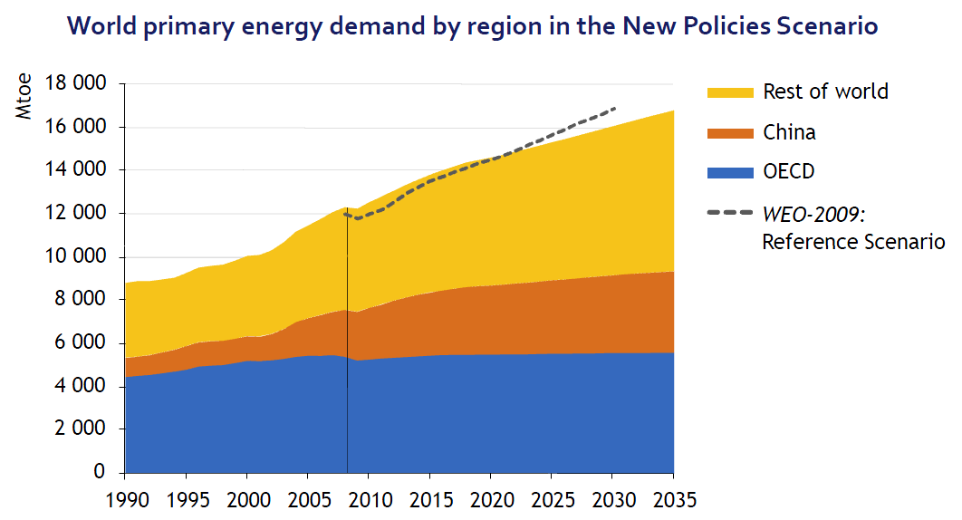
Scenarios
source: International Energy Agency, 2008
© Ester van der Voet, 2020
Notes:
Some IEA scenarios for energy use
On this slide, the demand is shown for different world regions. It shows that OECD countries are responsible for about half the demand now, but in future other world regions will become more important while energy use in OECD countries stabilises. Could be detailed much further – information is available.

Slide 19
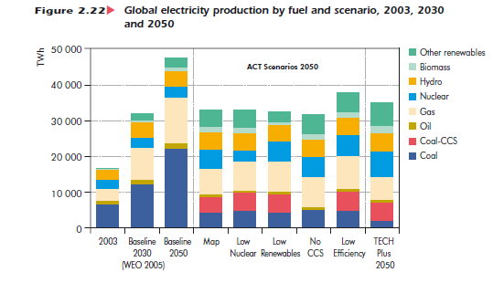
Scenarios
source: International Energy Agency, 2008
© Ester van der Voet, 2020
Notes:
This slide then shows a variety of energy technology mixes: the different supply scenarios belonging to the demand scenarios.

Slide 20
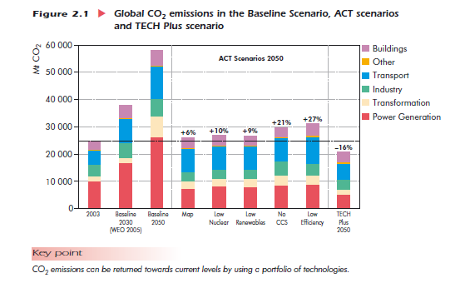
Scenarios
source: International Energy Agency, 2008
© Ester van der Voet, 2020
Notes:
..and this slide then shows the resulting CO2 emissions ….
… that can then be translated into temperature rise with global climate models.

Slide 21
Scenarios
Scenario storylines:
  Business as Usual / Baseline / Reference
  Alternative storylines considering target variable
Nowadays often: various “baselines”, getting away from the four quadrants
Shared Socio-economic Pathway scenarios (SSP scenarios) used now by IPCC in climate modelling are like that: different storylines of global development, climate change being a result rather than an input.
© Ester van der Voet, 2020
Notes:
Introduction of the SSP scenarios as being different from the scenario modelling so far. The storyline does not refer to climate change but to general socio-economic developments. In that sense, all SSP scenarios are baselines. All SSP scenarios also have a 2 degree variant, employing different energy systems to supply the demand.

Slide 22
Scenarios
Scenario modelling is the next step
Very important (and especially for CRMs): make a difference between modelling demand and supply!
© Ester van der Voet, 2020
Notes:
This point is really important and though quite simple apparently not self-evident. Even at global level, where it can be maintained (roughly) that supply equals demand, it is still very important to distinguish the two. Supply scenarios specify the “mix” of the different supply routes. Supply scenarios therefore are the entrance point for environmental assessments. They are also relevant for scenarios of the circular economy. A circular economy does not imply the demand is reduced, just that the supply is secondary supply for a considerable part.

Slide 23
Scenarios
Modelling demand:
Two possible approaches: “top-down” and “bottom-up”
Top down demand modelling:
  using time series information of resource demand, and of relevant driving forces
  comprehensive
  enables linking with economic (CGE) models
  flow-based, Input Output tables as main resource module
  used by OECD in their energy scenarios and also in their resource scenarios (tbp)
  suitable for BAU, difficult for non-trend scenarios
  often lacking in detail, not suitable for CRMs
© Ester van der Voet, 2020
Notes:
We see two different approaches emerging now for resource scenarios: top-down and bottom-up. The top-down approach originates in macro-economic analysis and often uses CGE models. Economists think such modelling is the main, or even the only, way to go. The bottom-up approach originates from engineering and starts out from technologies and individual products. Engineers think such modelling is the main, or even the only, way to go. In fact, both have their strong points as well as their limitations, and we need elements of both to compile meaningful scenarios for resources.

Slide 24
Scenarios
Modelling demand (continued)
Bottom up demand modelling:
  building it up from most detailed level of resource applications and using driving force variables to forecast these applications
  captures essential stock dynamics
  enables including CRM and other minor materials
  used by PBL in their IMAGE-TIMER models to forecast energy systems
  suitable for non-trend scenarios
  stock-based, dynamic Material Flow Analysis, Life Cycle Assessment
  data intensive, database quite incomplete
© Ester van der Voet, 2020
Notes:
CRM are only visible in a bottom-up approach. A top-down approach is too crude to enable following small-scale materials. It is however possible to take a bottom-up approach also with global level IAMs, as the examples from Deetman et al. and Marinova et al. show (see further slides).

Slide 25
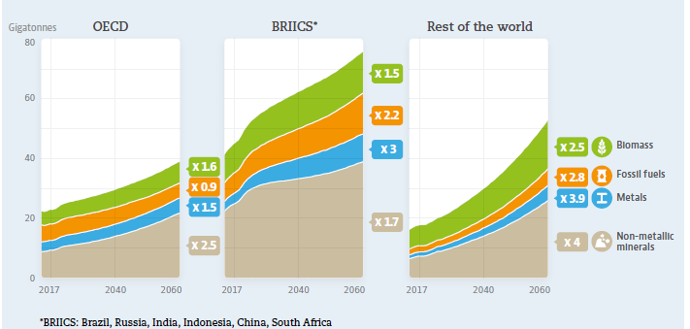
Scenarios
Top down scenarios of metal resp. raw material demand, 2010-2050 resp. 2015 - 2060
source: Elshkaki et al., 2018 source: OECD, 2018
© van der Voet, 2019
Notes:
This is a top-down approach using only GDP and population as driving forces. Such an approach can, as can be seen here, also be used at the level of individual materials. For CRM it doesn’t work so well as a (cor)relation between such drivers and the production of these materials cannot be established. This approach is taken by OECD in their resource scenarios, and also by the International Resource Panel in their Global Resources Outlook (IRP, 2019). Both these global level efforts are not relevant for CRM.

Slide 26
Scenarios
Bottom-up scenario of steel stock development for buildings in China, 2010-2050
source: Marinova et al., 2020
© Ester van der Voet, 2020
Notes:
An example of bottom-up modelling of construction materials. This example refers to China but in fact these results exist for all 26 global IMAGE regions (IMAGE being one of the major climate models used for the IPCC assessments).

Slide 27
Scenarios
Modelling supply: specify how demand is supposed to be met
  different production routes
  different shares of secondary production (circular economy)
  different efficiency of production processes
Separate supply modelling essential
  when supply and demand are not automatically connected
  when an assessment of waste generation and environmental impacts is required
© Ester van der Voet, 2020
Notes:
The relevant point here is that for CRM, as these are often co- of by-products of other materials, there is no automatic connection between supply and demand. Their supply depends on the demand for the “host” material.

Slide 28
Scenarios
Critical materials are a special case
Questions to be answered ...
seem to be mostly industry related, and mostly short-term BAU:
  will specific industries be able to meet their raw materials requirements in the next few years
  how can we develop a business case for the production of certain CRMs
more general questions, industry and government, are out there as well:
  will there be sufficient raw materials to upscale specific technologies
  how can we increase supply / develop substitutes / develop alternative technologies / create markets / temporise demand / .....
Choices for modelling limited
Essential to distinguish between demand and supply
© Ester van der Voet, 2020
Notes:
CRMs are particularly difficult to capture in long-term forecasts. They are mostly new markets and suffer under supply constraints. If for example as a result of the increase in renewable energy technologies the demand for these materials would explode, it may not be possible to raise supply accordingly. In that case it is likely that the application will not persist and different technologies will be developed. That makes it very difficult and also rather irrelevant to try and compose a “baseline” scenario for these materials with their volatile behaviour.

Slide 29
Scenarios
Modelling demand of critical materials:
top-down modelling impossible
  no data
  production often disconnected from demand
  no correlating driving force
so bottom up modelling is the only option
  modelling of demand for applications
  assuming the CRM will be used according to plan
© Ester van der Voet, 2020
Notes:
Modelling of applications of CRM is done and some examples are shown below. Such modelling assumes technologies will remain as they are now. This is most probably not a true assumption, but it is also very difficult to make a different assumption as it is quite uncertain or even unknown what will be the replacement.

Slide 30
Scenarios
Bottom-up modelling of CRM demand:
  demand for applications of CRMs
  combined with information on CRM content in applications
large data gaps
  data stops at raw material level: mining, production, and to some extent imports and exports of the raw material
  following materials up the supply chain not possible – or not public
  Input Output models covering supply chains not suitable
    translation into monetary terms doesn’t make sense
    insufficient level of detail in sectors
© Ester van der Voet, 2020
Notes:
In Input Output modelling, attempts are being made to include materials. This may be feasible for large-scale materials such as concrete or steel. It is futile for CRMs.

Slide 31
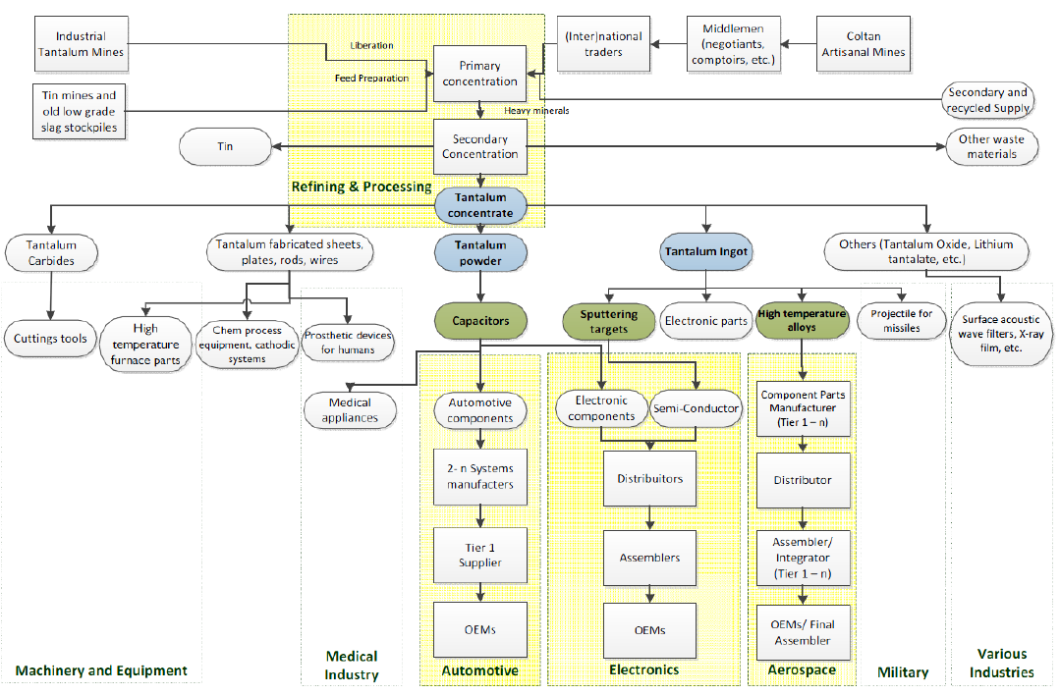
Scenarios
© Ester van der Voet, 2020
Notes:
Deetman et al. (2018) have shown what happens if an attempt is made to construct a material flow account for Tantalum in the EU, based on the EXIOBASE input-output classification. They managed to construct such an account, but the input-output classification, although already quite detailed, was useless for following Tantalum flows.

Slide 32
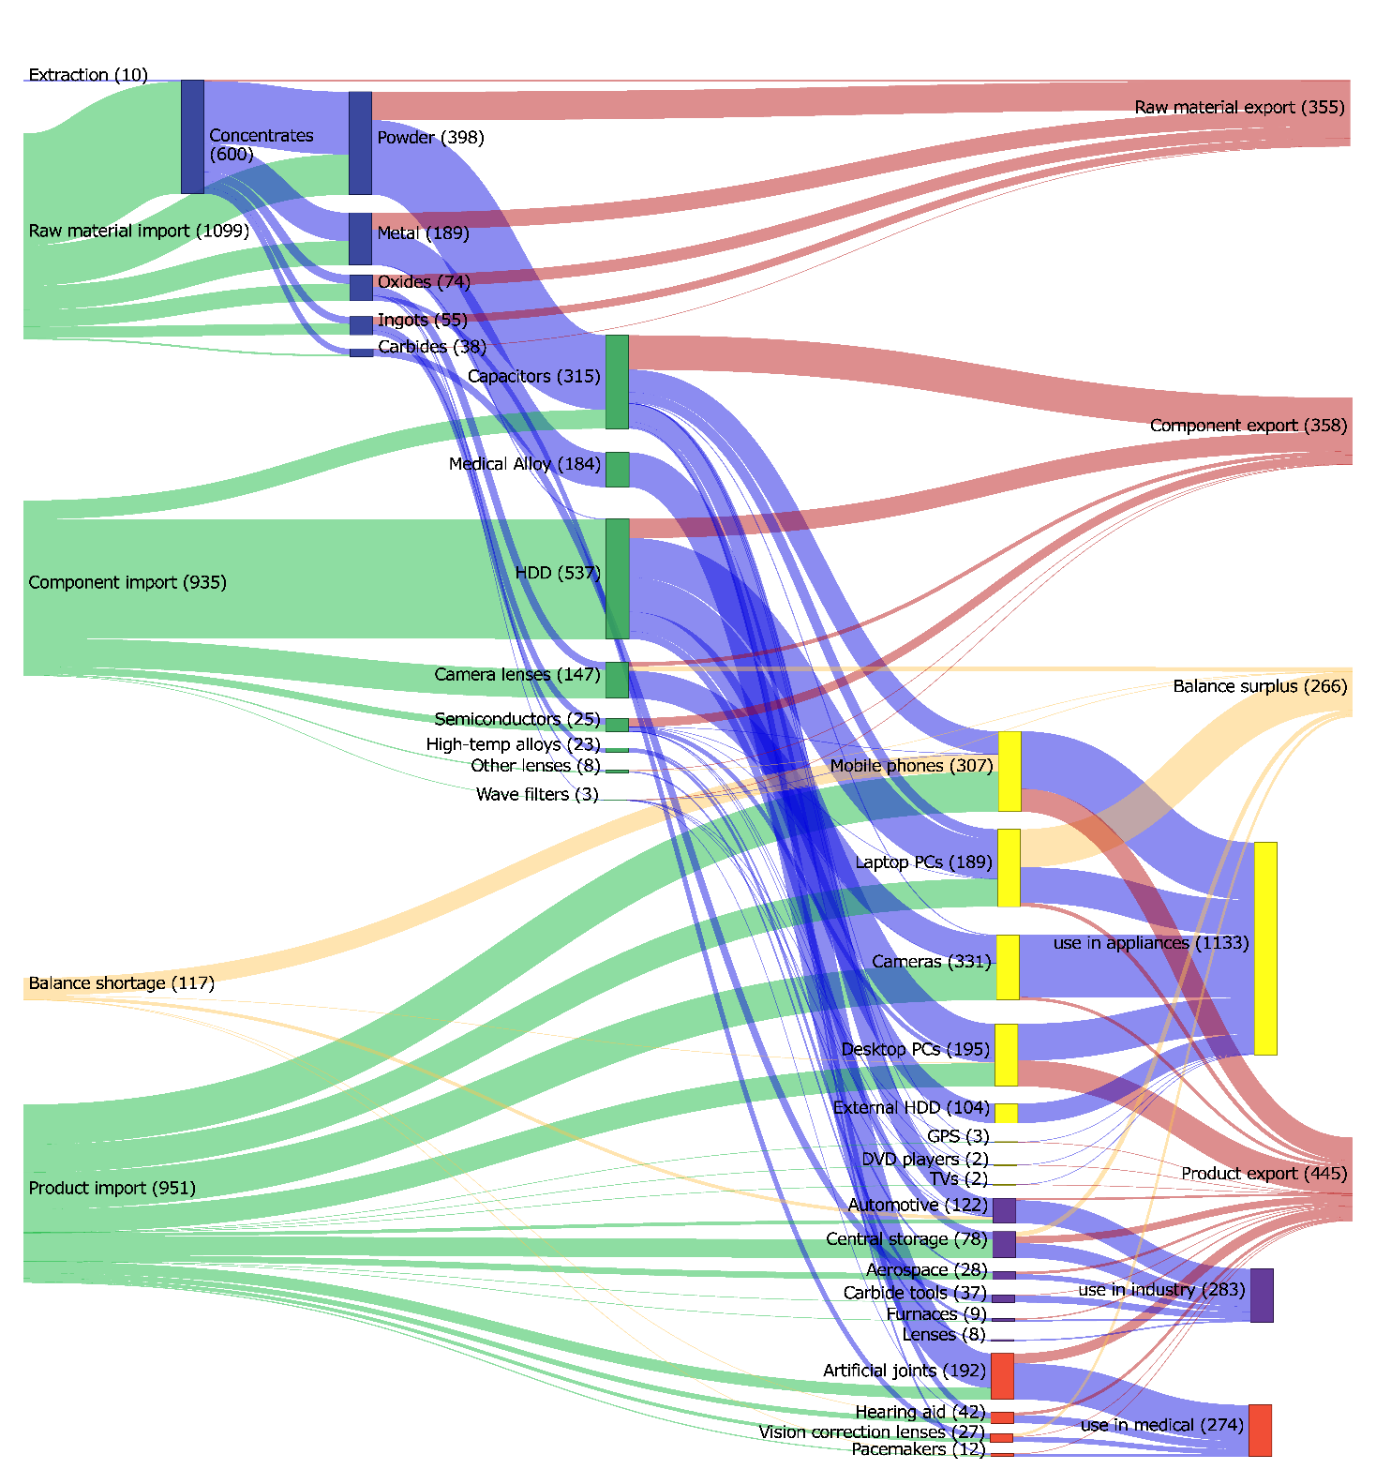
Scenarios
Tantalum flows in EU
(Deetman et al., 2018)
© Ester van der Voet, 2020
Notes:
An interesting side-result from this endeavour was, by the way, that there seem to be huge discrepancies in the global tantalum trade data. Trade flows of the raw material are huge compared to extraction data. Missing extraction data from some African countries is expected to be the cause of that.

Slide 33
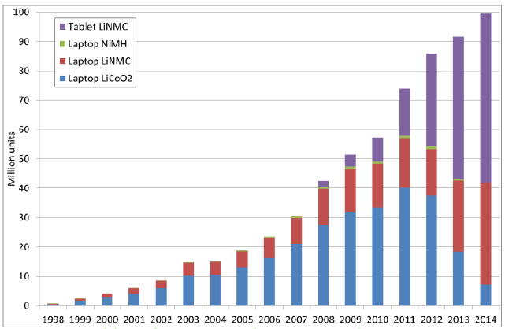
Scenarios
First attempt to harmonise quantification of appliances as well as material content: ProSUM project (http://www.prosumproject.eu/)
stock of Li in batteries EU
© Ester van der Voet, 2020
Notes:
The EU H2020 ProSUM project has done groundbreaking work in the classification of appliances to a level that is sufficienty detailed to enable assessing CRMs. They have applied their approach on electronic devices, on passenger cars and on batteries, for the EU and all its member states. Results can be found on their website.

Slide 34
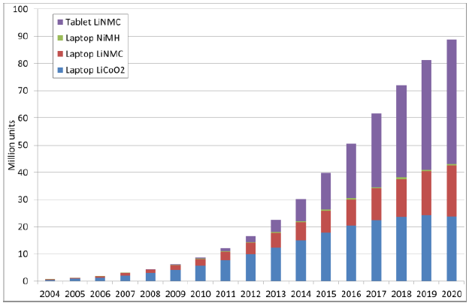
Scenarios
Estimated waste flows related to Li batteries EU (http://www.prosumproject.eu/)
© Ester van der Voet, 2020
Notes:
Production, trade, consumption and waste flows are assessed in the ProSUM project, at the product level but also at the element level.

Slide 35
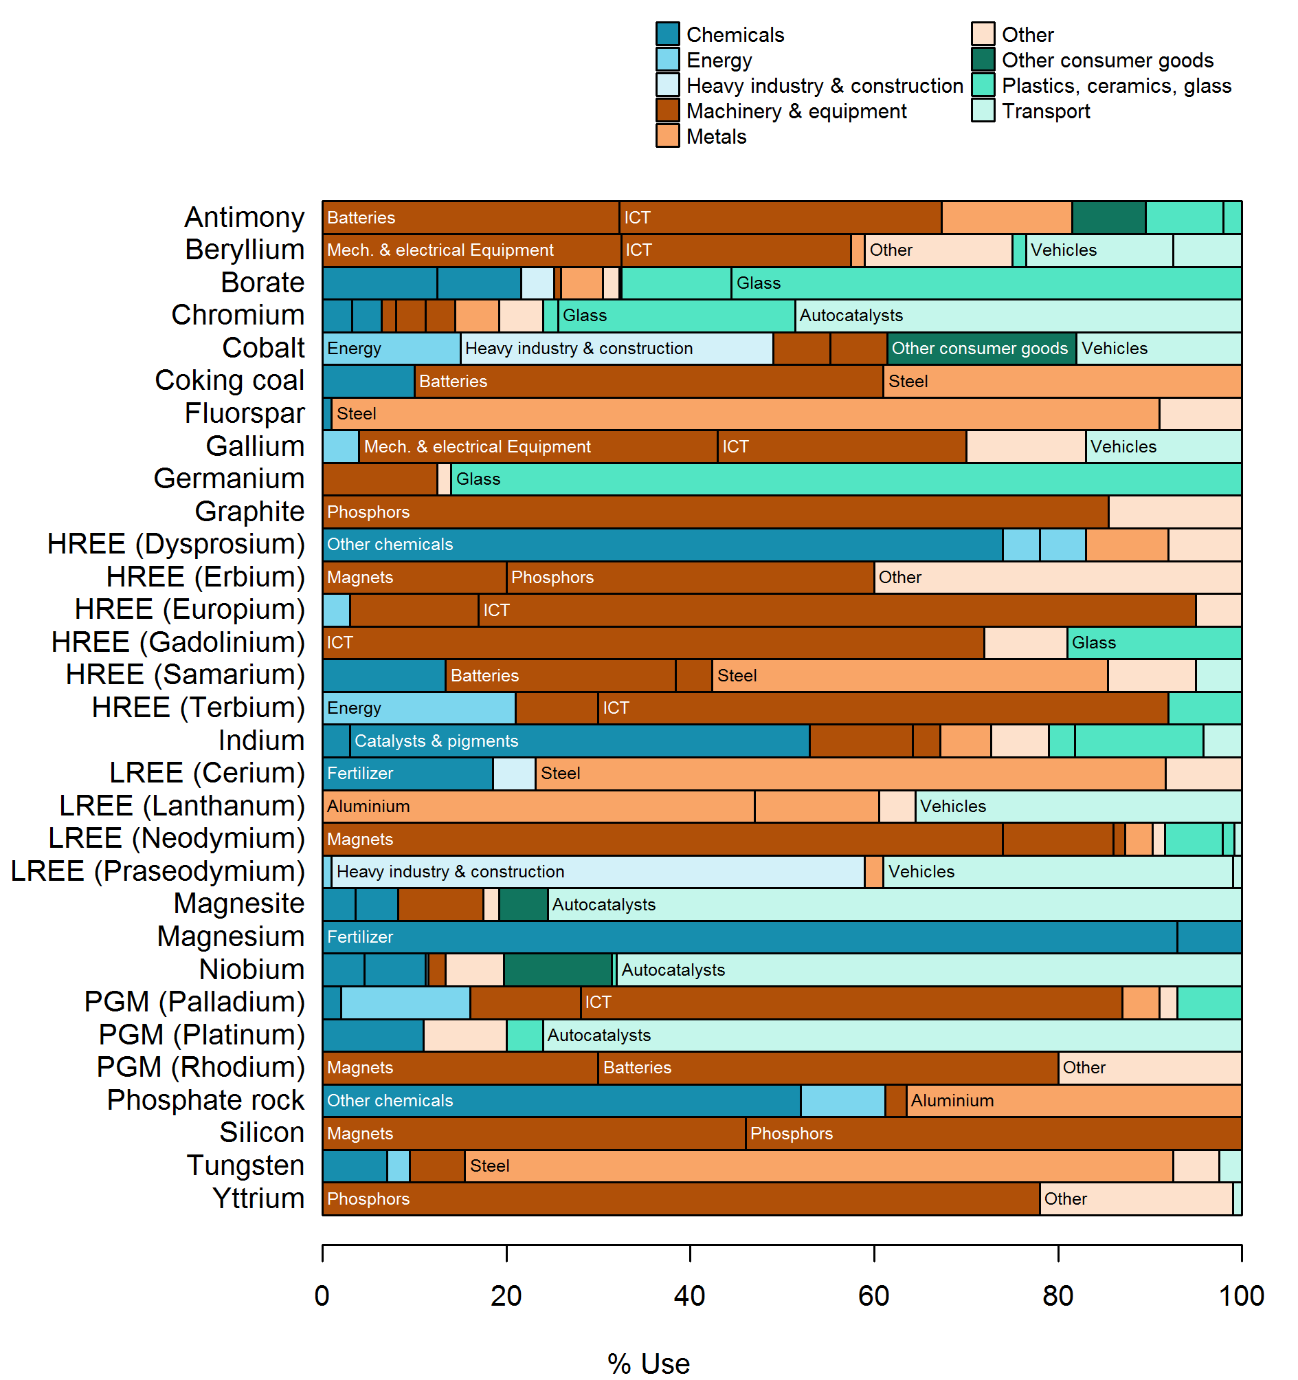
Scenarios
SCRREEN project D2.1:
applications of CRMs
(Deetman et al,. 2019)
© Ester van der Voet, 2020
© [Name], 2018
Notes:
Another project that has looked into CRMs is SCRREEN, another EU Horizon 2020 project. They have made an inventory of present applications of CRM, and starting from there have looked into the future.

Slide 36
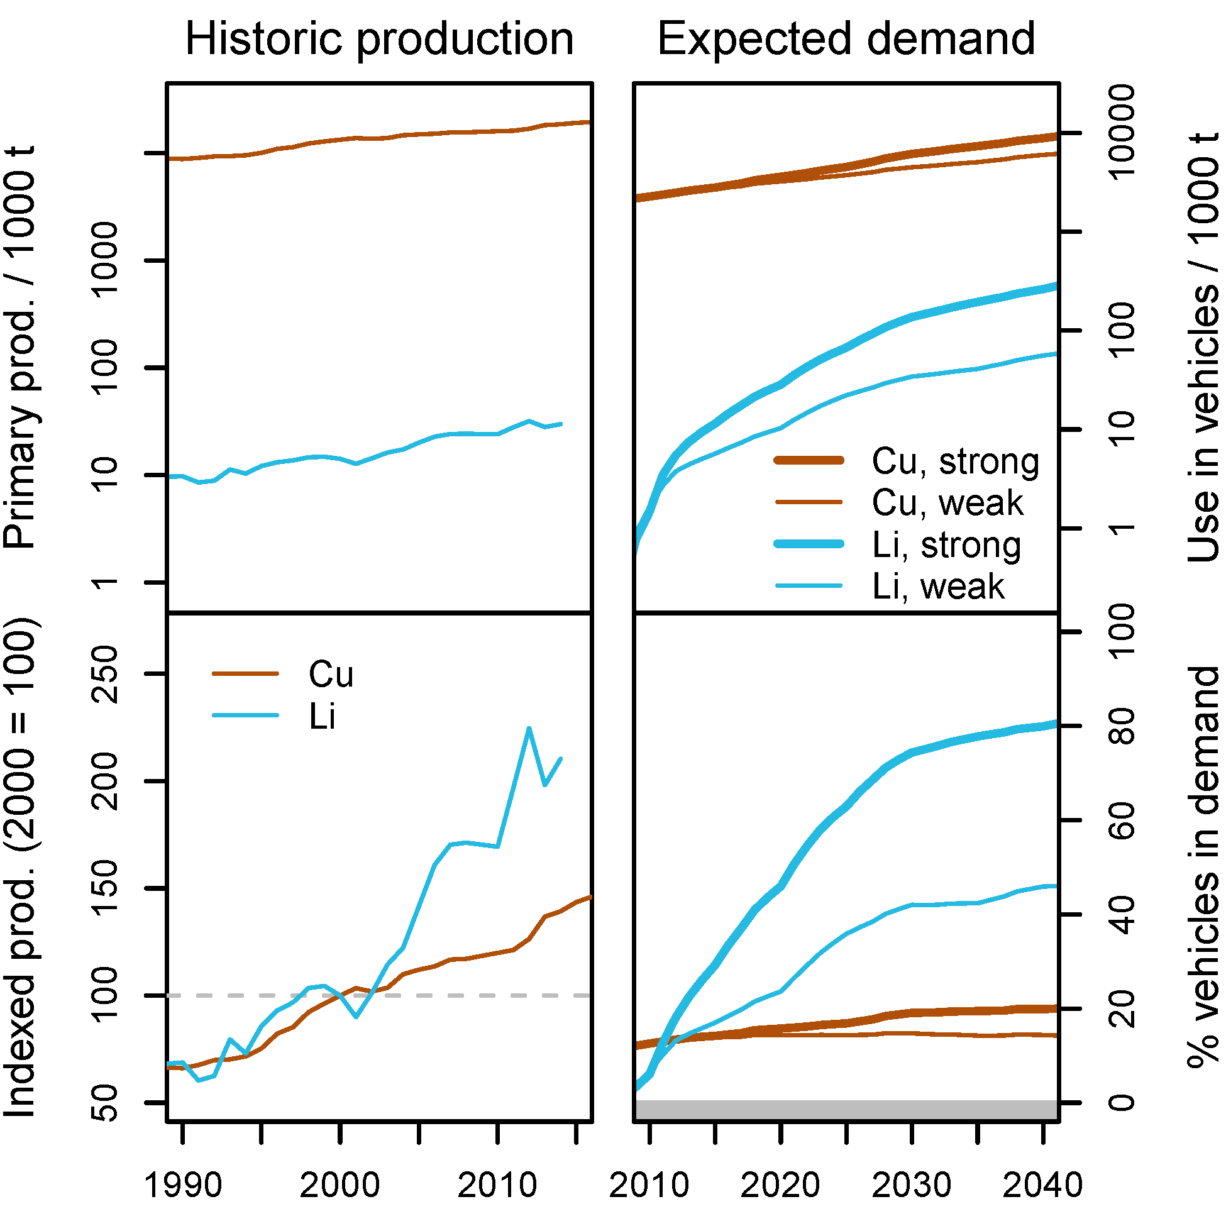
Scenarios
Tercero Espinosa et al., 2019 (D2.3 of SCRREEN project): bottom-up demand projections
© Ester van der Voet, 2020
Notes:
Projections into the future have been based mostly on the expectations around the technologies that these CRM are used in.

Slide 37
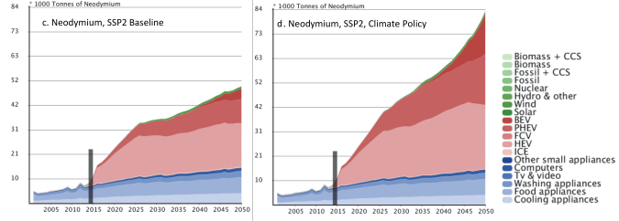
Scenarios
Deetman et al., 2018: demand for Nd projections from IMAGE-TIMER models
© Ester van der Voet, 2020
Notes:
This is another example of CRM scenarios, related to the IMAGE model and the quite detailed scenario information about energy and mobility technologies. Again, alas, no changes assumed in technology until 2050. In that sense this scenario (actually, the SSP2 scenario, baseline and 2 degrees) is not “realistic”. It does show, however, a huge increase in demand (in this case, of Neodymium, but the assessment has been made for a number of other materials as well) and can thus be input for decision making on whether or not to diversify technology or develop CRM free technology.

Slide 38
Scenarios
Modelling supply of CRMs?
Dependent on many things besides demand
  prices
  demand for host material
  share of secondary production
  .....
Models of little use
  supply chain resilience models?
In scenario exercises, focus is usually on demand
© Ester van der Voet, 2020

Slide 39
Scenarios
Bottom line of scenario exercises so far:
CRMs either have to become a regular commodity ...
... or they will not be used in appliances at a large scale in the long run.
© Ester van der Voet, 2020
Notes:
This is a personal observation of the author of these slides. It seems a logical conclusion from the fact that the demand under unchanging technology assumptions will rise so dramatically, and supply almost certainly will not be able to keep up. Feel free to omit this slide if disagreed.

Slide 40
Scenarios
References
British Geological Survey https://www.bgs.ac.uk/ downloadable data for mineral production worldwide
International Energy Agency (2008). Energy Technology Perspectives.
International Resource Panel (2019). Global Resources Outlook.
Van der Voet, E., L. van Oers, M. Verboon & K. Kuipers (2019). Environmental Implications of Demand Scenarios for Metals, Methodology and Application to Seven Major Metals. Journal of Industrial Ecology, 23(1) pp 141-155
Elshkaki, A., T. E. Graedel, L. Ciacci, and B. K. Reck (2018). Resource Demand scenarios for the major metals. Environ Sci Technol. 2018 Mar 6; 52(5): 2491-2497
OECD, 2018. Global Material Resources Outlook to 2060 – Economic Drivers and Environmental Consequences.
Marinova, S., S.P. Deetman, E. van der Voet & V. Daioglou (2020). Global construction materials database and stock analysis of residential buildings between 1970-2050. Journal of Cleaner Production 247 (2020) 119-146
Deetman, S.P., L. van Oers, E. van der Voet & A. Tukker (2018). Deriving European Tantalum Flows using Trade and Production statistics. Journal of Industrial Ecology 22(1), 166-179
Deetman, S., S Pauliuk, D van Vuuren, E Van Der Voet, A Tukker (2018). Scenarios for demand growth of metals in electricity generation technologies, cars and electronic appliances. Environmental Science & Technology 52 (8), pp 4950–4959.
Deetman, S., N. Mancheri, A. Tukker, T. Brown, E. Petavratzi, L. Tercero Espinoza (2019). Report on the current use of critical raw materials. SCRREEN Deliverable 2.1, http://scrreen.eu/results/
Tercero Espinoza, L., A. Loibl, S. Langkau, A. de Koning, E. van der Voet, S. Michaux (2019). Report on the Future Use of Critical Raw Materials. SCRREEN Deliverable 2.3, http://scrreen.eu/results/
© Ester van der Voet, 2020

Slide 41
Scenarios
Thank you !!!
© Ester van der Voet, 2020

Slide 42


















www.suscritmat.eu
Sustainable Management of Critical Raw Materials

